Slide 1
Functions and an Introduction to Recursion
Chapter 6 of C++ How to Program, 9/e
©1992-2017 by Pearson Education, Inc. All Rights Reserved.

Slide 2
©1992-2017 by Pearson Education, Inc. All Rights Reserved.

Slide 3
©1992-2017 by Pearson Education, Inc. All Rights Reserved.

Slide 4
©1992-2017 by Pearson Education, Inc. All Rights Reserved.

Slide 5
6.1 Introduction
Develop and maintain a large program by constructing it from small, simple pieces, or components.
divide and conquer.
Emphasize how to declare and use functions to facilitate the design, implementation, operation and maintenance of large programs.
Function prototypes and how the compiler uses them to convert the type of an argument in a function call to the type specified in a function’s parameter list, if necessary.
Simulation techniques with random number generation.
C++’s scope rules.
©1992-2017 by Pearson Education, Inc. All Rights Reserved.

Slide 6
6.1 Introduction (cont.)
How C++ keeps track of which function is currently executing, how parameters and other local variables of functions are maintained in memory and how a function knows where to return after it completes execution.
Function overloading.
Function templates.
Recursion.
©1992-2017 by Pearson Education, Inc. All Rights Reserved.

Slide 7
6.2 Program Components in C++
C++ programs are typically written by combining “prepackaged” functions and classes available in the C++ Standard Library with new functions and classes you write.
The C++ Standard Library provides a rich collection of functions.
Functions allow you to modularize a program by separating its tasks into self-contained units.
©1992-2017 by Pearson Education, Inc. All Rights Reserved.

Slide 8
©1992-2017 by Pearson Education, Inc. All Rights Reserved.

Slide 9
6.2 Program Components in C++ (cont.)
A function is invoked by a function call, and when the called function completes its task, it either returns a result or simply returns control to the caller.
An analogy is the hierarchical form of management (Figure 6.1).
A boss (similar to the calling function) asks a worker (similar to the called function) to perform a task and report back (i.e., return) the results after completing the task.
The boss does not know how the worker performs its tasks.
The worker may also call other workers, unbeknownst to the boss.
This hiding of implementation details promotes good software engineering.
©1992-2017 by Pearson Education, Inc. All Rights Reserved.

Slide 10
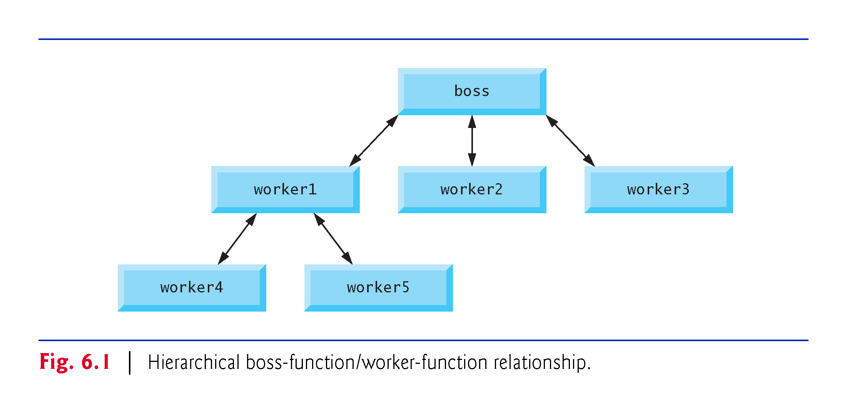
©1992-2017 by Pearson Education, Inc. All Rights Reserved.

Slide 11
6.3 Math Library Functions
Sometimes functions are not members of a class.
Called global functions.
The <cmath> header provides a collection of functions that enable you to perform common mathematical calculations.
All functions in the <cmath> header are global functions—therefore, each is called simply by specifying the name of the function followed by parentheses containing the function’s arguments.
©1992-2017 by Pearson Education, Inc. All Rights Reserved.

Slide 12
©1992-2017 by Pearson Education, Inc. All Rights Reserved.

Slide 13
6.3 Math Library Functions (cont.)
Some math library functions are summarized in Fig. 6.2.
In the figure, the variables x and y are of type double.
©1992-2017 by Pearson Education, Inc. All Rights Reserved.

Slide 14
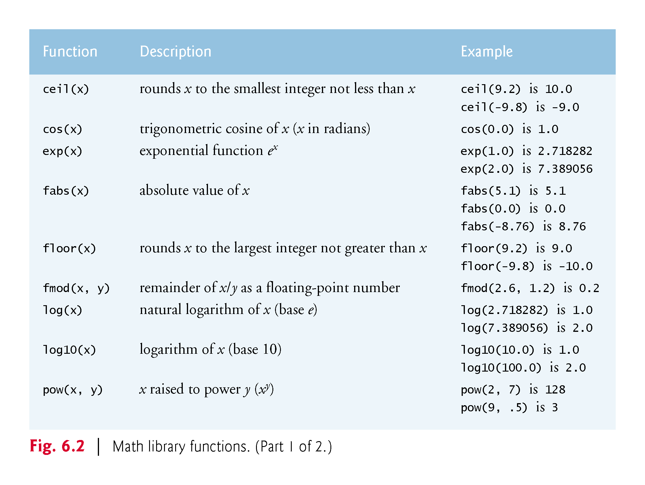
©1992-2017 by Pearson Education, Inc. All Rights Reserved.

Slide 15
©1992-2017 by Pearson Education, Inc. All Rights Reserved.

Slide 16
6.4 Function Prototypes
In this section, we create a user-defined function called maximum (Fig. 6.3) that returns the largest of its three int arguments.
©1992-2017 by Pearson Education, Inc. All Rights Reserved.

Slide 17
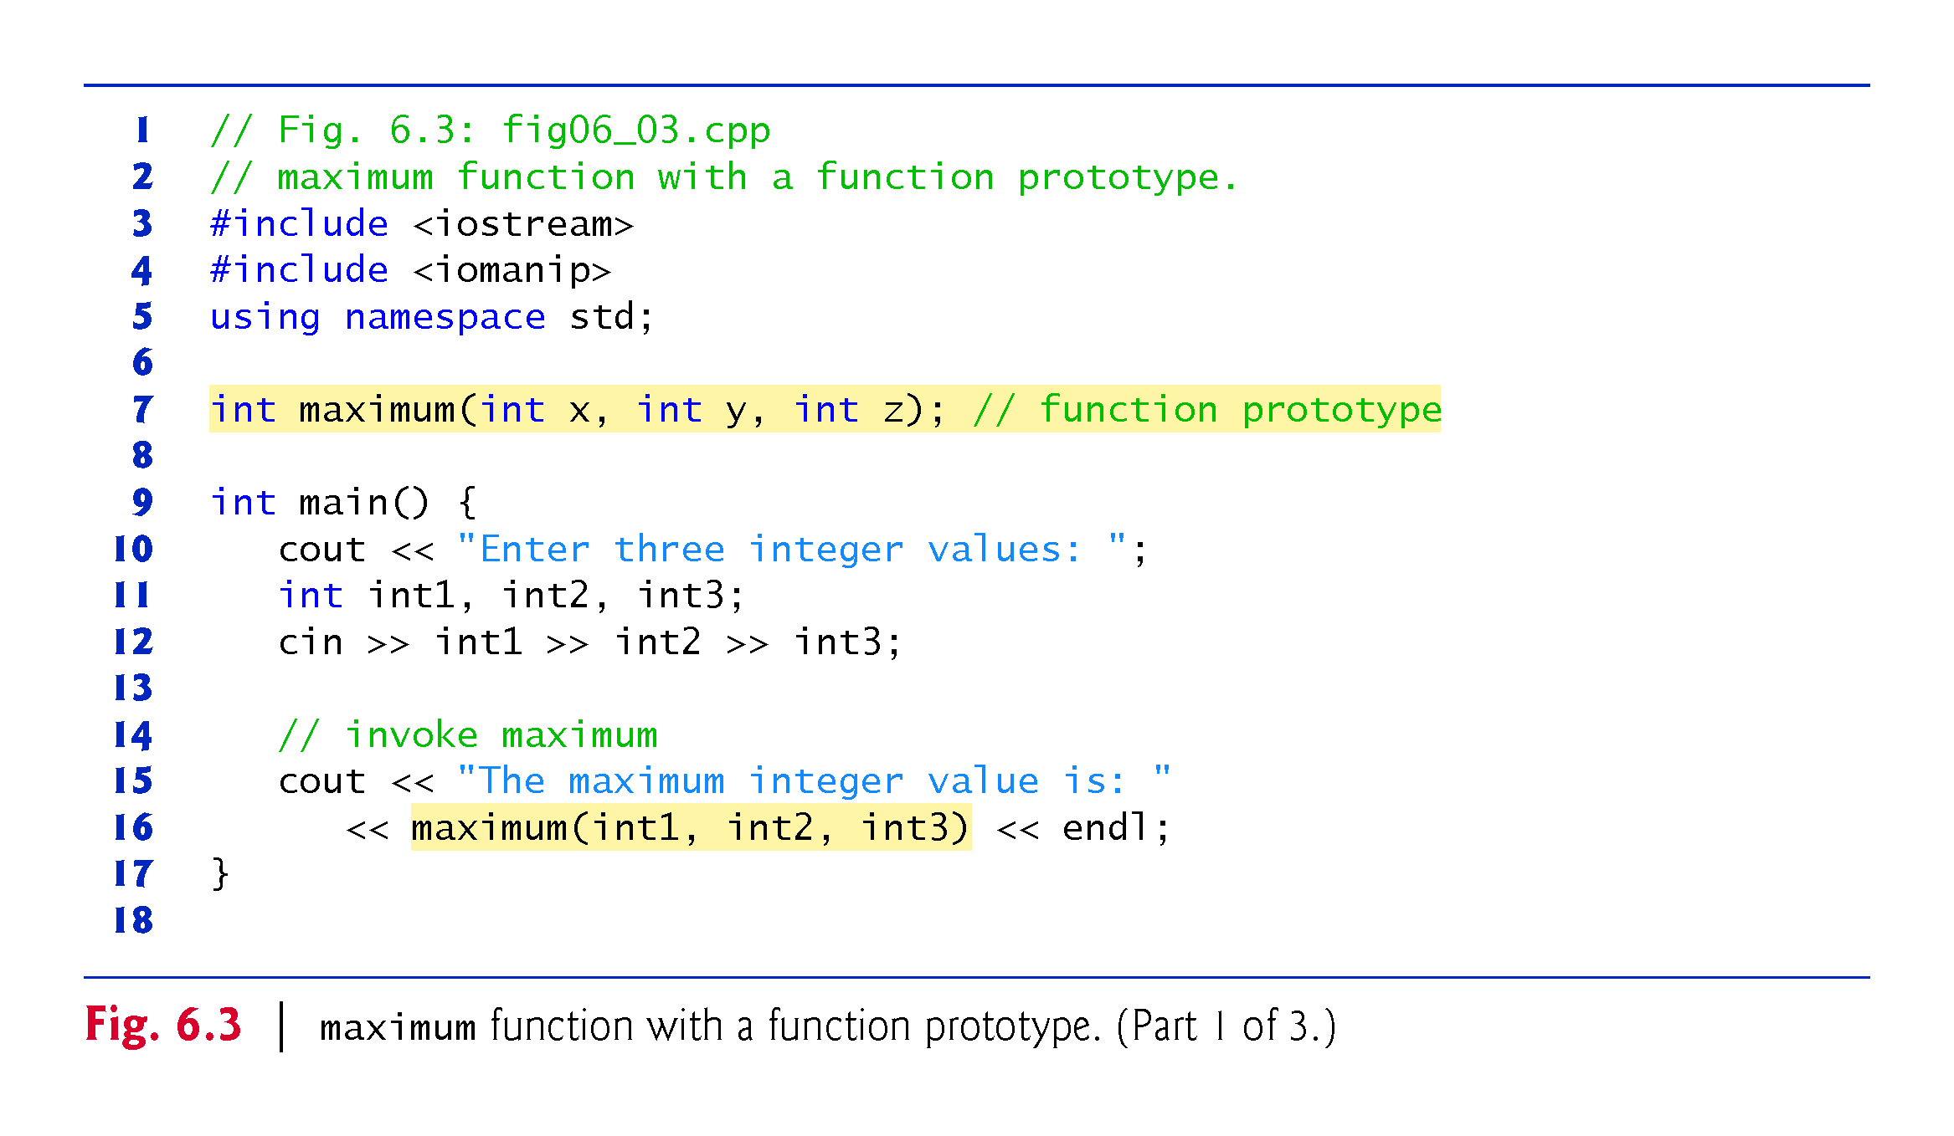
©1992-2017 by Pearson Education, Inc. All Rights Reserved.

Slide 18
©1992-2017 by Pearson Education, Inc. All Rights Reserved.

Slide 19
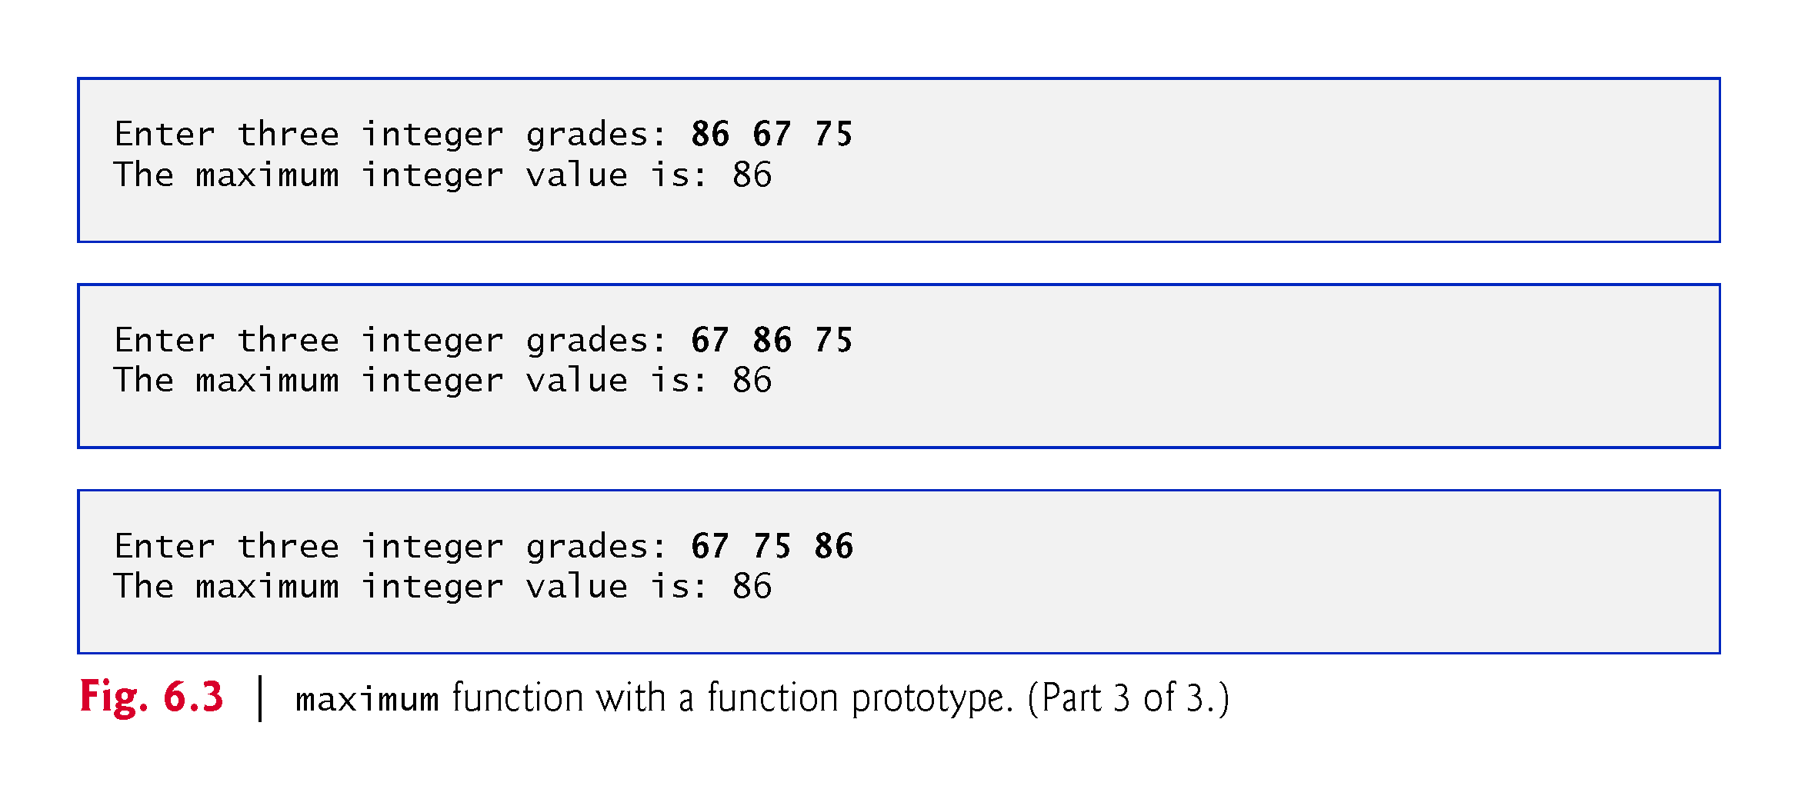
©1992-2017 by Pearson Education, Inc. All Rights Reserved.

Slide 20
6.4 Function Prototypes (cont.)
In preceding chapters, we created classes with various member functions.
We defined each class in a header (.h) and included it before main in a program’s source-code file.
Doing this ensures that the class (and thus its member functions) is defined before main creates and manipulates objects of that class.
The compiler then can ensure that we call each class’s constructors and member functions correcly—for example, passing each the correct number and types of arguments.
©1992-2017 by Pearson Education, Inc. All Rights Reserved.

Slide 21
6.4 Function Prototypes (cont.)
A function prototype is a declaration of a function
tells the compiler the function’s name, its return type and the types of its parameters. .
The function prototype is the same as the first line of the corresponding function definition (line 20), but ends with a required semicolon.
©1992-2017 by Pearson Education, Inc. All Rights Reserved.

Slide 22
©1992-2017 by Pearson Education, Inc. All Rights Reserved.

Slide 23
6.4 Function Prototypes (cont.)
When compiling the program, the compiler uses the prototype to
Ensure that maximum’s first line matches its prototype.
Check that the call to maximum contains the correct number and types of arguments, and that the types of the arguments are in the correct order.
Ensure that the value returned by the function can be used correctly in the expression that called the function.
Ensure that each argument is consistent with the type of the corresponding parameter.
If the arguments passed to a function do not match the types specified in the function’s prototype, the compiler attempts to convert the arguments to those types.
©1992-2017 by Pearson Education, Inc. All Rights Reserved.

Slide 24
©1992-2017 by Pearson Education, Inc. All Rights Reserved.

Slide 25
©1992-2017 by Pearson Education, Inc. All Rights Reserved.

Slide 26
©1992-2017 by Pearson Education, Inc. All Rights Reserved.

Slide 27
6.4 Function Prototypes (cont.)
Multiple parameters are specified in both the function prototype and the function header as a comma-separated list, as are multiple arguments in a function call.
©1992-2017 by Pearson Education, Inc. All Rights Reserved.

Slide 28
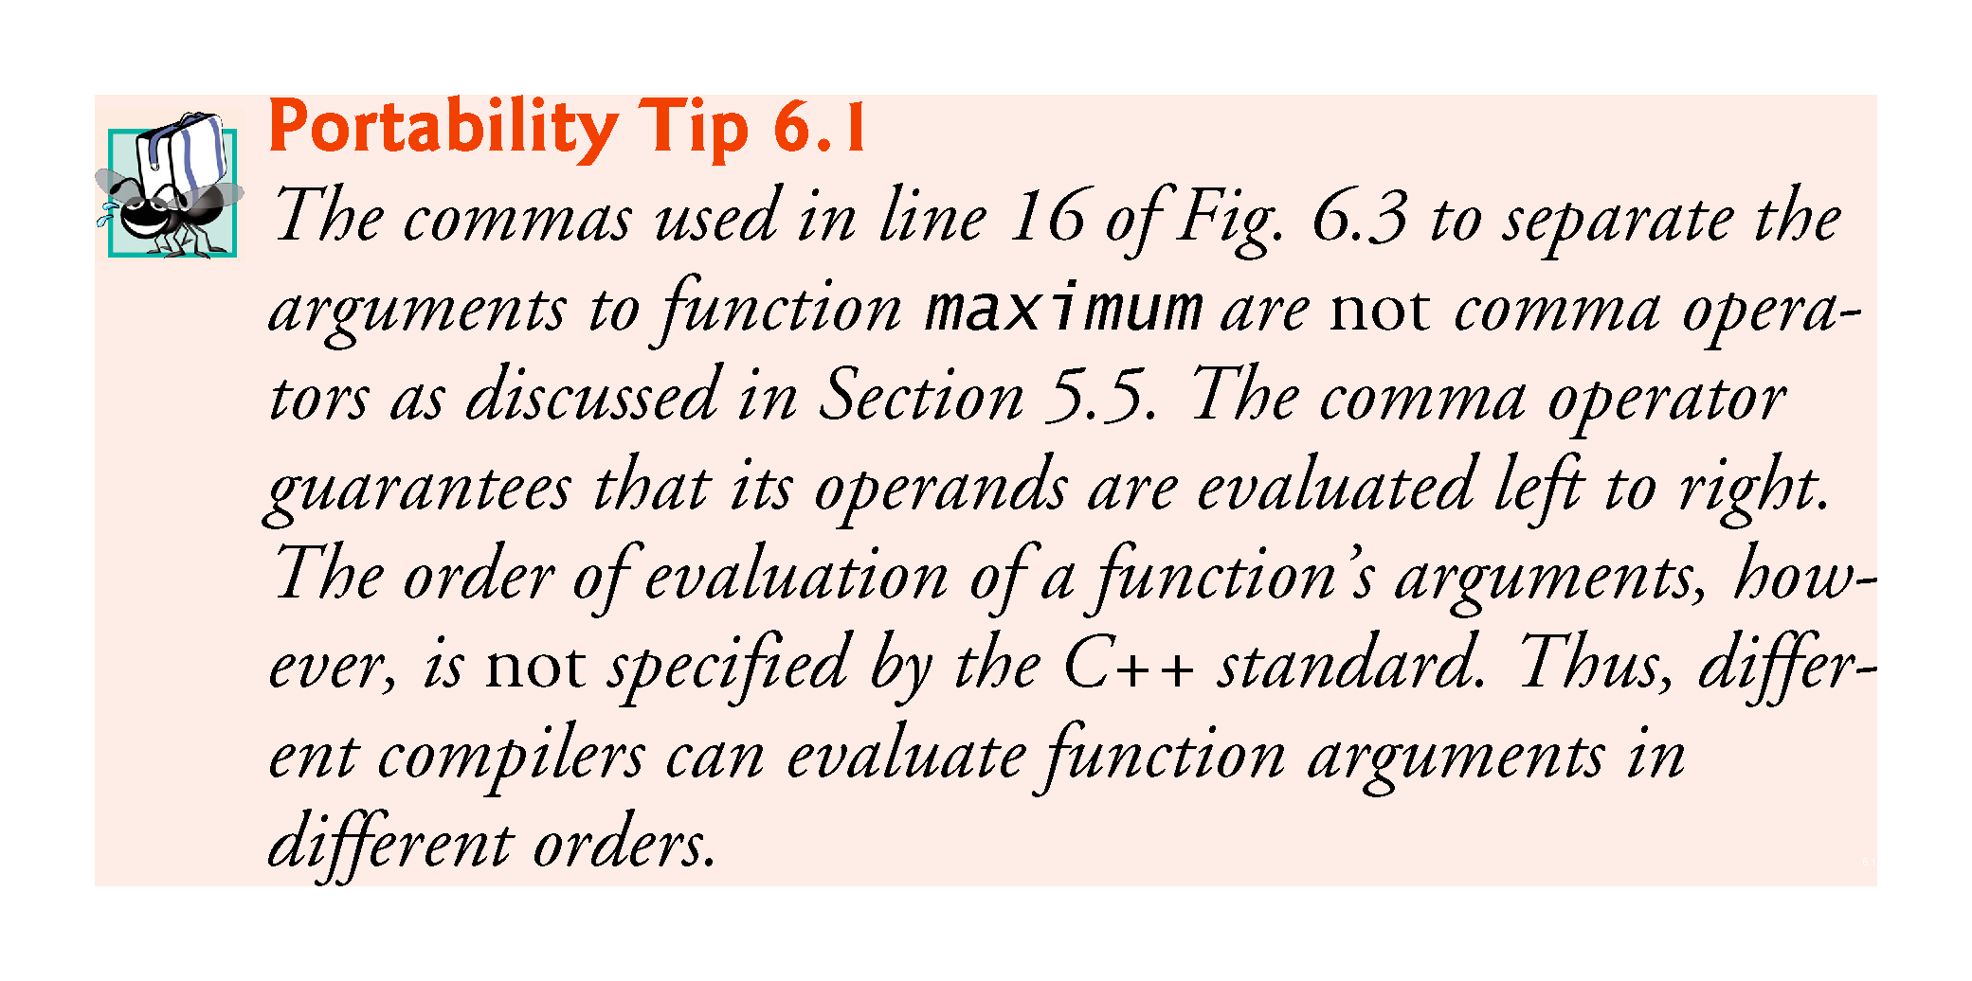
©1992-2017 by Pearson Education, Inc. All Rights Reserved.

Slide 29
©1992-2017 by Pearson Education, Inc. All Rights Reserved.

Slide 30
©1992-2017 by Pearson Education, Inc. All Rights Reserved.

Slide 31
6.4 Function Definitions with Multiple Parameters (cont.)
In a function that does not return a result (i.e., it has a void return type), we showed that control returns when the program reaches the function-ending right brace.
You also can explicitly return control to the caller by executing the statement
return;
©1992-2017 by Pearson Education, Inc. All Rights Reserved.

Slide 32
Basic exercises
Write a function “cube” that takes an integer and outputs the cube of the output.
Write a function “power” that takes a double x and an integer pow and outputs x ^{power} (use a for loop, do not use pow).
Write a function “concatenate” with void output that takes two strings and couts one string next to the other (that is, for example, concatenate(foo, yee) will print out fooyee).
©1992-2017 by Pearson Education, Inc. All Rights Reserved.

Slide 33
6.5 Function-Prototypes and Argument-Coercion Notes
A function prototype is required unless the function is defined before it’s used.
When you use a standard library function like sqrt, you do not have access to the function’s definition, therefore it cannot be defined in your code before you call the function.
Instead, you must include its corresponding header (<cmath>), which contains the function’s prototype.
©1992-2017 by Pearson Education, Inc. All Rights Reserved.

Slide 34
©1992-2017 by Pearson Education, Inc. All Rights Reserved.

Slide 35
©1992-2017 by Pearson Education, Inc. All Rights Reserved.

Slide 36
6.5.1 Function Signatures and Function Prototypes
The portion of a function prototype that includes the name of the function and the types of its arguments is called the function signature or simply the signature.
Signature does not specify the function’s return type.
The scope of a function is the region of a program in which the function is known and accessible.
©1992-2017 by Pearson Education, Inc. All Rights Reserved.

Slide 37
©1992-2017 by Pearson Education, Inc. All Rights Reserved.

Slide 38
6.5.2 Argument Coercion
An important feature of function prototypes is argument coercion
forcing arguments to the appropriate types specified by the parameter declarations.
These conversions occur as specified by C++’s promotion rules.
©1992-2017 by Pearson Education, Inc. All Rights Reserved.

Slide 39
6.5.3 Argument-Promotion Rules and Implicit Conversions
The promotion rules indicate how to convert between types without losing data.
The promotion rules apply to expressions containing values of two or more data types
also referred to as mixed-type expressions.
The type of each value in a mixed-type expression is promoted to the “highest” type in the expression.
©1992-2017 by Pearson Education, Inc. All Rights Reserved.

Slide 40
6.5.3 Argument-Promotion Rules and Implicit Conversions
Figure 6.4 lists the arithmetic data types in order from “highest type” to “lowest type.”
Converting values to lower fundamental types can result in incorrect values.
Therefore, a value can be converted to a lower fundamental type only by explicitly assigning the value to a variable of lower type or by using a cast operator.
©1992-2017 by Pearson Education, Inc. All Rights Reserved.

Slide 41
©1992-2017 by Pearson Education, Inc. All Rights Reserved.

Slide 42
©1992-2017 by Pearson Education, Inc. All Rights Reserved.

Slide 43
6.6 C++ Standard Library Header Files
The C++ Standard Library is divided into many portions, each with its own header file.
The header files contain the function prototypes for the related functions that form each portion of the library.
The header files also contain definitions of various class types and functions, as well as constants needed by those functions.
A header file “instructs” the compiler on how to interface with library and user-written components.
Figure 6.5 lists some common C++ Standard Library header files, most of which are discussed later in the book.
©1992-2017 by Pearson Education, Inc. All Rights Reserved.

Slide 44
©1992-2017 by Pearson Education, Inc. All Rights Reserved.

Slide 45
©1992-2017 by Pearson Education, Inc. All Rights Reserved.

Slide 46
©1992-2017 by Pearson Education, Inc. All Rights Reserved.

Slide 47
©1992-2017 by Pearson Education, Inc. All Rights Reserved.

Slide 48
6.6.5 Variables – scope and lifetime
When an identifier (that is, a variable, such as “int i”) is declared, it has two important characteristics:
Where is the variable usable (scope).
How long is the variable usable (lifetime).
Click here for a good explanation of these concepts:
http://www.mathcs.emory.edu/~cheung/Courses/561/Syllabus/3-C/scoping.html
©1992-2017 by Pearson Education, Inc. All Rights Reserved.

Slide 49
6.6.5 Scope: 6 kinds
Block scope: A name declared within a function, including the parameter names, has local scope. They are only visible from their point of declaration to the end of the function. Any variable defined within a pair of braces { … } has block scope.
Global namespace scope: A global name is one that is declared outside of any class or function. The scope of global names extends from the point of declaration to the end of the file in which they are declared.
Class scope: Names of class members have class scope, which extends throughout the class definition regardless of the point of declaration.
Function scope Variables declared within a function have function scope, which means it is visible throughout a function body even before its point of declaration.
Function-prototype scope: Names used in a function prototype are visible until the end of the prototype declaration.
Namespace scope: A name that is declared within a namespace, outside of any class or enum definition or function block, is visible from its point of declaration to the end of namespace.
©1992-2017 by Pearson Education, Inc. All Rights Reserved.

Slide 50
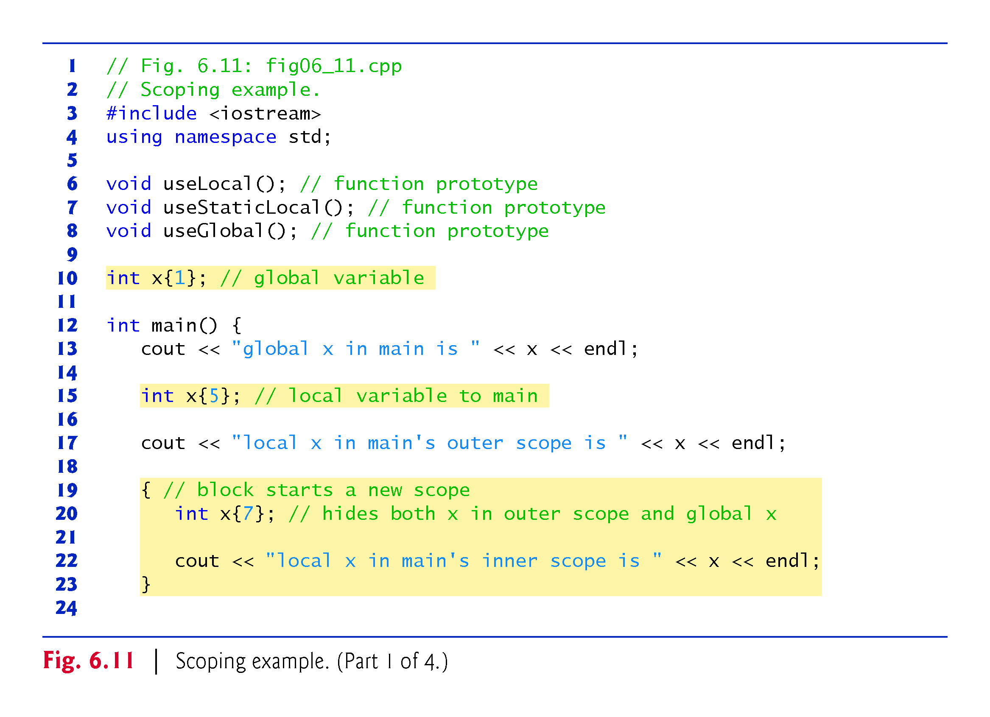
©1992-2017 by Pearson Education, Inc. All Rights Reserved.

Slide 51
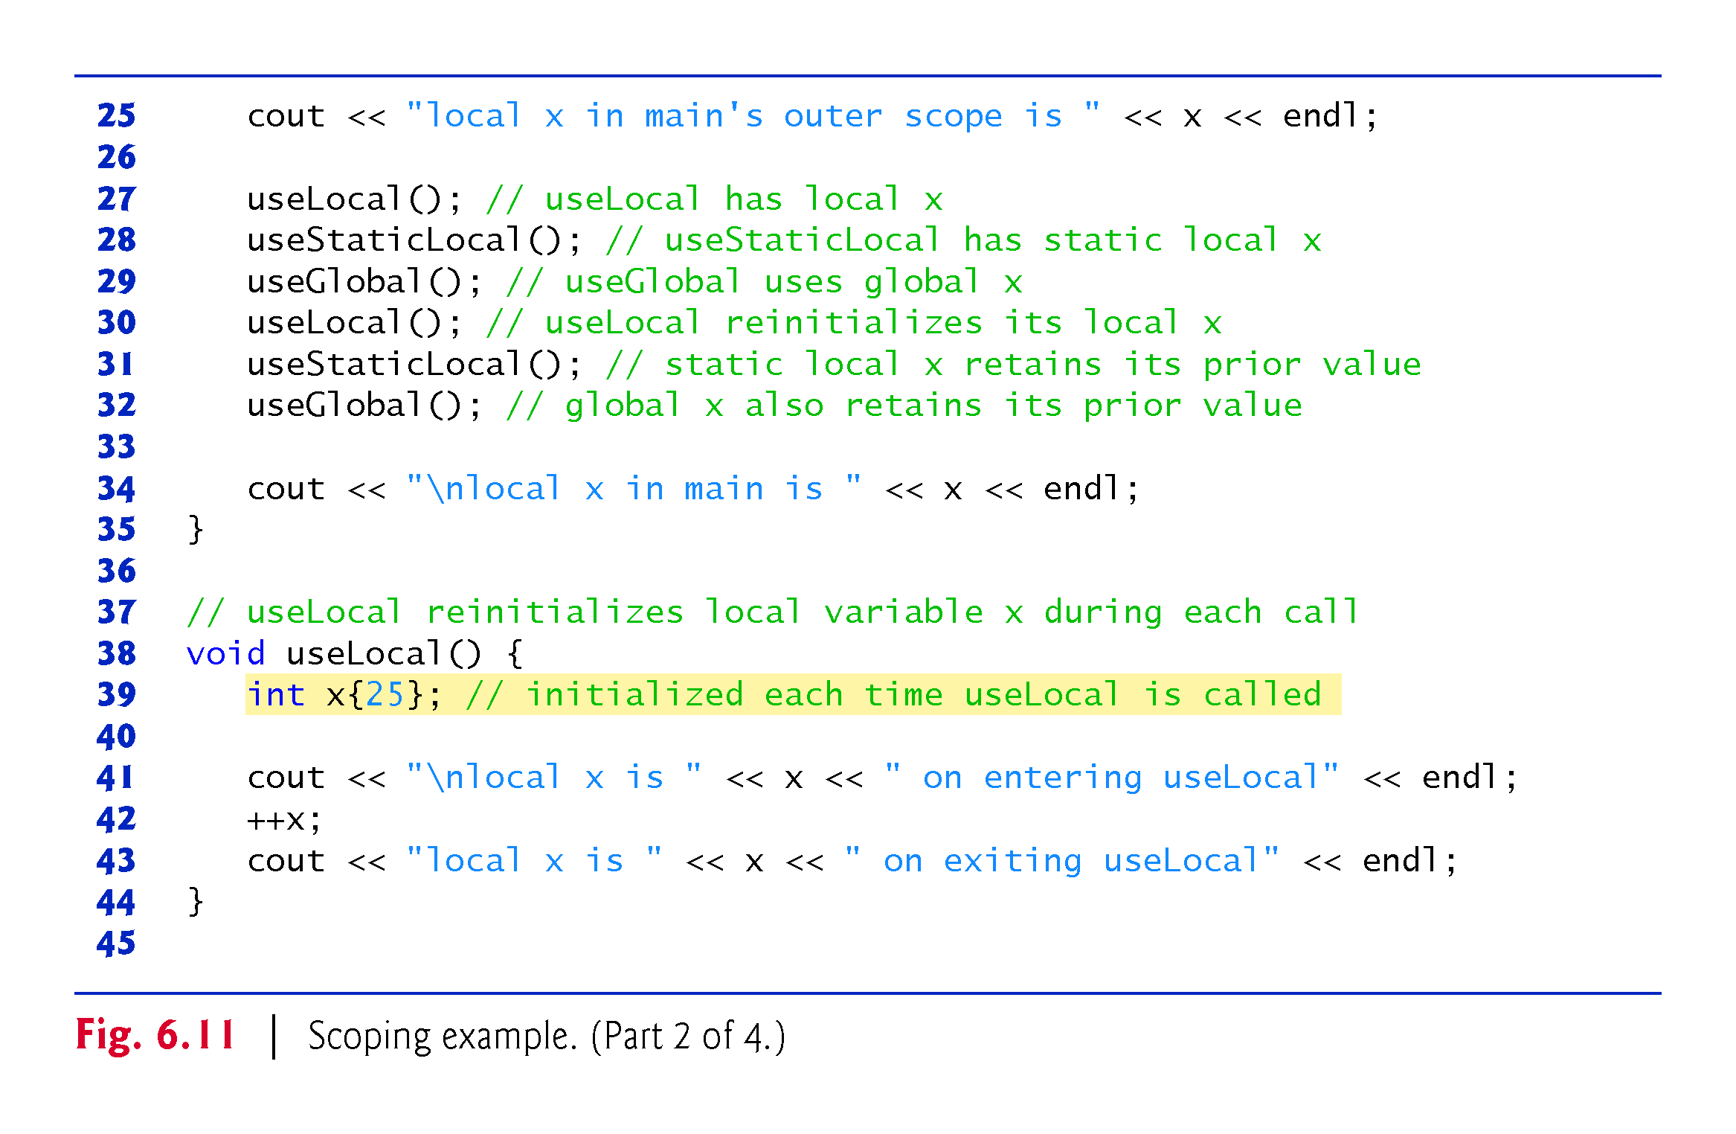
©1992-2017 by Pearson Education, Inc. All Rights Reserved.

Slide 52
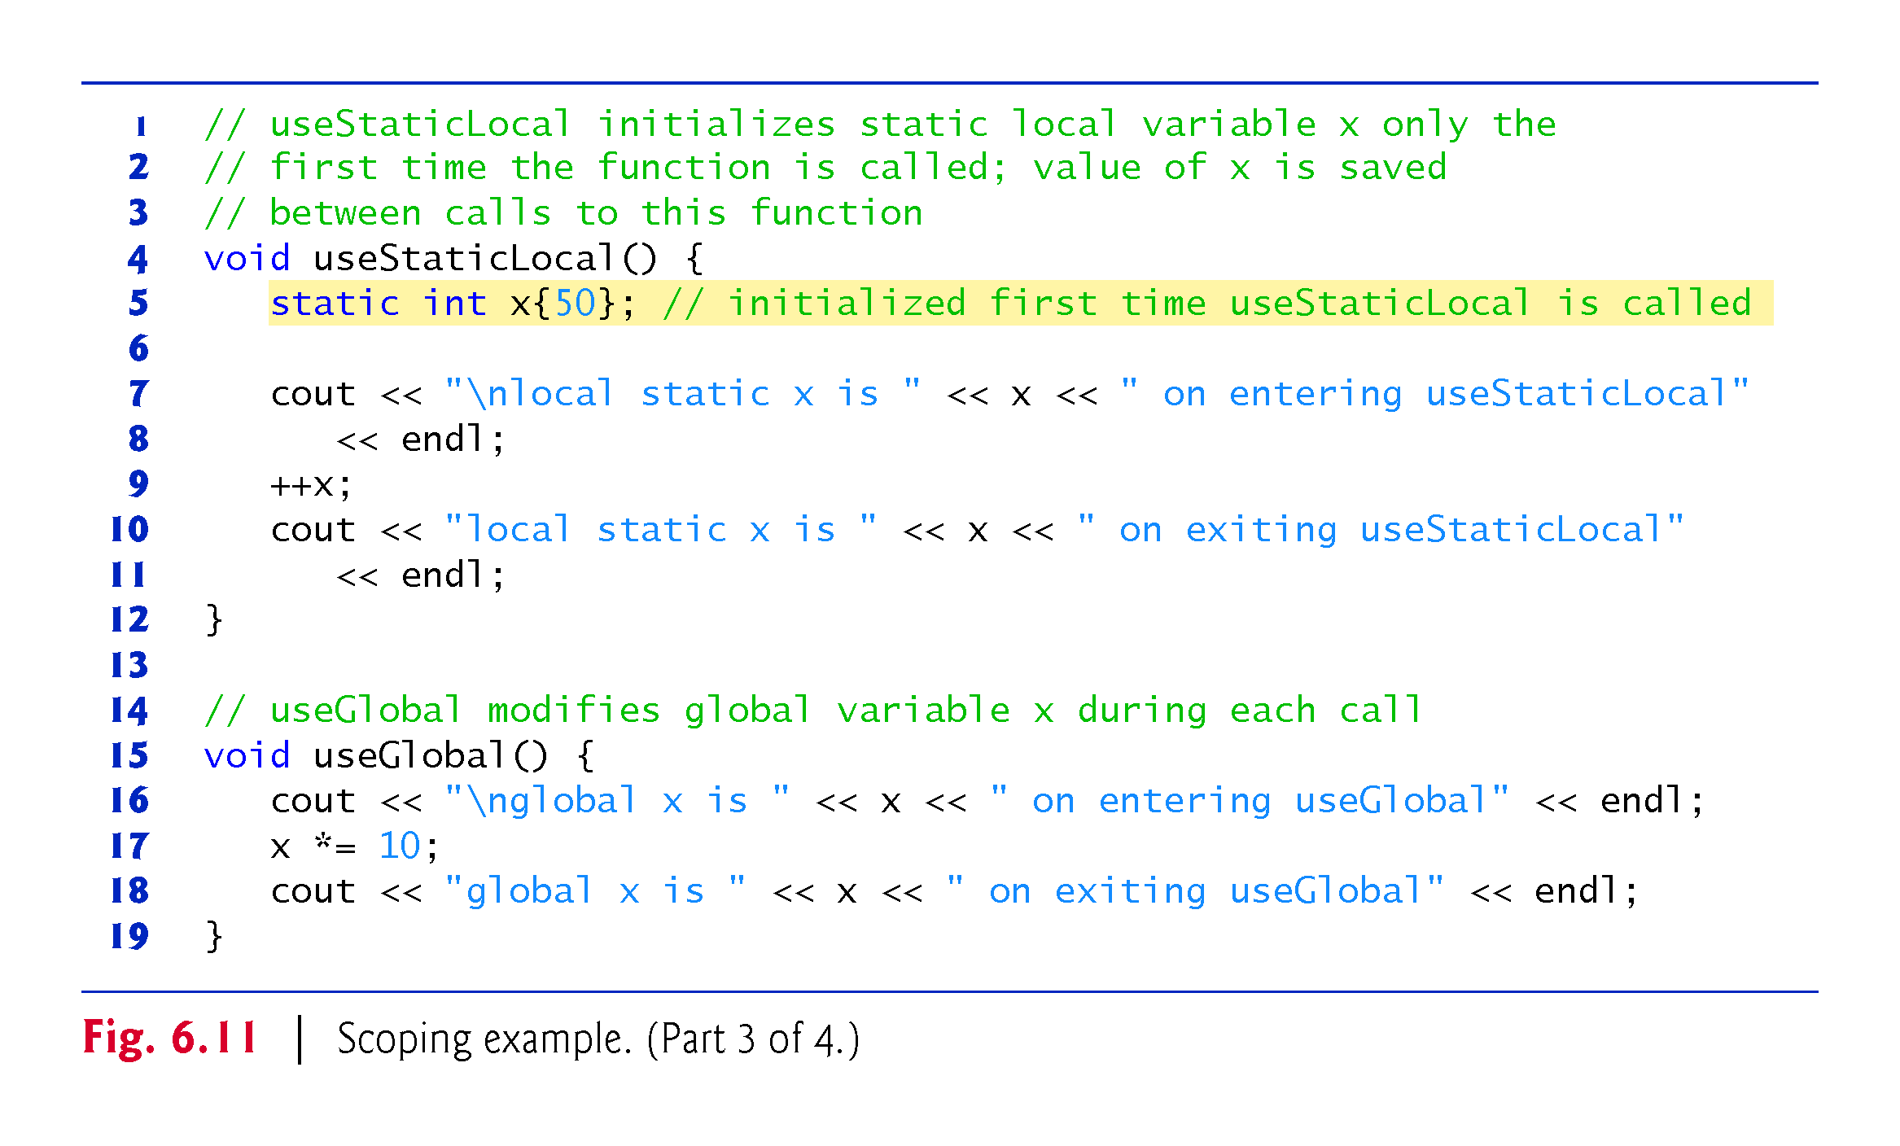
©1992-2017 by Pearson Education, Inc. All Rights Reserved.

Slide 53
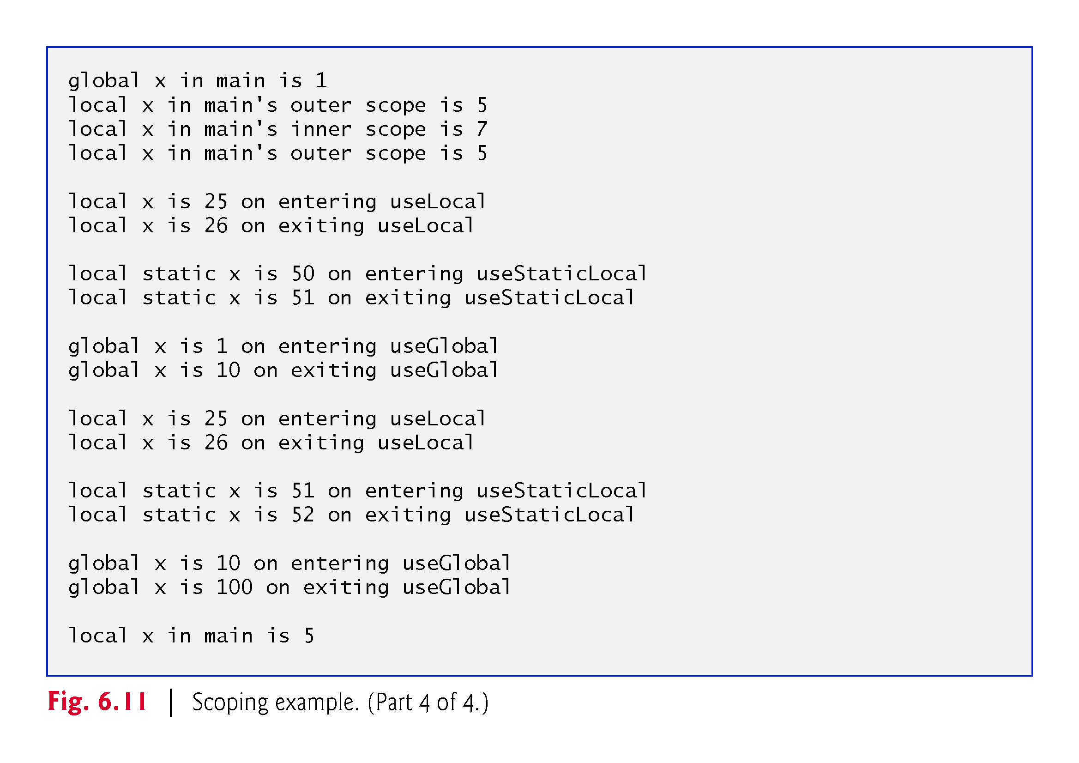
©1992-2017 by Pearson Education, Inc. All Rights Reserved.

Slide 54
©1992-2017 by Pearson Education, Inc. All Rights Reserved.

Slide 55
6.6.5 Lifetime (aka storage class): 5 kinds
Every variable in C++ exists, has a constant address, and retains its last-stored value (except when the value is indeterminate) over a portion of program execution known as this object's lifetime. Variables are destroyed (that is, forgotten for ever) as soon as the program feels that they are not needed.
Auto: The default when no storage class is specified. They stay in memory only until the last brace where it is defined is executed, then it dies.
Register: Same as auto, but its value is placed in CPU registers for faster access.
Static: They live from the point when they are defined until the program ends. NOTE that they may have local scope (so cannot be seen from outside) but their value is preserved until the end.
Extern: Same as static, except that in addition they have global scope even across different files. Do not worry about this at this point!
Mutable: This is only used with classes, which we will see soon. Mutable is used for data members in a class to make them modifiable even when the class is declared constant. Do not worry about this at this point!
©1992-2017 by Pearson Education, Inc. All Rights Reserved.

Slide 56
6.6.7 The const qualifier - identifiers
Programs often have constant identifiers (constant variables sounds funny). For example, if I have to write many functions involving the number 3.14159265359, it is easier to define “double PI= 3.14159265359;” and then use PI instead of having to write that long number. The problem is that by accident PI could be modified. To prevent this C++ has the constant qualifier that impedes functions to modify the value:
const int PI = 3.14159265359;
If you then write something like PI = 3.14, you will get an error. This is good to catch mistakes.
©1992-2017 by Pearson Education, Inc. All Rights Reserved.

Slide 57
6.6.7 The const qualifier - functions
A function can have the constant qualifier in 3 different places (!), and each means something different:
double square(const int x); → means that the function cannot modify the identifier used as input. This is just a precaution. For example: void printNumber(const int x){cout << x << endl;} Evidently printNumber does not modify x, but to be sure one writes const there. This will matter more later when we study passing arguments by reference.
double square(int x) const; → constant attributes in a class cannot be used in functions unless the function is declared constant. More on this when we study classes.
const double square(int x); → means that the function’s output cannot be modified by other functions – will be useful later when we study pointers.
©1992-2017 by Pearson Education, Inc. All Rights Reserved.

Slide 58
6.7 Case Study: Random Number Generation
The element of chance can be introduced into computer applications by using the C++ Standard Library function rand.
The function rand generates an unsigned integer between 0 and RAND_MAX (a symbolic constant defined in the <cstdlib> header file).
For GNU C++, the value of RAND_MAX is 2147483647; for Visual Studio, the value of RAND_MAX is 32767.
If rand truly produces integers at random, every number between 0 and RAND_MAX has an equal chance (or probability) of being chosen each time rand is called.
To find the value of RAND_MAX, write a program with #include <cstdlib> and type cout << RAND_MAX << endl;
©1992-2017 by Pearson Education, Inc. All Rights Reserved.

Slide 59
6.7.1 Rolling a Six-Sided Die
The function prototype for the rand function is in <cstdlib>.
To produce integers in the range 0 to 5, we use the modulus operator (%) with rand:
rand() % 6
This is called scaling.
The number 6 is called the scaling factor. Six values are produced.
We can shift the range of numbers produced by adding a value.
©1992-2017 by Pearson Education, Inc. All Rights Reserved.

Slide 60
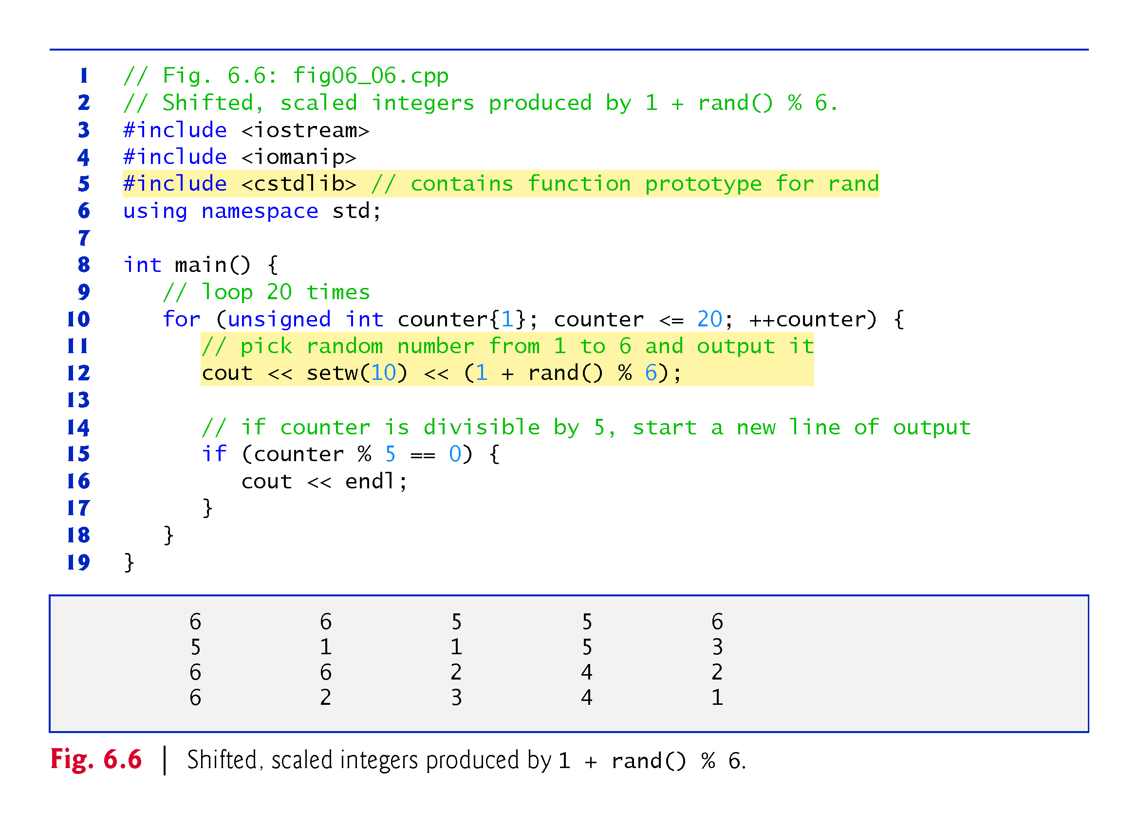
©1992-2017 by Pearson Education, Inc. All Rights Reserved.

Slide 61
6.7.2 Rolling a Six-Sided Die 60,000,000 Times
To show that the numbers produced by rand occur with approximately equal likelihood, Fig. 6.7 simulates 60,000,000 rolls of a die.
Each integer in the range 1 to 6 should appear approximately 10,000,000 times.
©1992-2017 by Pearson Education, Inc. All Rights Reserved.

Slide 62
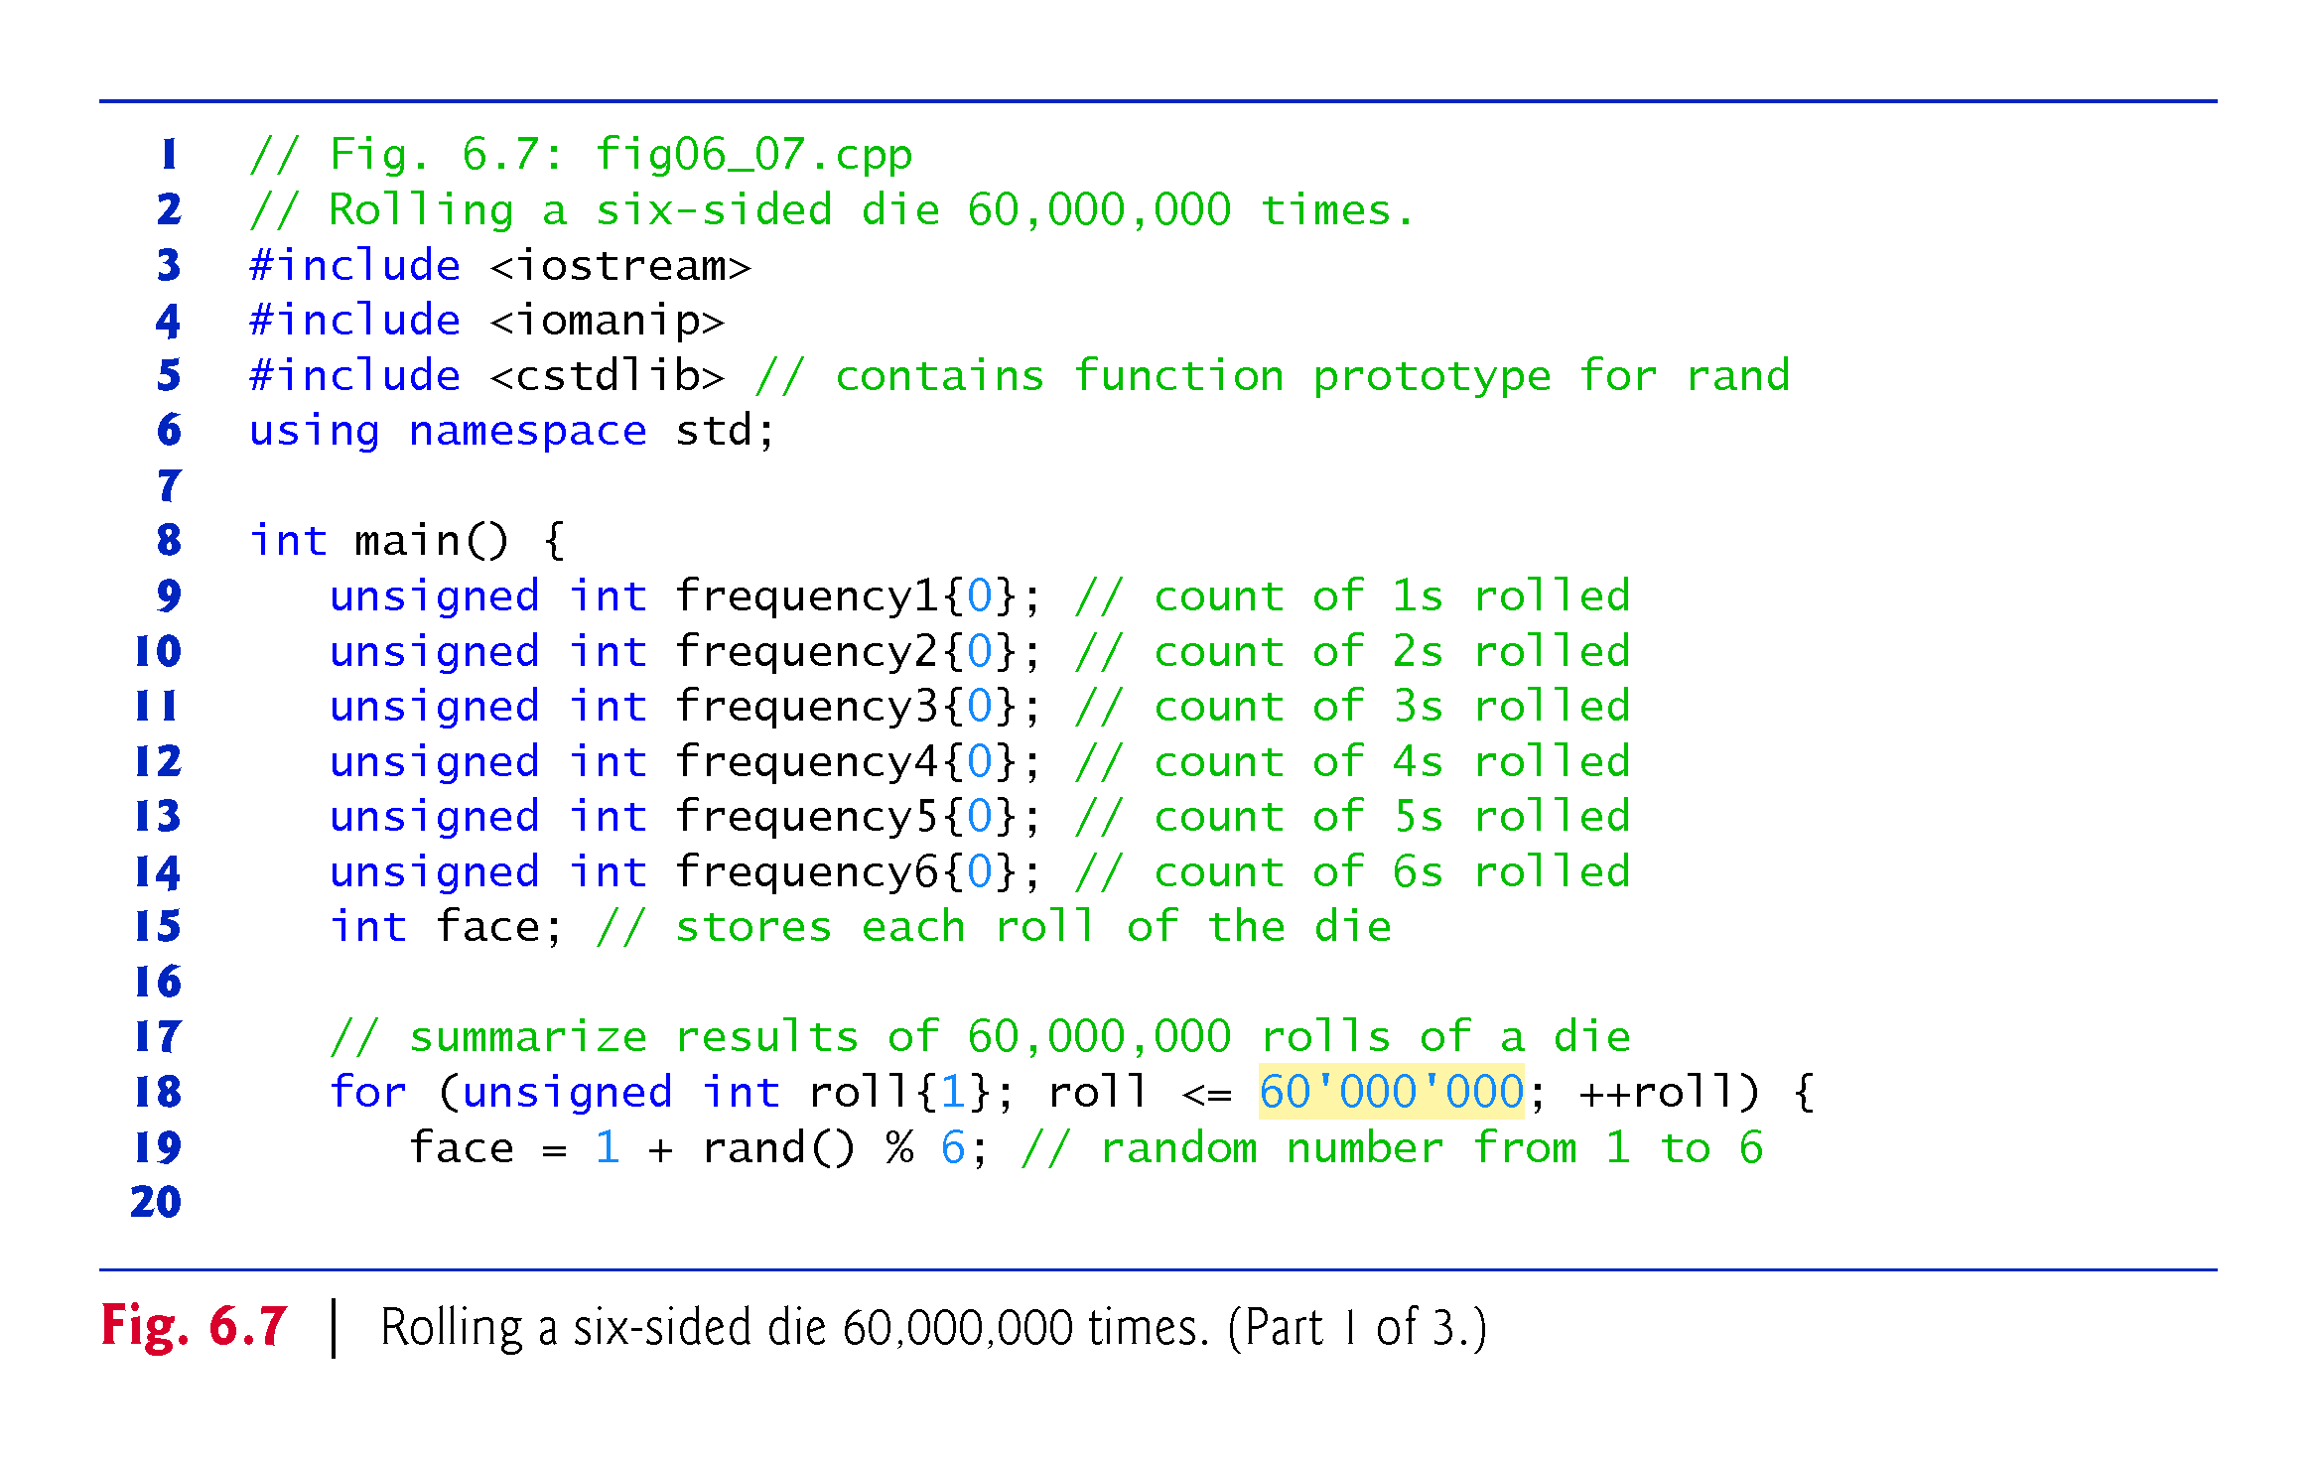
©1992-2017 by Pearson Education, Inc. All Rights Reserved.

Slide 63
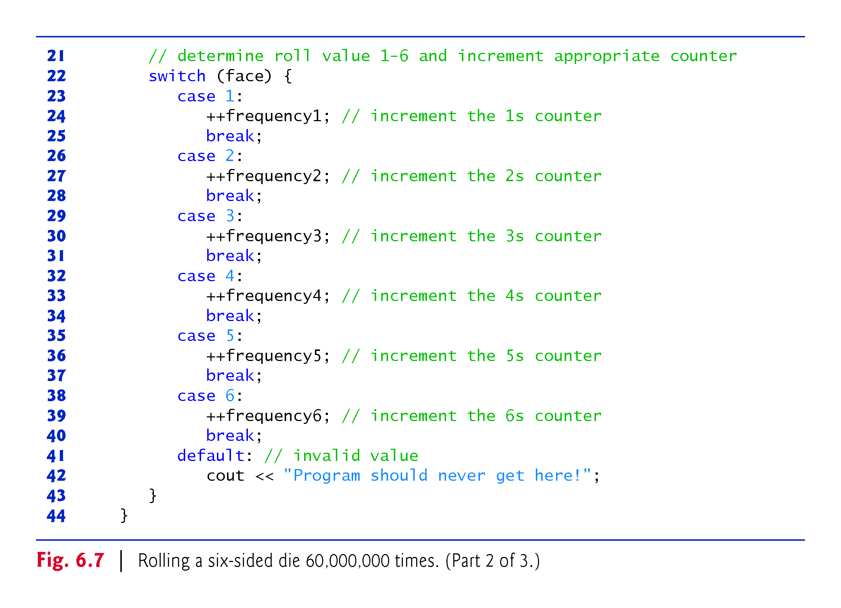
©1992-2017 by Pearson Education, Inc. All Rights Reserved.

Slide 64
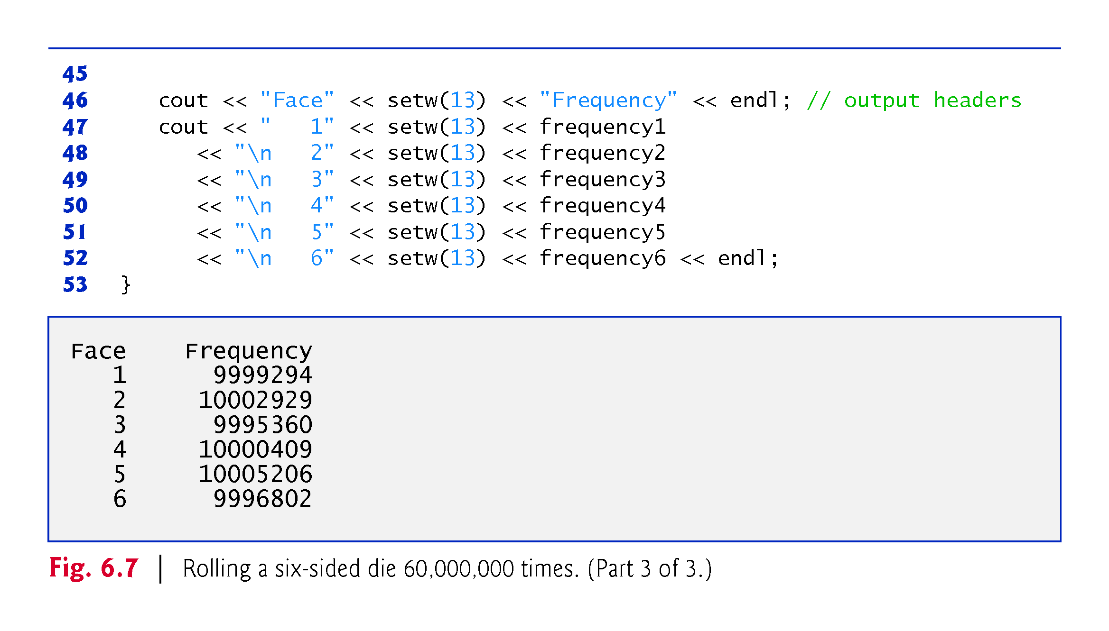
©1992-2017 by Pearson Education, Inc. All Rights Reserved.

Slide 65
6.7.3 Randomizing the Random-Number Generator with srand
Executing the program of Fig. 6.6 again produces exactly the same sequence of values.
Repeatability is an important characteristic of rand.
Can help with testing and debugging.
rand generates pseudorandom numbers.
a sequence of numbers that appears to be random.
sequence repeats itself each time the program executes.
©1992-2017 by Pearson Education, Inc. All Rights Reserved.

Slide 66
6.7.3 Randomizing the Random-Number Generator with srand
Once a program has been debugged, it can be conditioned to produce a different sequence of random numbers for each execution.
This is called randomizing and is accomplished with the C++ Standard Library function srand.
Takes an unsigned integer argument and seeds rand to produce a different sequence of random numbers for each execution.
©1992-2017 by Pearson Education, Inc. All Rights Reserved.

Slide 67
6.7 Case Study: Random Number Generation (cont.)
Seeding the Random Number Generator with srand
Figure 6.8 demonstrates function srand.
©1992-2017 by Pearson Education, Inc. All Rights Reserved.

Slide 68
©1992-2017 by Pearson Education, Inc. All Rights Reserved.

Slide 69
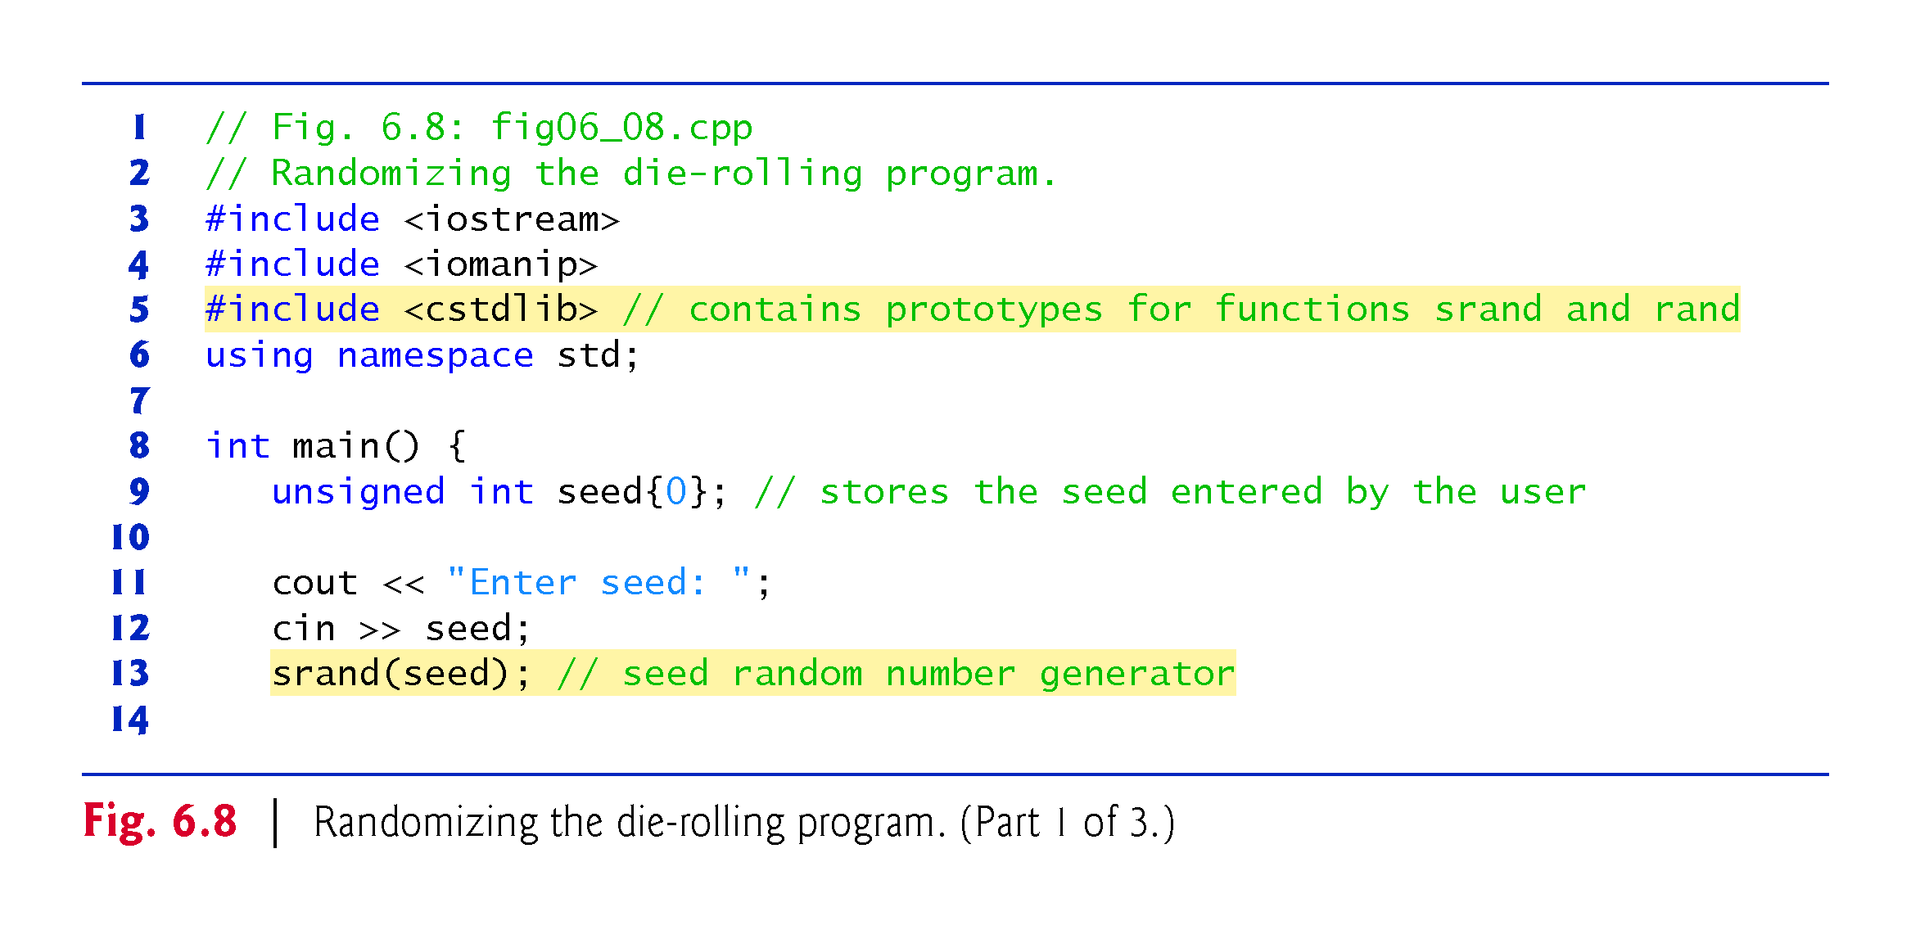
©1992-2017 by Pearson Education, Inc. All Rights Reserved.

Slide 70
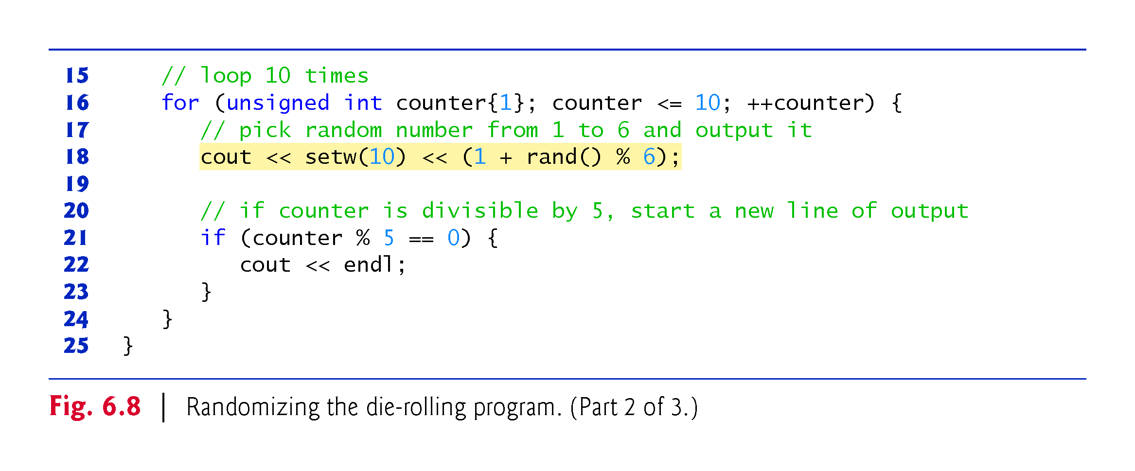
©1992-2017 by Pearson Education, Inc. All Rights Reserved.

Slide 71
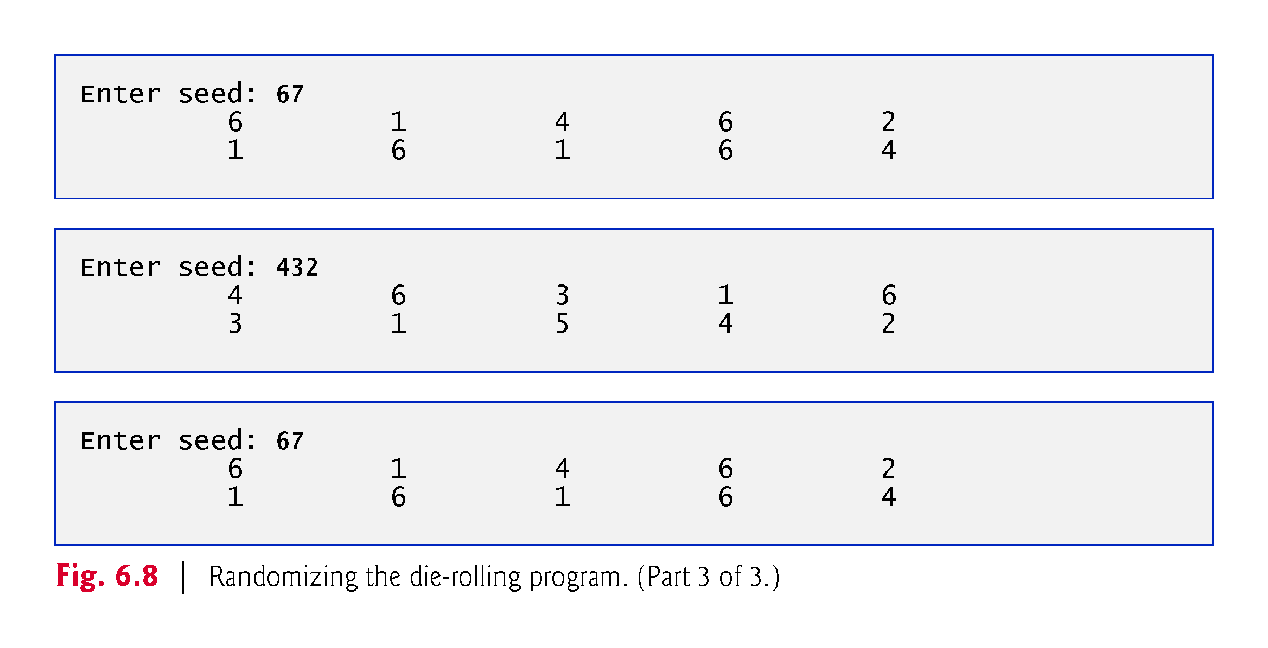
©1992-2017 by Pearson Education, Inc. All Rights Reserved.

Slide 72
6.7.4 Seeding the Random-Number Generator with the Current Time
To randomize without having to enter a seed
srand(static_cast<unsigned int>(time(0)));
Causes the computer to read its clock to obtain the value for the seed.
Function time (with the argument 0 as written in the preceding statement) returns the current time as the number of seconds since January 1, 1970, at midnight Greenwich Mean Time (GMT).
The function prototype for time is in <ctime>.
©1992-2017 by Pearson Education, Inc. All Rights Reserved.

Slide 73
6.7.5 Scaling and Shifting Random Numbers
To produce random numbers in a specific range use:
type variableName = shiftingValue + rand() % scalingFactor;
shiftingValue is equal to the first number in the desired range of consecutive integers
scalingFactor is equal to the width of the de-sired range of consecutive integers.
©1992-2017 by Pearson Education, Inc. All Rights Reserved.

Slide 74
6.8 Case Study: Game of Chance; Introducing enum
Rules of Craps
A player rolls two dice. Each die has six faces.
Faces contain 1, 2, 3, 4, 5 and 6 spots.
After the dice have come to rest, the sum of the spots on the two upward faces is calculated.
If the sum is 7 or 11 on the first roll, the player wins.
If the sum is 2, 3 or 12 on the first roll (called “craps”), the player loses (i.e., the “house” wins).
If the sum is 4, 5, 6, 8, 9 or 10 on the first roll, then that sum becomes the player’s “point.”
To win, continue rolling until you “make your point.”
You lose by rolling a 7 before making the point.
The program in Fig. 6.9 simulates the game.
©1992-2017 by Pearson Education, Inc. All Rights Reserved.

Slide 75
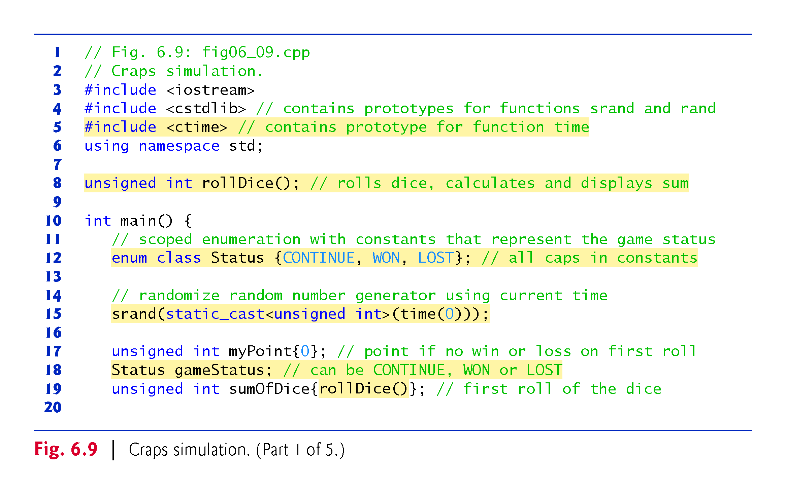
©1992-2017 by Pearson Education, Inc. All Rights Reserved.

Slide 76
©1992-2017 by Pearson Education, Inc. All Rights Reserved.

Slide 77
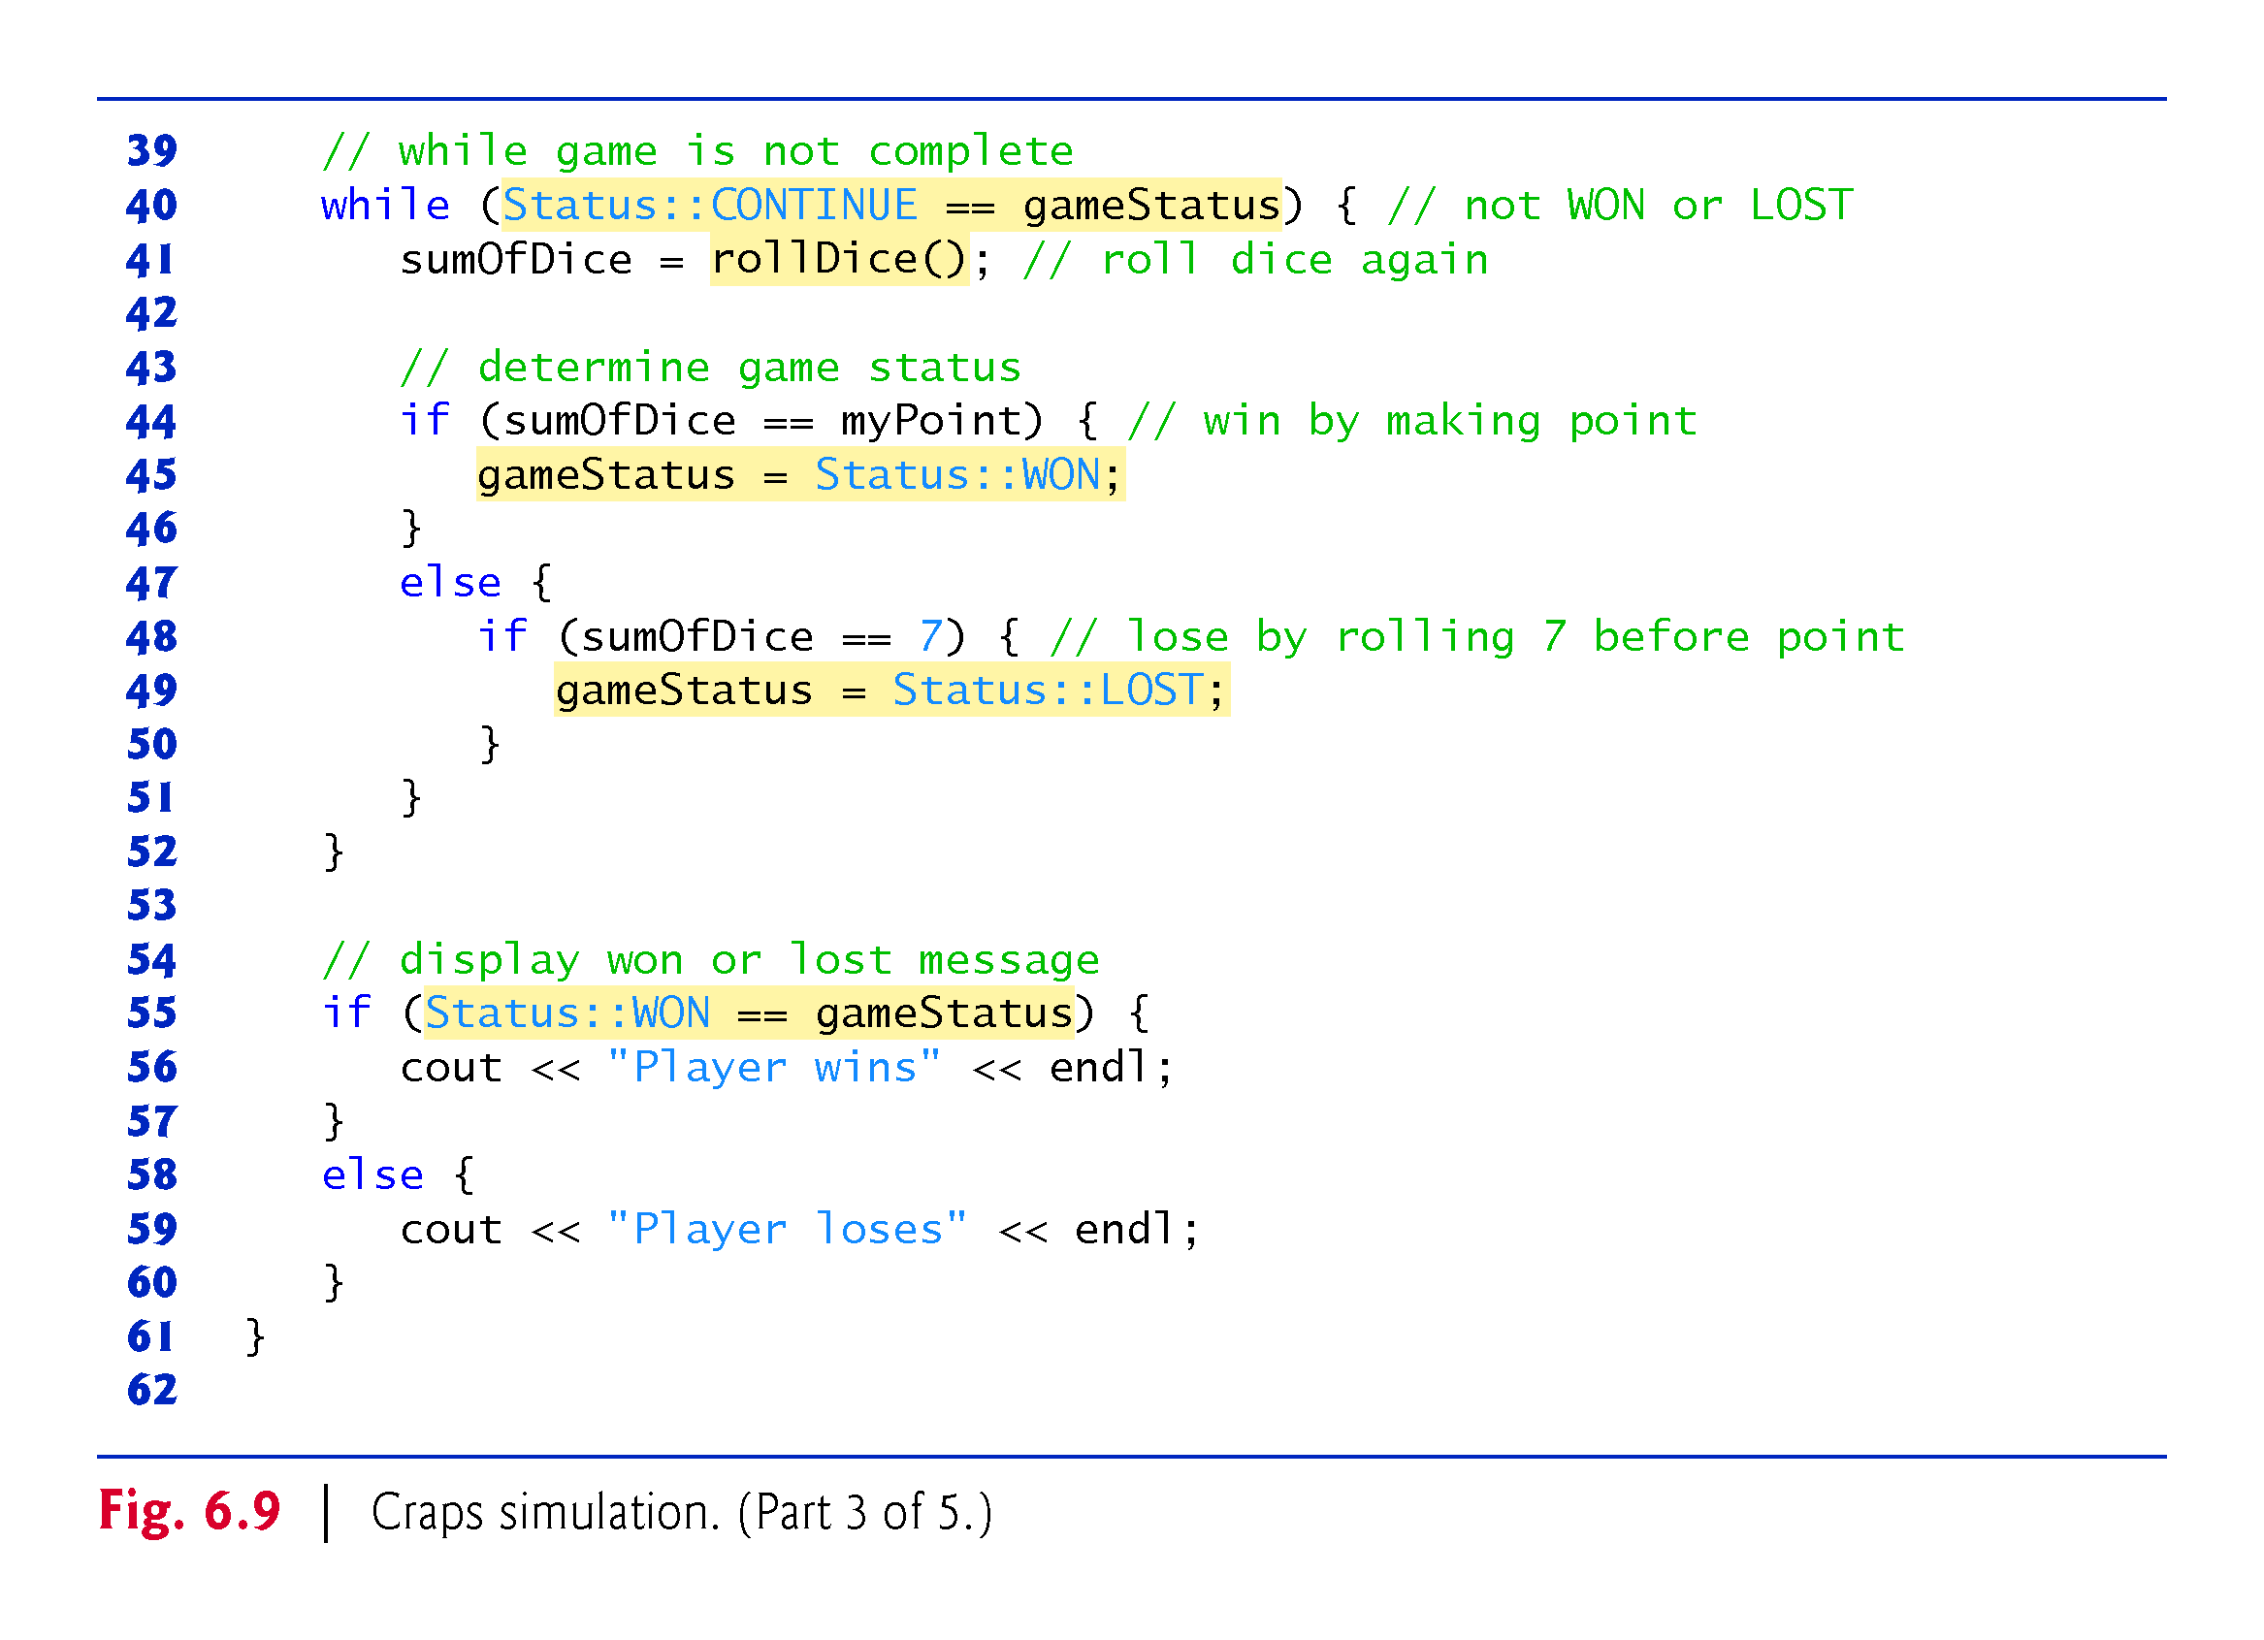
©1992-2017 by Pearson Education, Inc. All Rights Reserved.

Slide 78
©1992-2017 by Pearson Education, Inc. All Rights Reserved.

Slide 79
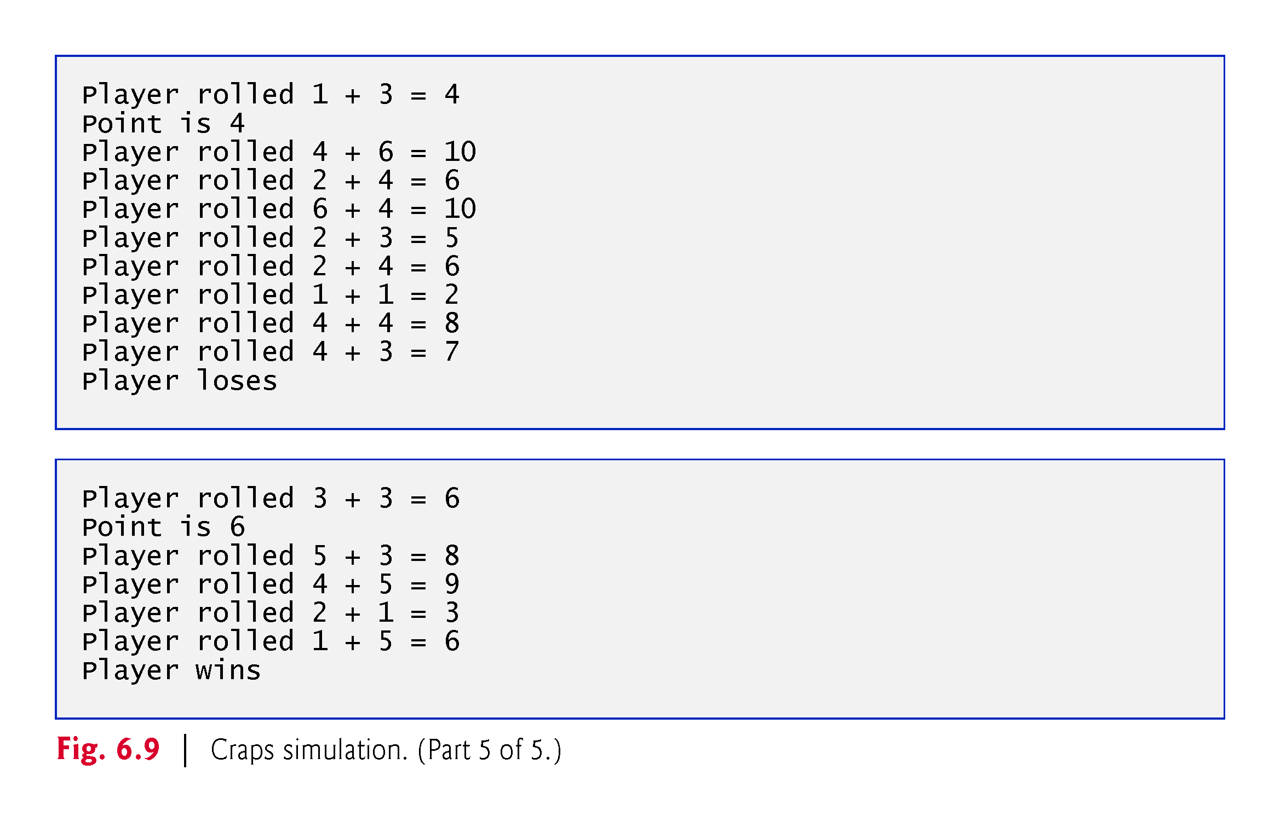
©1992-2017 by Pearson Education, Inc. All Rights Reserved.

Slide 80
6.8 Case Study: Game of Chance; Introducing enum (cont.)
A scoped enumeration (C++11) introduced by enum class and followed by a type name, is a set of identifiers representing integer constants.
The values of these enumeration constants start at 0, unless specified otherwise, and increment by 1.
The identifiers must be unique, but separate enumeration constants can have the same value.
Variables of an enum class can be assigned only one of the values declared in the enumeration.
©1992-2017 by Pearson Education, Inc. All Rights Reserved.

Slide 81
©1992-2017 by Pearson Education, Inc. All Rights Reserved.

Slide 82
©1992-2017 by Pearson Education, Inc. All Rights Reserved.

Slide 83
6.8 Case Study: Game of Chance; Introducing enum (cont.)
To reference a scoped enum constant, qualify it with the type name and the scope-resolution operator (::), as in Status::CONTINUE.
©1992-2017 by Pearson Education, Inc. All Rights Reserved.

Slide 84
©1992-2017 by Pearson Education, Inc. All Rights Reserved.

Slide 85
6.8 Case Study: Game of Chance; Introducing enum (cont.)
Another popular enumeration is
enum class Months { JAN = 1, FEB, MAR, APR, MAY, JUN, JUL, AUG, SEP, OCT, NOV, DEC };
creates user-defined type Months with enumeration constants representing the months of the year.
The first value in the preceding enumeration is explicitly set to 1, so the remaining values increment from 1, resulting in the values 1 through 12.
Any enumeration constant can be assigned an integer value in the enumeration definition.
©1992-2017 by Pearson Education, Inc. All Rights Reserved.

Slide 86
©1992-2017 by Pearson Education, Inc. All Rights Reserved.

Slide 87
6.8 Case Study: Game of Chance; Introducing enum (cont.)
Prior to C++11, enumerations were defined with enum (unscoped enums)
Problem: multiple enums may contain the same identifiers.
Using such enums in the same program can lead to naming collisions and logic errors.
©1992-2017 by Pearson Education, Inc. All Rights Reserved.

Slide 88
©1992-2017 by Pearson Education, Inc. All Rights Reserved.

Slide 89
6.8 Case Study: Game of Chance; Introducing enum (cont.)
Enumeration constants are represented as integers.
An unscoped enum’s underlying integral type depends on its constants’ values—the type is guaranteed to be large enough to store the constant values specified.
A scoped enum’s underlying integral type is int.
You to specify a scoped enum’s underlying integral type by following the enum’s type name with a colon (:) and the integral type.
We can specify that the constants in the enum class Status should have type unsigned int, as in
enum class Status : unsigned int {CONTINUE, WON, LOST};
©1992-2017 by Pearson Education, Inc. All Rights Reserved.

Slide 90
©1992-2017 by Pearson Education, Inc. All Rights Reserved.

Slide 91
6.9 C++11 Random Numbers
According to CERT, function rand does not have “good statistical properties” and can be predictable, which makes programs that use rand less secure (CERT guideline MSC30-CPP).
C++11 provides a new, more secure library of random-number capabilities that can produce nondeterministic random numbers that can’t be predicted.
Such random-number generators are used in simulations and security scenarios where predictability is undesirable.
New capabilities are located in the C++ Standard Library’s <random> header.
©1992-2017 by Pearson Education, Inc. All Rights Reserved.

Slide 92
6.9 C++11 Random Numbers (cont.)
For flexibility based on how random numbers are used in programs, C++11 provides many classes that represent various random-number generation engines and distributions.
An engine implements a random-number generation algorithm that produce pseudorandom numbers.
A distribution controls the range of values produced by an engine, the types of those values (e.g., int, double, etc.) and the statistical properties of the values.
uniform_int_distribution evenly distributes pseudorandom integers over a specified range of values.
©1992-2017 by Pearson Education, Inc. All Rights Reserved.

Slide 93
6.9 C++11 Random Numbers (cont.)
Rolling a Six-Sided Die
Figure 6.10 uses the default_random_engine and the uniform_int_distribution to roll a six-sided die.
default_random_engine object named engine.
Its constructor argument seeds the random-number generation engine with the current time.
If you don’t pass a value to the constructor, the default seed will be used and the program will produce the same sequence of numbers each time it executes.
randomInt—a uniform_int_distribution object that produces unsigned int values (as specified by <unsigned int>) in the range 1 to 6 (as specified by the constructor arguments).
The expression randomInt(engine) returns one unsigned int value in the range 1 to 6.
©1992-2017 by Pearson Education, Inc. All Rights Reserved.

Slide 94
6.9 C++11 Random Numbers (cont.)
The notation <unsigned int> indicates that uniform_int_distribution is a class template.
In this case, any integer type can be specified in the angle brackets (< and >).
In Chapter 18, we discuss how to create class templates and various other chapters show how to use existing class templates from the C++ Standard Library.
For now, you should feel comfortable using class template uniform_int_distribution by mimicking the syntax shown in the example.
©1992-2017 by Pearson Education, Inc. All Rights Reserved.

Slide 95
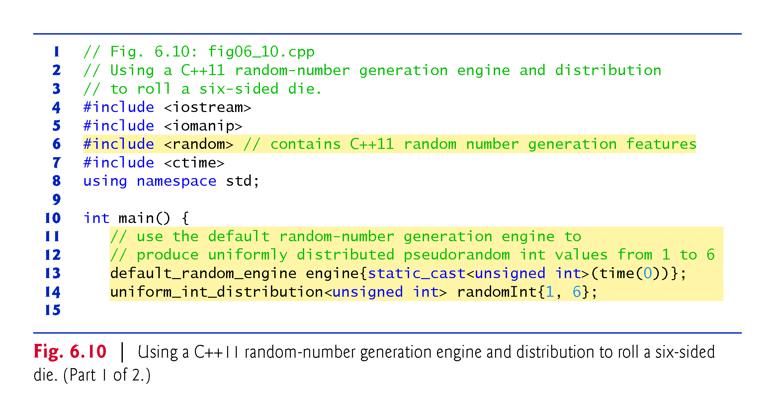
©1992-2017 by Pearson Education, Inc. All Rights Reserved.

Slide 96
©1992-2017 by Pearson Education, Inc. All Rights Reserved.

Slide 97
6.10 Scope Rules
The portion of the program where an identifier can be used is known as its scope.
This section discusses
block scope
global namespace scope
©1992-2017 by Pearson Education, Inc. All Rights Reserved.

Slide 98
6.10 Scope Rules (cont.)
Identifiers declared inside a block have block scope, which begins at the identifier’s declaration and ends at the terminating right brace (}) of the enclosing block.
Local variables have block scope, as do function parameters.
Any block can contain variable declarations.
In nested blocks, if an identifier in an outer block has the same name as an identifier in an inner block, the one in the outer block is “hidden” until the inner block terminates.
The inner block “sees” its own local variable’s value and not that of the enclosing block’s identically named variable.
©1992-2017 by Pearson Education, Inc. All Rights Reserved.

Slide 99
©1992-2017 by Pearson Education, Inc. All Rights Reserved.

Slide 100
©1992-2017 by Pearson Education, Inc. All Rights Reserved.

Slide 101
6.10 Scope Rules (cont.)
An identifier declared outside any function or class has global namespace scope.
“known” in all functions from the point at which it’s declared until the end of the file.
Function definitions, function prototypes placed outside a function, class definitions and global variables all have global namespace scope.
Global variables are created by placing variable declarations outside any class or function definition. Such variables retain their values throughout a program’s execution.
©1992-2017 by Pearson Education, Inc. All Rights Reserved.

Slide 102
©1992-2017 by Pearson Education, Inc. All Rights Reserved.

Slide 103
6.10 Scope Rules (cont.)
Scope Demonstration
The program of Fig. 6.11 demonstrates scoping issues with global variables, automatic local variables and static local variables.
©1992-2017 by Pearson Education, Inc. All Rights Reserved.

Slide 104
Exercise
Write a program that asks for an integer “seed” and prints 20 random integers with that seed. Use srand(seed) and rand() to generate the numbers. Try with different values of seed.
Modify the program so that the values are between 0 and 9.
Modify the program so that the values are between 5 and 10.
©1992-2017 by Pearson Education, Inc. All Rights Reserved.

Slide 105
6.11 Function Call Stack and Activation Records
To understand how C++ performs function calls, we first need to consider a data structure (i.e., collection of related data items) known as a stack.
Analogous to a pile of dishes.
When a dish is placed on the pile, it’s normally placed at the top—referred to as pushing.
Similarly, when a dish is removed from the pile, it’s normally removed from the top—referred to as popping.
Last-in, first-out (LIFO) data structures—the last item pushed (inserted) is the first item popped (removed).
©1992-2017 by Pearson Education, Inc. All Rights Reserved.

Slide 106
6.11 Function Call Stack and Activation Records (cont.)
Function-Call Stack
One of the most important mechanisms for computer science students to understand is the function call stack (or program execution stack).
supports the function call/return mechanism.
Also supports the creation, maintenance and destruction of each called function’s automatic variables.
©1992-2017 by Pearson Education, Inc. All Rights Reserved.

Slide 107
6.11 Function Call Stack and Activation Records (cont.)
Stack Frames
Each function eventually must return control to the function that called it.
Each time a function calls another function, an entry is pushed onto the function call stack.
This entry, called a stack frame or an activation record, contains the return address that the called function needs in order to return to the calling function.
©1992-2017 by Pearson Education, Inc. All Rights Reserved.

Slide 108
6.11 Function Call Stack and Activation Records (cont.)
Automatic Local Variables and Stack Frames
When a function call returns, the stack frame for the function call is popped, and control transfers to the return address in the popped stack frame.
Stack Overflow
The amount of memory in a computer is finite, so only a certain amount of memory can be used to store activation records on the function call stack.
If more function calls occur than can have their activation records stored on the function call stack, an a fatal error known as stack overflow occurs.
©1992-2017 by Pearson Education, Inc. All Rights Reserved.

Slide 109
6.11 Function Call Stack and Activation Records (cont.)
Function Call Stack in Action
Now let’s consider how the call stack supports the operation of a square function called by main (Fig. 6.12).
First the operating system calls main—this pushes an activation record onto the stack (shown in Fig. 6.13).
The activation record tells main how to return to the operating system (i.e., transfer to return address R1) and contains the space for main’s automatic variable (i.e., a, which is initialized to 10).
©1992-2017 by Pearson Education, Inc. All Rights Reserved.

Slide 110
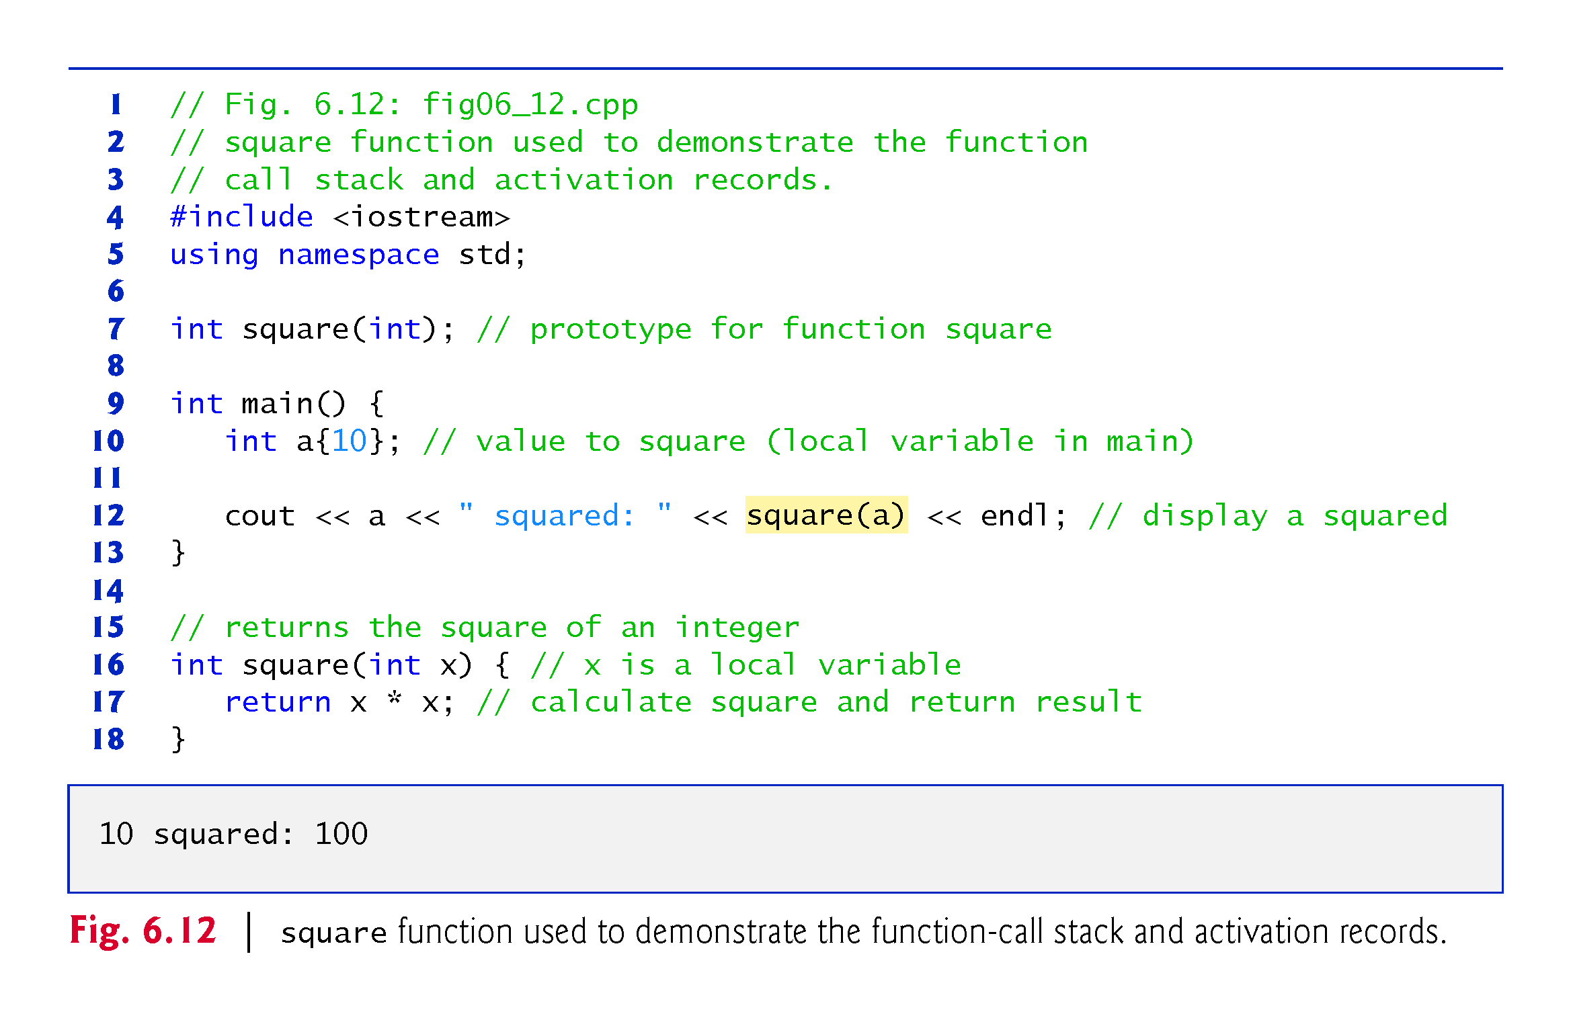
©1992-2017 by Pearson Education, Inc. All Rights Reserved.

Slide 111
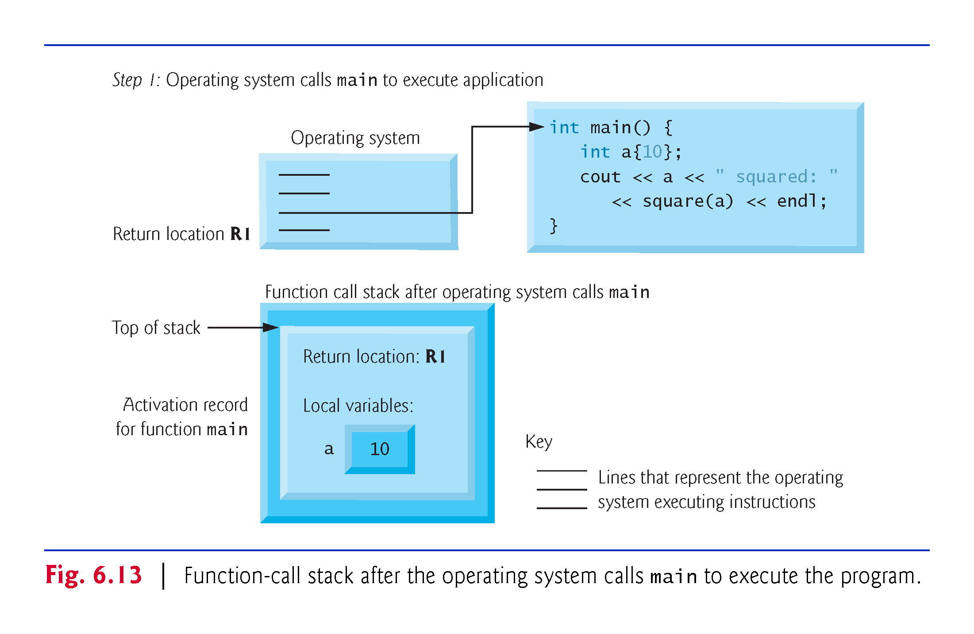
©1992-2017 by Pearson Education, Inc. All Rights Reserved.

Slide 112
6.12 Function Call Stack and Activation Records (cont.)
Function main—before returning to the operating system—now calls function square in line 12 of Fig. 6.12.
This causes a stack frame for square (lines 16–18) to be pushed onto the function call stack (Fig. 6.14).
This stack frame contains the return address that square needs to return to main (i.e., R2) and the memory for square’s automatic variable (i.e., x).
©1992-2017 by Pearson Education, Inc. All Rights Reserved.

Slide 113
©1992-2017 by Pearson Education, Inc. All Rights Reserved.

Slide 114
6.12 Function Call Stack and Activation Records (cont.)
After square calculates the square of its argument, it needs to return to main—and no longer needs the memory for its automatic variable x. So square’s stack frame is popped from the stack—giving square the return location in main (i.e., R2) and losing square’s automatic variable.
Figure 6.15 shows the function call stack after square’s activation record has been popped.
©1992-2017 by Pearson Education, Inc. All Rights Reserved.

Slide 115
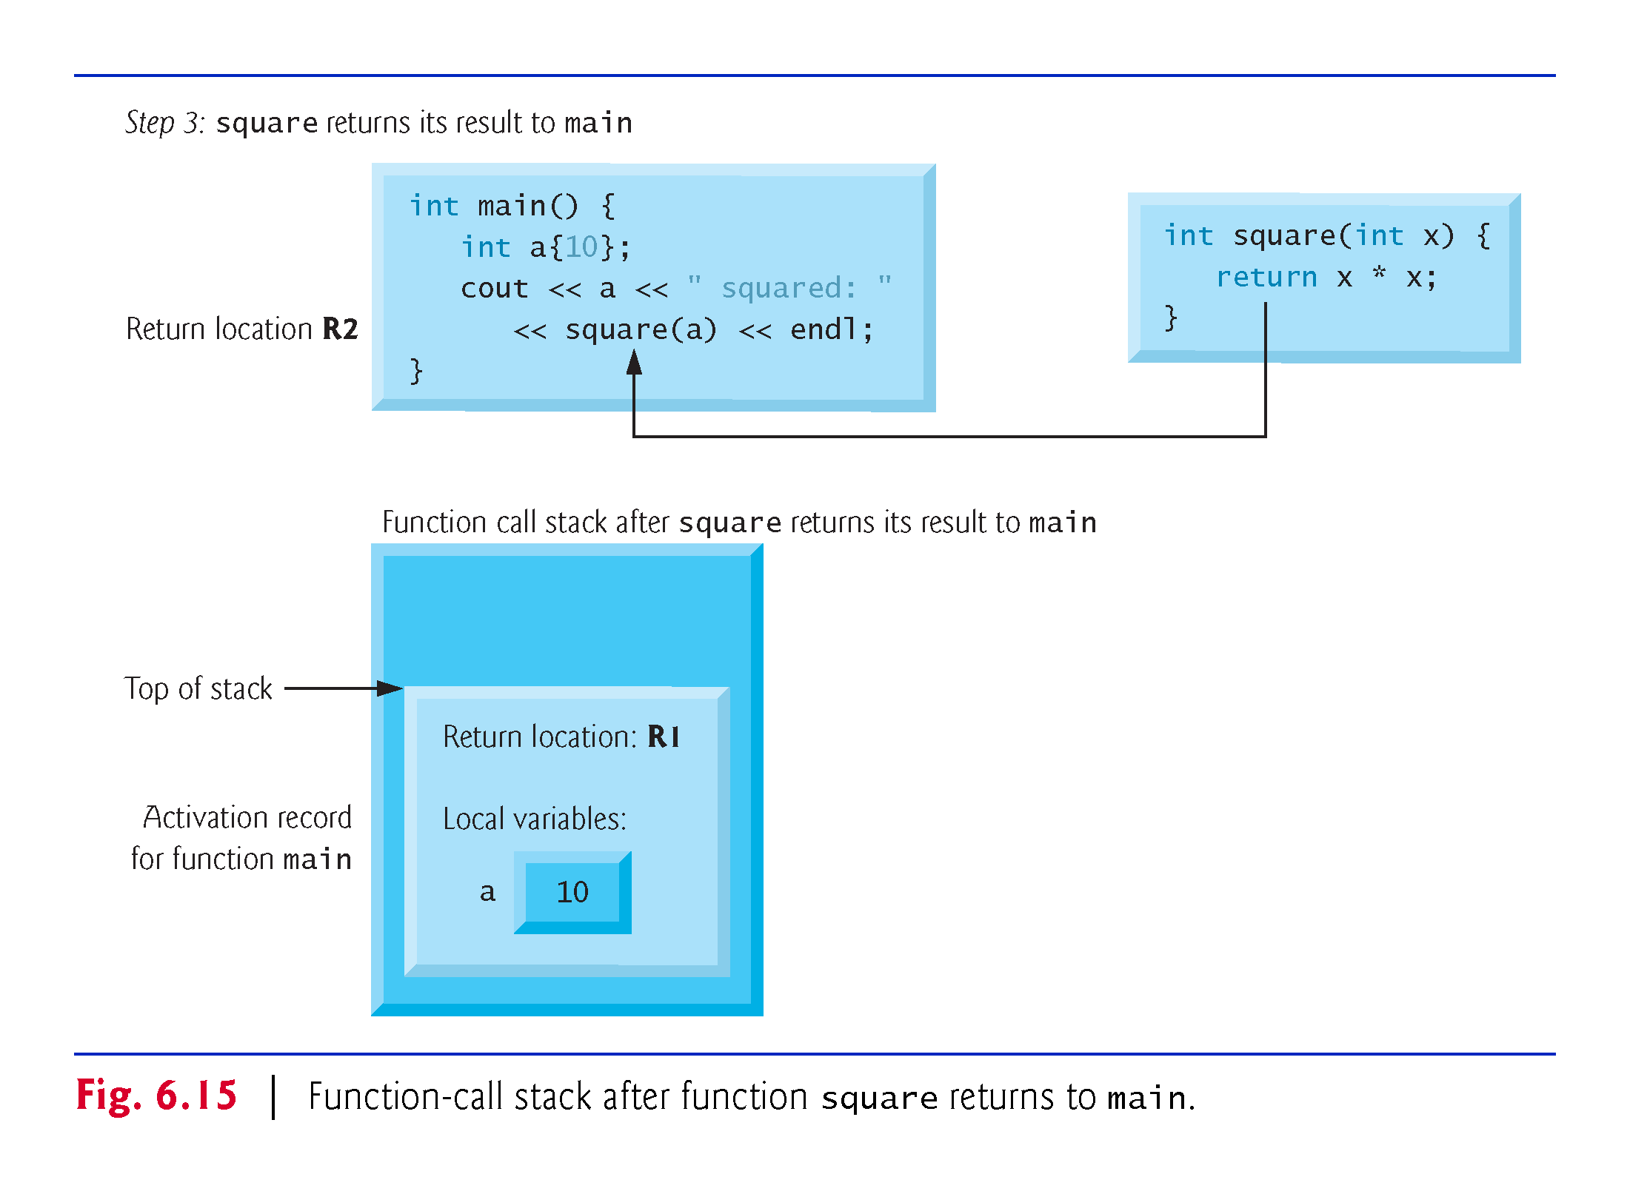
©1992-2017 by Pearson Education, Inc. All Rights Reserved.

Slide 116
6.12 Inline Functions
C++ provides inline functions to help reduce function call overhead.
Placing the qualifier inline before a function’s return type in the function definition advises the compiler to generate a copy of the function’s code in every place where the function is called (when appropriate) to avoid a function call.
This often makes the program larger.
Reusable inline functions are typically placed in headers, so that their definitions can be included in each source file that uses them.
©1992-2017 by Pearson Education, Inc. All Rights Reserved.

Slide 117
©1992-2017 by Pearson Education, Inc. All Rights Reserved.

Slide 118
©1992-2017 by Pearson Education, Inc. All Rights Reserved.

Slide 119
6.14 Inline Functions
Figure 6.16 uses inline function cube (lines 9–11) to calculate the volume of a cube.
Keyword const in function cube’s parameter list (line 9) tells the compiler that the function does not modify variable side.
This ensures that side’s value is not changed by the function during the calculation.
©1992-2017 by Pearson Education, Inc. All Rights Reserved.

Slide 120
©1992-2017 by Pearson Education, Inc. All Rights Reserved.

Slide 121
©1992-2017 by Pearson Education, Inc. All Rights Reserved.

Slide 122
6.13 References and Reference Parameters
Two ways to pass arguments to functions in many programming languages are pass-by-value and pass-by-reference.
When an argument is passed by value, a copy of the argument’s value is made and passed (on the function call stack) to the called function.
Changes to the copy do not affect the original variable’s value in the caller.
To specify a reference to a constant, place the const qualifier before the type specifier in the parameter declaration.
©1992-2017 by Pearson Education, Inc. All Rights Reserved.

Slide 123
©1992-2017 by Pearson Education, Inc. All Rights Reserved.

Slide 124
6.15 References and Reference Parameters (cont.)
With pass-by-reference, the caller gives the called function the ability to access the caller’s data directly, and to modify that data.
A reference parameter is an alias for its corresponding argument in a function call.
To indicate that a function parameter is passed by reference, simply follow the parameter’s type in the function prototype by an ampersand (&); use the same convention when listing the parameter’s type in the function header.
Figure 6.17 compares pass-by-value and pass-by-reference with reference parameters.
©1992-2017 by Pearson Education, Inc. All Rights Reserved.

Slide 125
©1992-2017 by Pearson Education, Inc. All Rights Reserved.

Slide 126
©1992-2017 by Pearson Education, Inc. All Rights Reserved.

Slide 127
©1992-2017 by Pearson Education, Inc. All Rights Reserved.

Slide 128
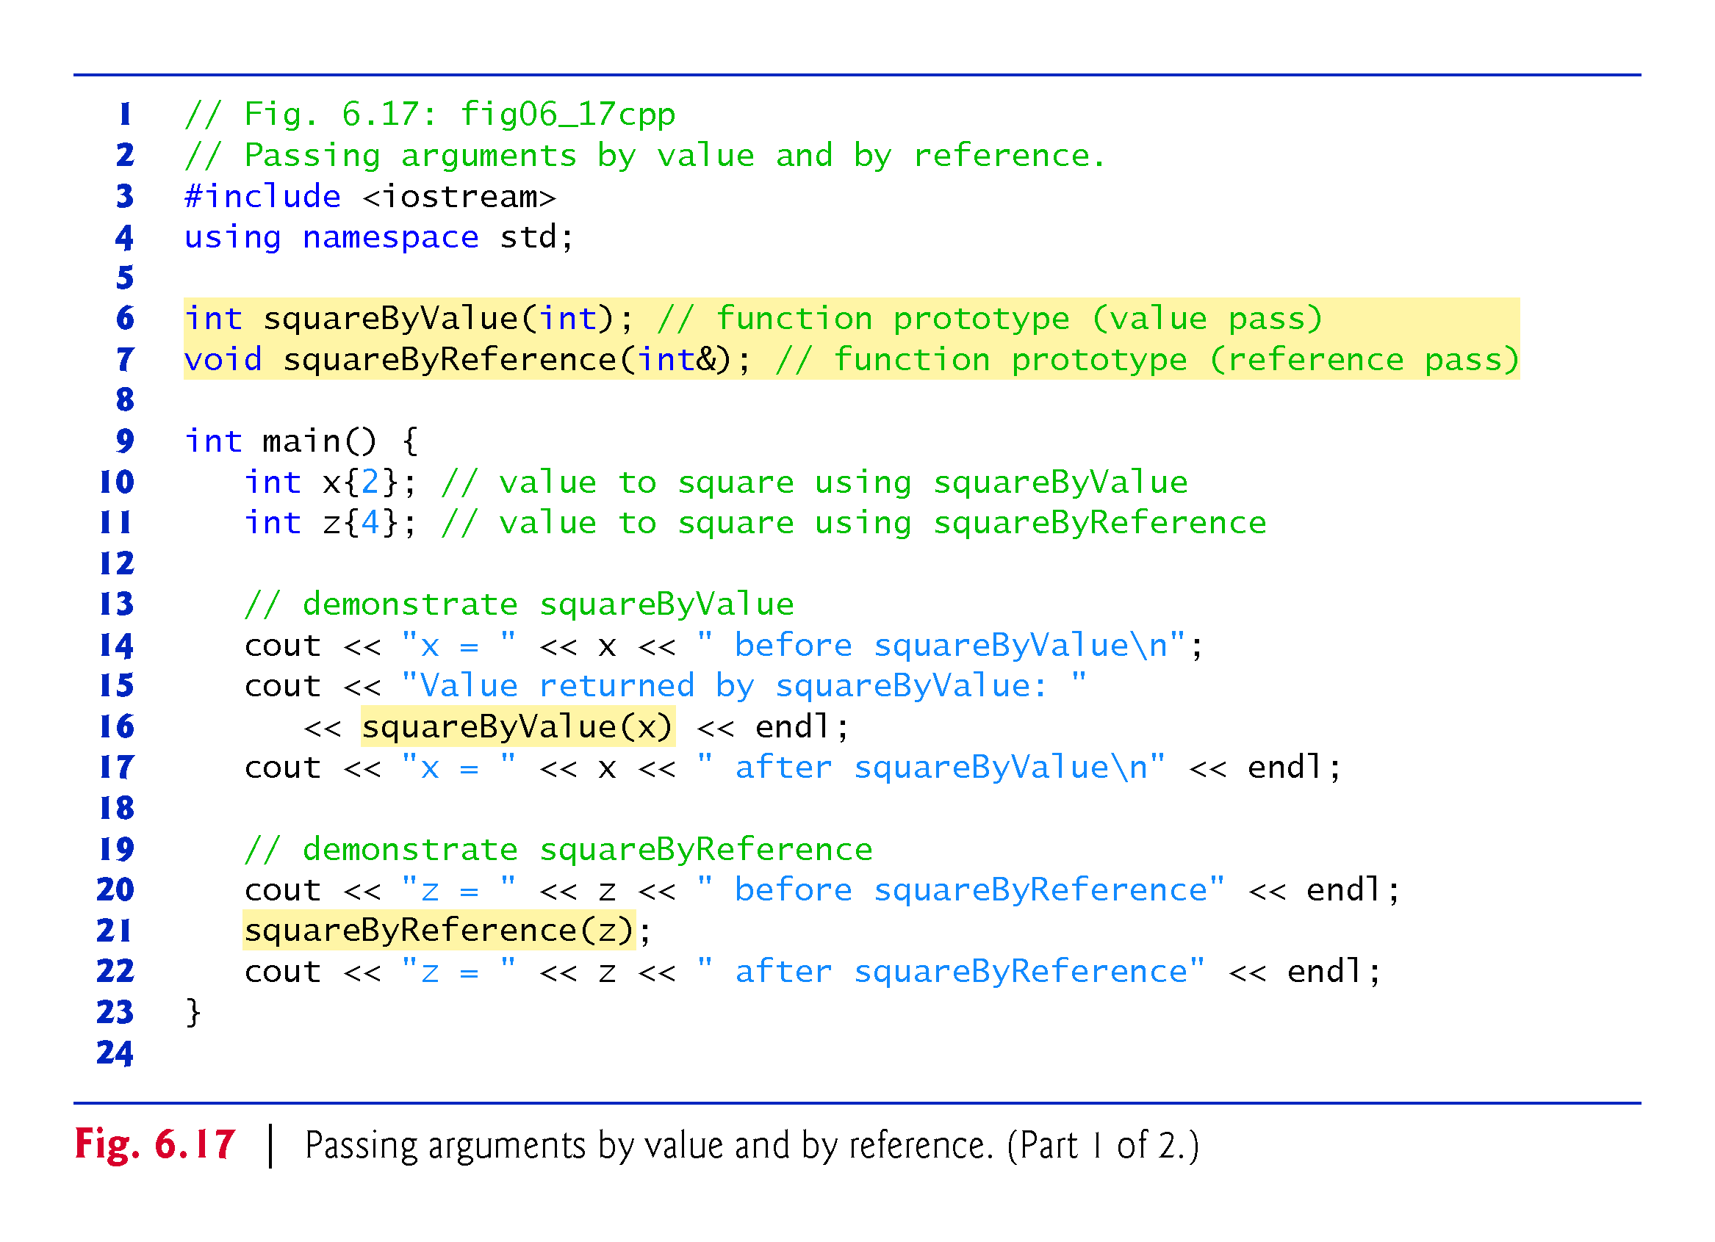
©1992-2017 by Pearson Education, Inc. All Rights Reserved.

Slide 129
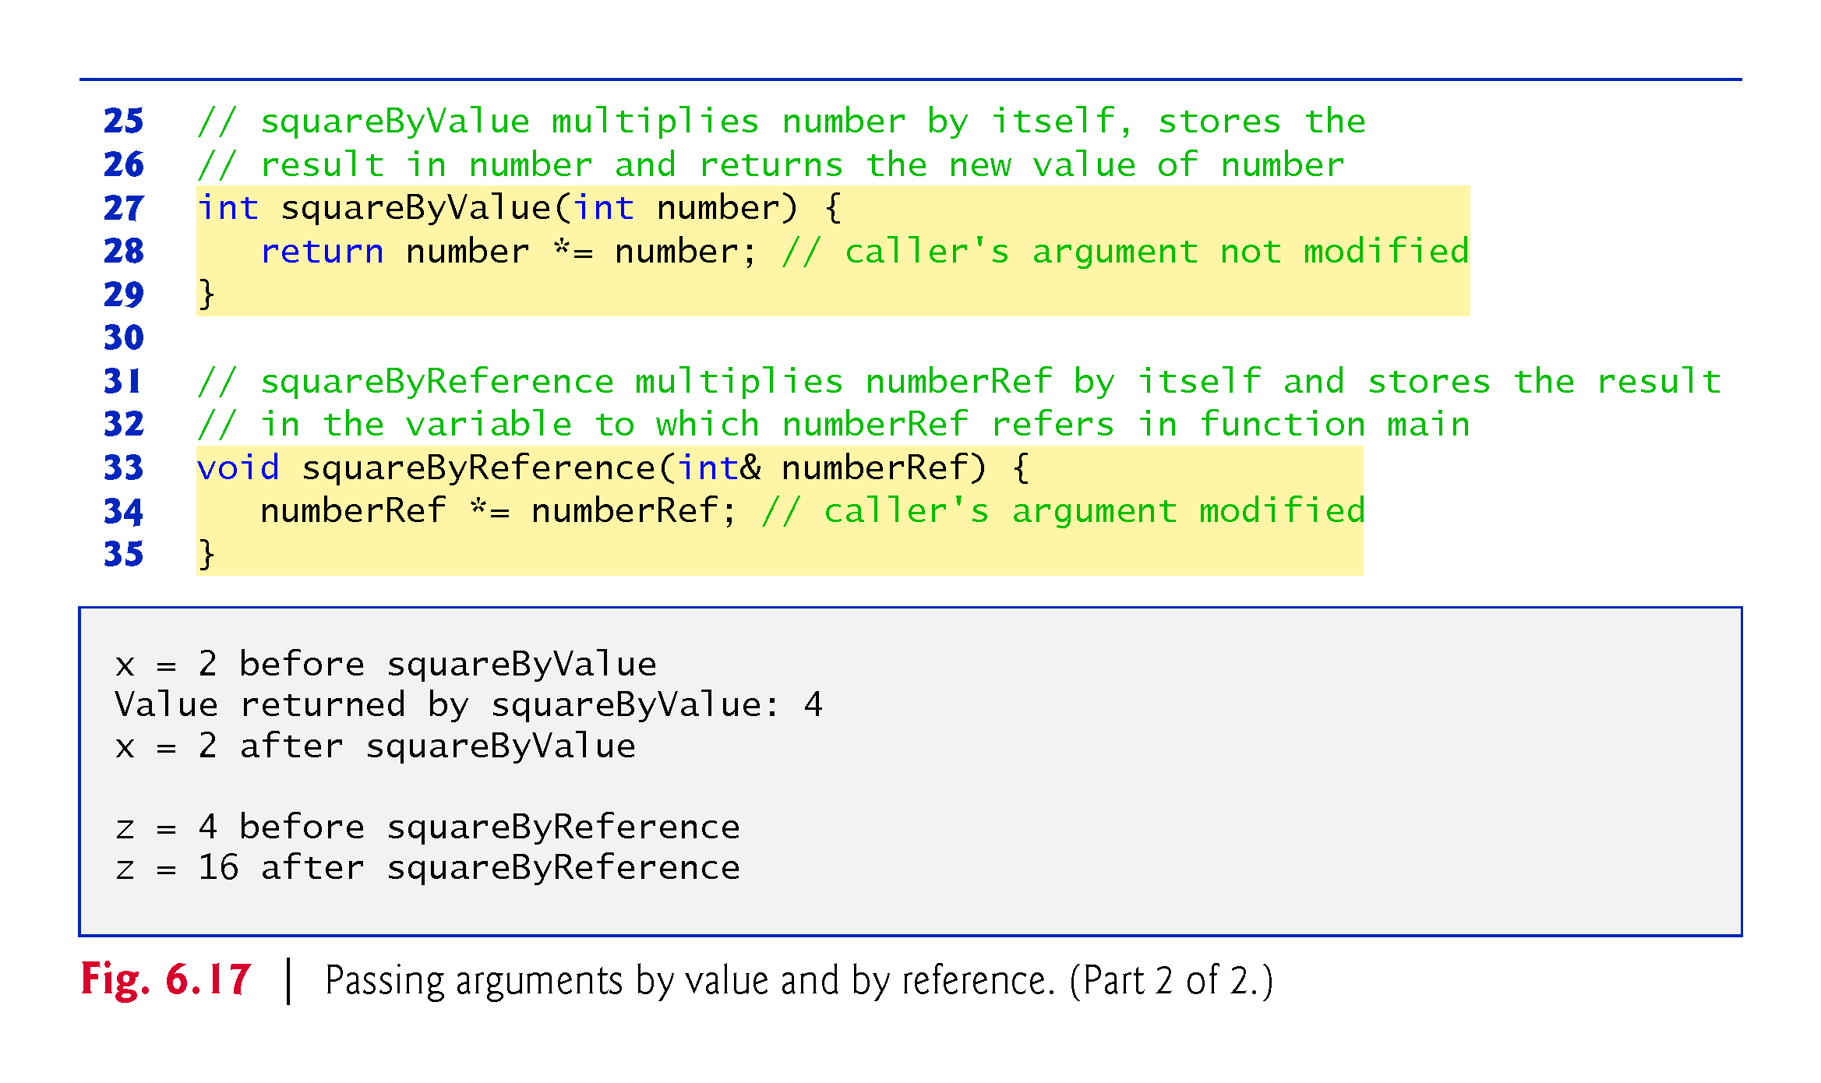
©1992-2017 by Pearson Education, Inc. All Rights Reserved.

Slide 130
6.15 References and Reference Parameters (cont.)
References can also be used as aliases for other variables within a function.
Reference variables must be initialized in their declarations and cannot be reassigned as aliases to other variables.
Once a reference is declared as an alias for another variable, all operations supposedly performed on the alias are actually performed on the original variable.
©1992-2017 by Pearson Education, Inc. All Rights Reserved.

Slide 131
6.15 References and Reference Parameters (cont.)
To specify that a reference parameter should not be allowed to modify the corresponding argument, place the const qualifier before the type name in the parameter’s declaration.
string objects can be large, so they (and objects in general) should be passed to functions by reference.
Functions can return references, but this can be dangerous – more about this when we do pointers.
©1992-2017 by Pearson Education, Inc. All Rights Reserved.

Slide 132
©1992-2017 by Pearson Education, Inc. All Rights Reserved.

Slide 133
6.15 References and Reference Parameters (cont.)
Functions can return references, but this can be dangerous.
When returning a reference to a variable declared in the called function, the variable should be declared static in that function.
©1992-2017 by Pearson Education, Inc. All Rights Reserved.

Slide 134
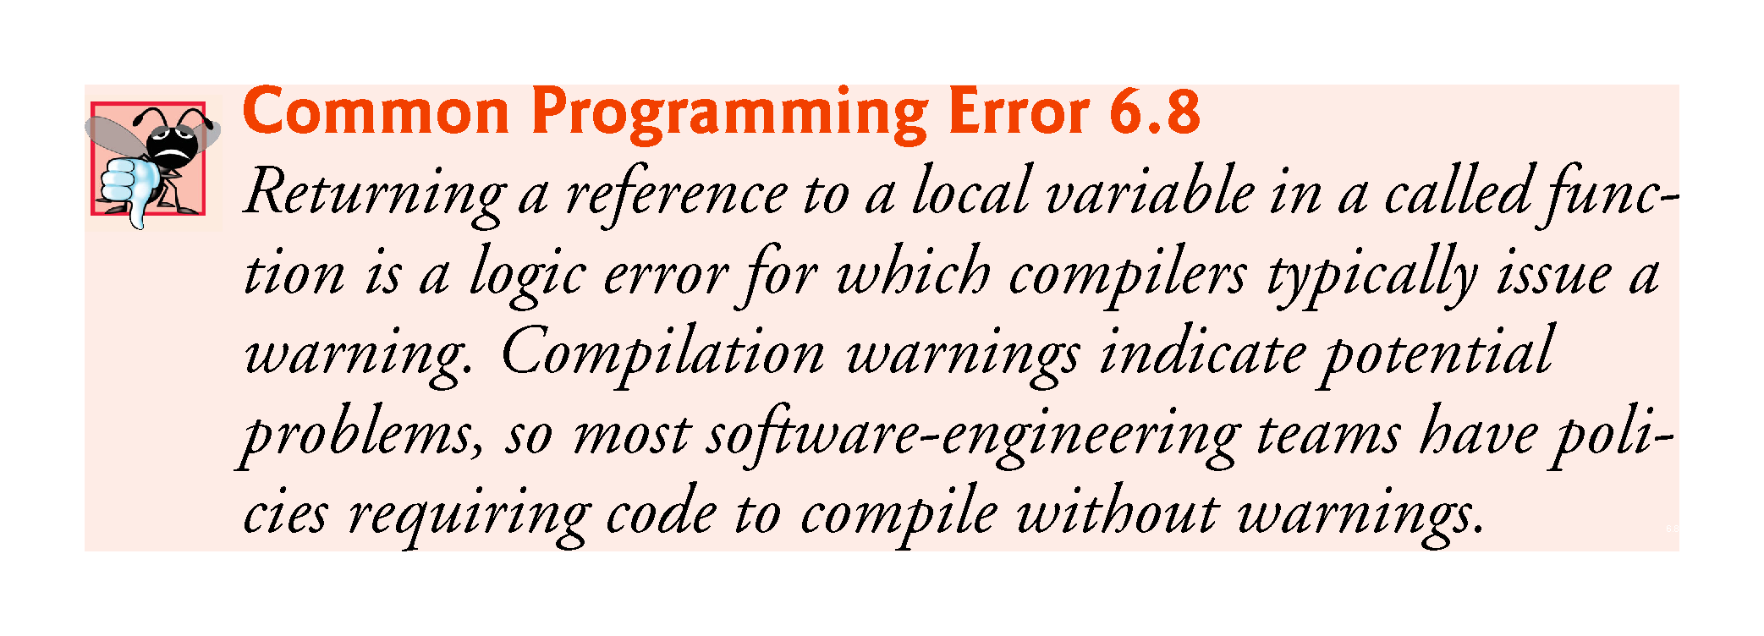
©1992-2017 by Pearson Education, Inc. All Rights Reserved.

Slide 135
6.14 Default Arguments
It common for a program to invoke a function repeatedly with the same argument value for a particular parameter.
Can specify that such a parameter has a default argument, i.e., a default value to be passed to that parameter.
When a program omits an argument for a parameter with a default argument in a function call, the compiler rewrites the function call and inserts the default value of that argument.
Figure 6.18 demonstrates using default arguments to calculate a box’s volume.
©1992-2017 by Pearson Education, Inc. All Rights Reserved.

Slide 136
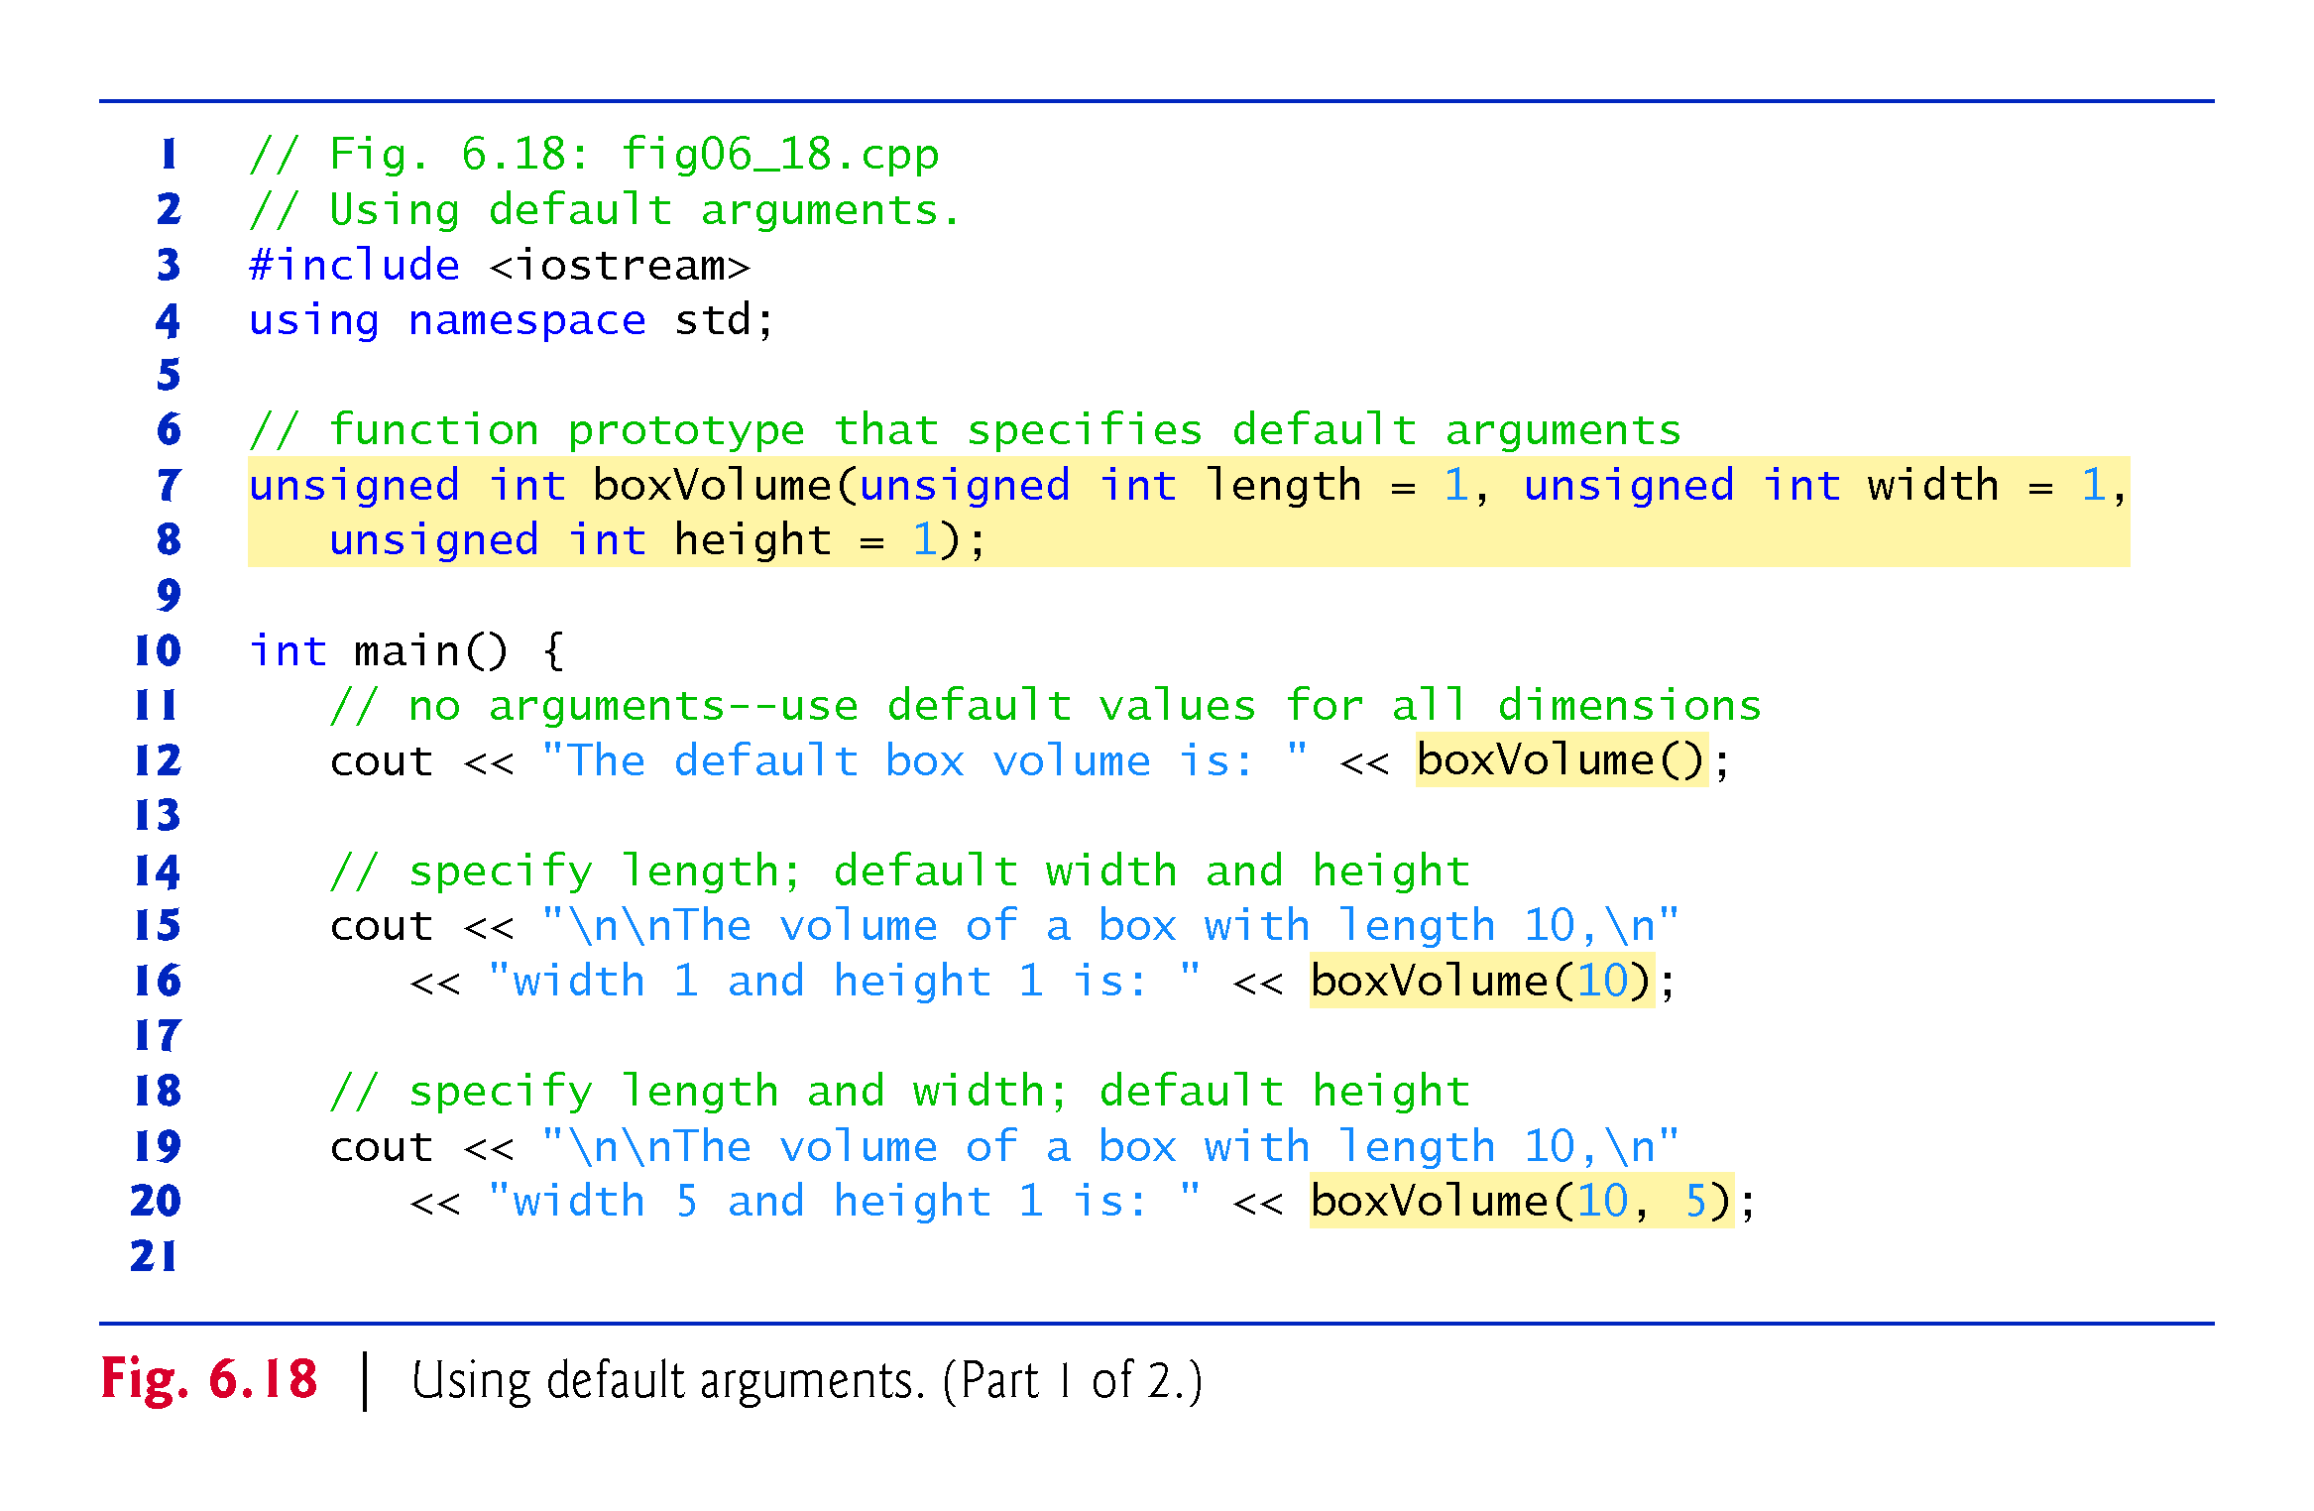
©1992-2017 by Pearson Education, Inc. All Rights Reserved.

Slide 137
©1992-2017 by Pearson Education, Inc. All Rights Reserved.

Slide 138
6.14 Default Arguments
Default arguments must be the rightmost (trailing) arguments in a function’s parameter list.
When calling a function with two or more default arguments, if an omitted argument is not the rightmost argument, then all arguments to the right of that argument also must be omitted.
Default arguments must be specified with the first occurrence of the function name—typically, in the function prototype.
Default values can be any expression, including constants, global variables or function calls. Default arguments also can be used with inline functions.
©1992-2017 by Pearson Education, Inc. All Rights Reserved.

Slide 139
©1992-2017 by Pearson Education, Inc. All Rights Reserved.

Slide 140
6.15 Unary Scope Resolution Operator
C++ provides the unary scope resolution operator (::) to access a global variable when a local variable of the same name is in scope.
Using the unary scope resolution operator (::) with a given variable name is optional when the only variable with that name is a global variable.
Figure 6.19 shows the unary scope resolution operator with local and global variables of the same name.
©1992-2017 by Pearson Education, Inc. All Rights Reserved.

Slide 141
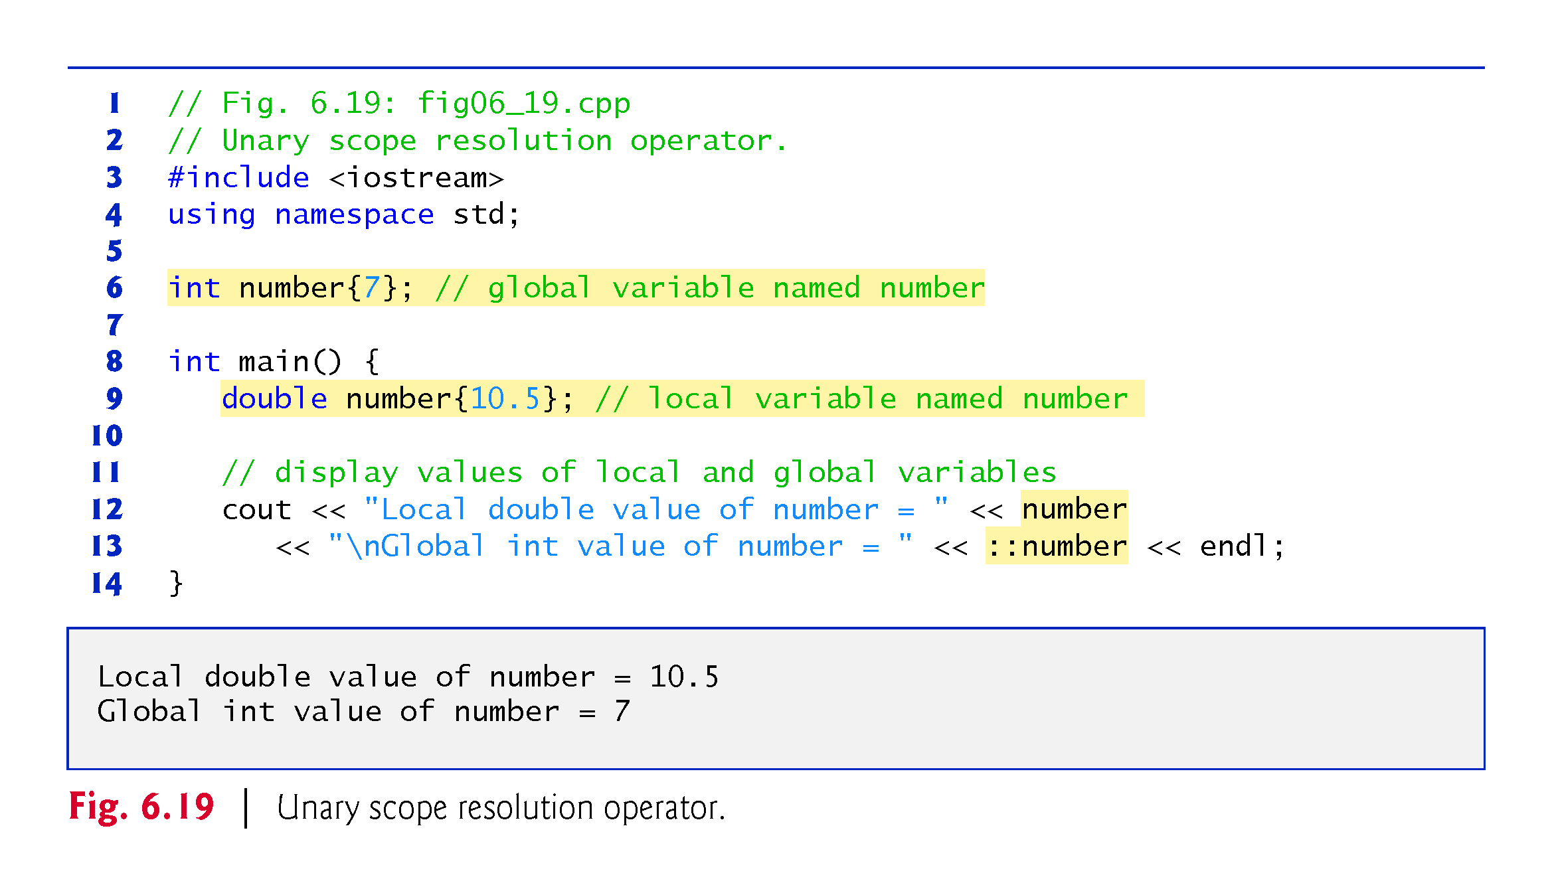
©1992-2017 by Pearson Education, Inc. All Rights Reserved.

Slide 142
©1992-2017 by Pearson Education, Inc. All Rights Reserved.

Slide 143
©1992-2017 by Pearson Education, Inc. All Rights Reserved.

Slide 144
©1992-2017 by Pearson Education, Inc. All Rights Reserved.

Slide 145
©1992-2017 by Pearson Education, Inc. All Rights Reserved.

Slide 146
6.16 Function Overloading
C++ enables several functions of the same name to be defined, as long as they have different signatures.
This is called function overloading.
The C++ compiler selects the proper function to call by examining the number, types and order of the arguments in the call.
Function overloading is used to create several functions of the same name that perform similar tasks, but on different data types.
©1992-2017 by Pearson Education, Inc. All Rights Reserved.

Slide 147
©1992-2017 by Pearson Education, Inc. All Rights Reserved.

Slide 148
6.16 Function Overloading (cont.)
Figure 6.20 uses overloaded square functions to calculate the square of an int and the square of a double.
©1992-2017 by Pearson Education, Inc. All Rights Reserved.

Slide 149
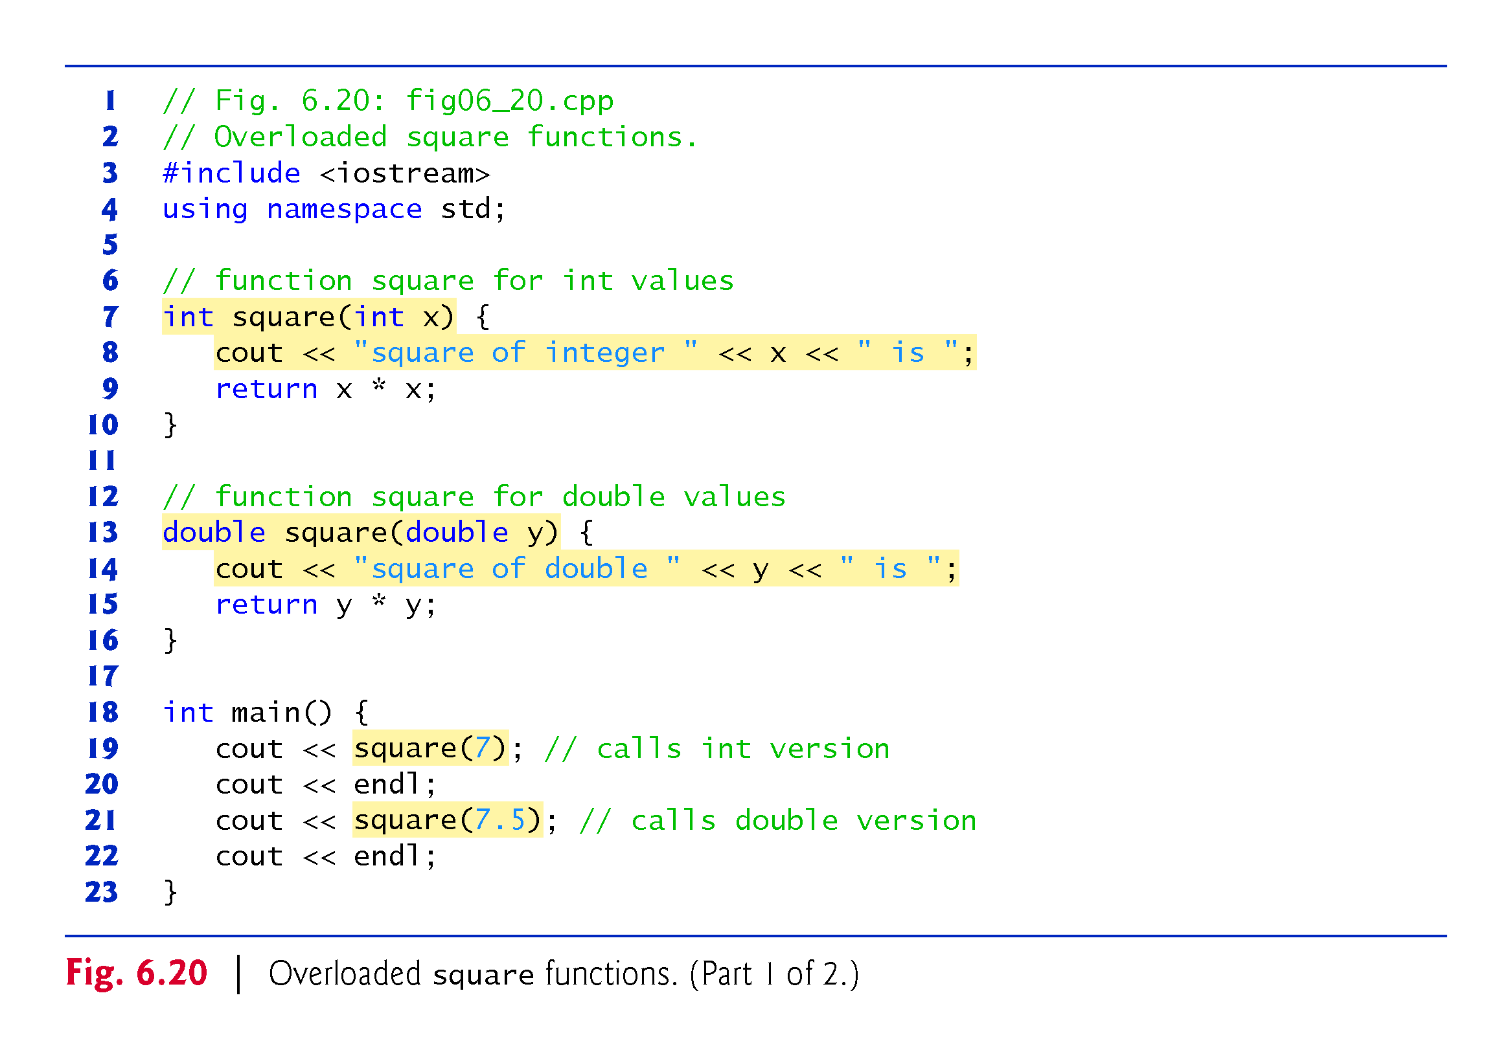
©1992-2017 by Pearson Education, Inc. All Rights Reserved.

Slide 150
©1992-2017 by Pearson Education, Inc. All Rights Reserved.

Slide 151
6.16 Function Overloading (cont.)
How the Compiler Differentiates Among Overloaded Functions
Overloaded functions are distinguished by their signatures.
A signature is a combination of a function’s name and its parameter types (in order).
The compiler encodes each function identifier with the types of its parameters (sometimes referred to as name mangling or name decoration) to enable type-safe linkage.
Ensures that the proper overloaded function is called and that the types of the arguments conform to the types of the parameters.
Figure 6.21 was compiled with GNU C++.
Rather than showing the execution output of the program, we show the mangled function names produced in assembly language by GNU C++.
©1992-2017 by Pearson Education, Inc. All Rights Reserved.

Slide 152
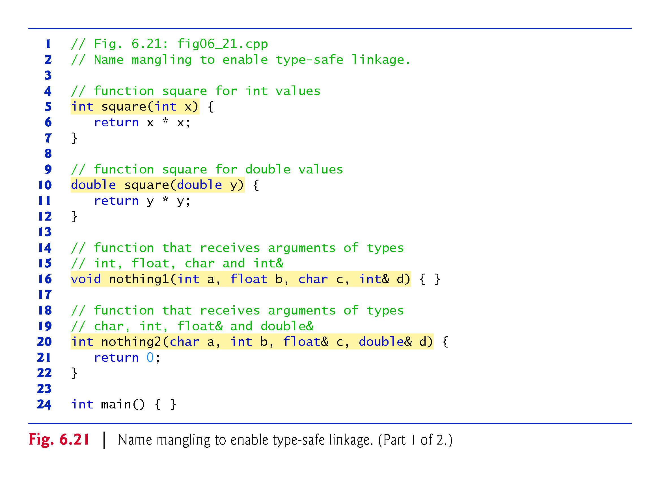
©1992-2017 by Pearson Education, Inc. All Rights Reserved.

Slide 153
©1992-2017 by Pearson Education, Inc. All Rights Reserved.

Slide 154
6.16 Function Overloading (cont.)
For GNU C++, each mangled name (other than main) begins with two underscores (__) followed by the letter Z, a number and the function name.
The number specifies how many characters are in the function’s name.
The compiler distinguishes the two square functions by their parameter lists—one specifies i for int and the other d for double.
The return types of the functions are not specified in the mangled names.
Overloaded functions can have different return types, but if they do, they must also have different parameter lists.
Function-name mangling is compiler specific.
©1992-2017 by Pearson Education, Inc. All Rights Reserved.

Slide 155
©1992-2017 by Pearson Education, Inc. All Rights Reserved.

Slide 156
©1992-2017 by Pearson Education, Inc. All Rights Reserved.

Slide 157
6.17 Function Templates
If the program logic and operations are identical for each data type, overloading may be performed more compactly and conveniently by using function templates.
You write a single function template definition.
Given the argument types provided in calls to this function, C++ automatically generates separate function template specializations to handle each type of call appropriately.
©1992-2017 by Pearson Education, Inc. All Rights Reserved.

Slide 158
6.17 Function Templates (cont.)
Figure 6.22 defines a maximum function that determines the largest of three values.
All function template definitions begin with the template keyword followed by a template parameter list enclosed in angle brackets (< and >).
Every parameter in the template parameter list is preceded by keyword typename or keyword class.
The type parameters are placeholders for fundamental types or user-defined types.
Used to specify the types of the function’s parameters, to specify the function’s return type and to declare variables within the body of the function definition.
©1992-2017 by Pearson Education, Inc. All Rights Reserved.

Slide 159
©1992-2017 by Pearson Education, Inc. All Rights Reserved.

Slide 160
6.19 Function Templates (cont.)
Figure 6.23 uses the maximum function template to determine the largest of three int values, three double values and three char values, respectively.
Separate functions are created as a result of the calls—expecting three int values, three double values and three char values, respectively.
©1992-2017 by Pearson Education, Inc. All Rights Reserved.

Slide 161
©1992-2017 by Pearson Education, Inc. All Rights Reserved.

Slide 162
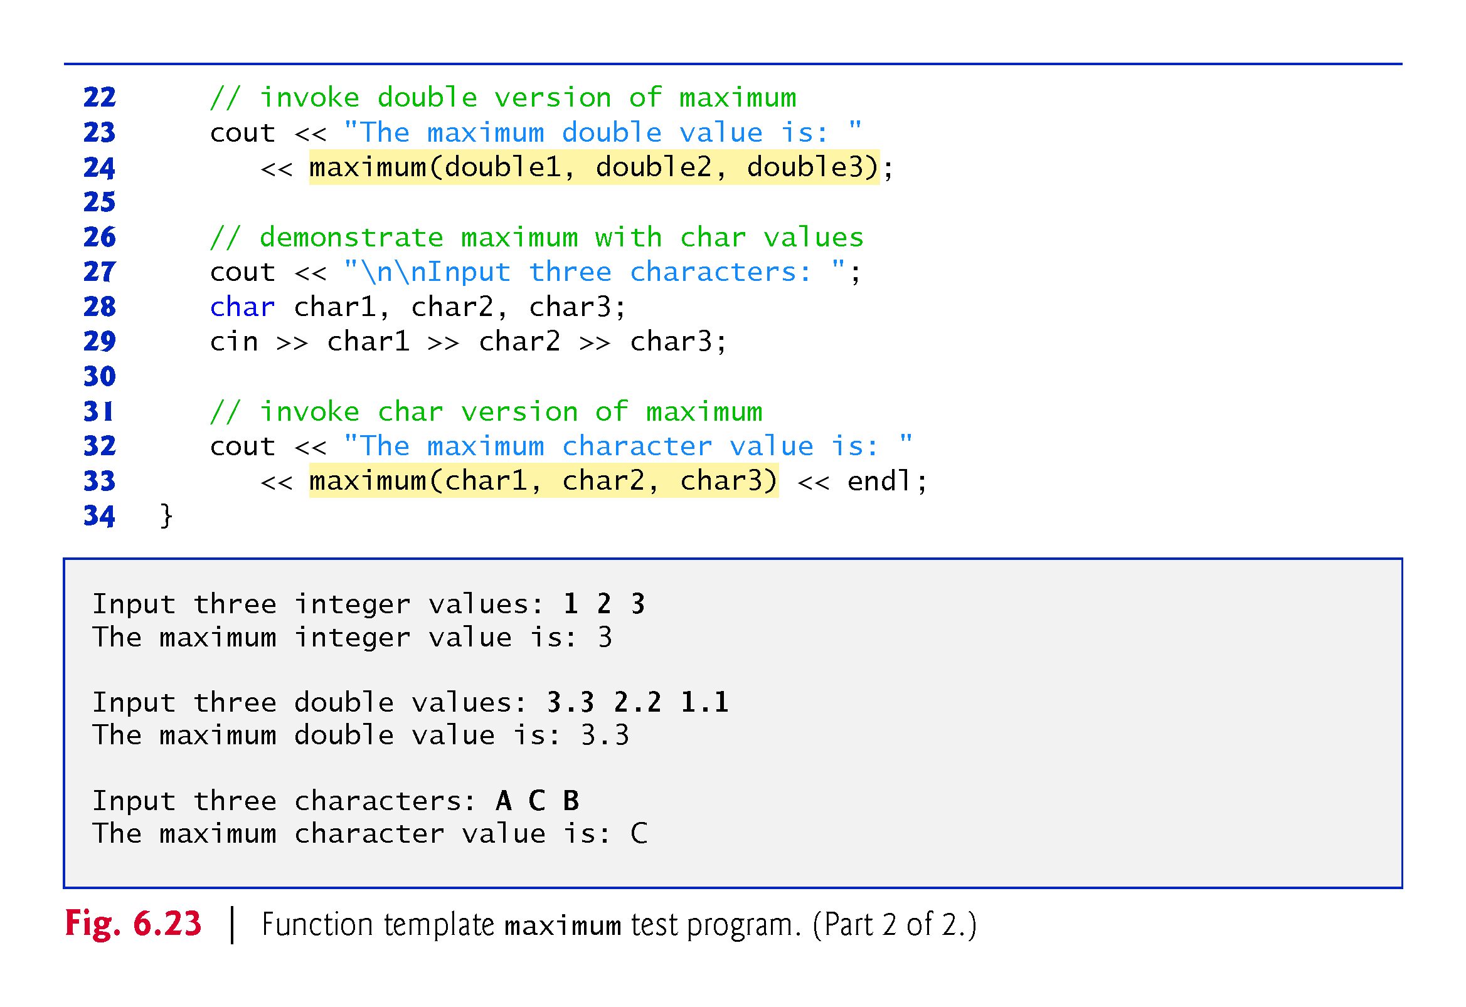
©1992-2017 by Pearson Education, Inc. All Rights Reserved.

Slide 163
6.18 Recursion
A recursive function is a function that calls itself, either directly, or indirectly (through another function).
Recursive problem-solving approaches have a number of elements in common.
A recursive function is called to solve a problem.
The function actually knows how to solve only the simplest case(s), or so-called base case(s).
If the function is called with a base case, the function simply returns a result.
If the function is called with a more complex problem, it typically divides the problem into two conceptual pieces—a piece that the function knows how to do and a piece that it does not know how to do.
This new problem looks like the original, so the function calls a copy of itself to work on the smaller problem—this is referred to as a recursive call and is also called the recursion step.
©1992-2017 by Pearson Education, Inc. All Rights Reserved.

Slide 164
©1992-2017 by Pearson Education, Inc. All Rights Reserved.

Slide 165
6.18 Recursion (cont.)
The recursion step often includes the key-word return, because its result will be combined with the portion of the problem the function knew how to solve to form the result passed back to the original caller, possibly main.
The recursion step executes while the original call to the function is still “open,” i.e., it has not yet finished executing.
The recursion step can result in many more such recursive calls.
©1992-2017 by Pearson Education, Inc. All Rights Reserved.

Slide 166
6.18 Recursion (cont.)
Factorial
The factorial of a nonnegative integer n, written n! (and pronounced “n factorial”), is the product
n · (n – 1) · (n – 2) · … · 1
with 1! equal to 1, and 0! defined to be 1.
©1992-2017 by Pearson Education, Inc. All Rights Reserved.

Slide 167
6.18 Recursion (cont.)
Iterative Factorial
The factorial of an integer, number, greater than or equal to 0, can be calculated iteratively (nonrecursively) by using a loop.
Recursive Factorial
A recursive definition of the factorial function is arrived at by observing the following algebraic relationship:
n! = n · (n – 1)!
©1992-2017 by Pearson Education, Inc. All Rights Reserved.

Slide 168
6.18 Recursion (cont.)
Evaluating 5!
The evaluation of 5! would proceed as shown in Fig. 6.24, which illustrates how the succession of recursive calls proceeds until 1! is evaluated to be 1, terminating the recursion.
Figure 6.24(b) shows the values returned from each recursive call to its caller until the final value is calculated and returned.
©1992-2017 by Pearson Education, Inc. All Rights Reserved.

Slide 169
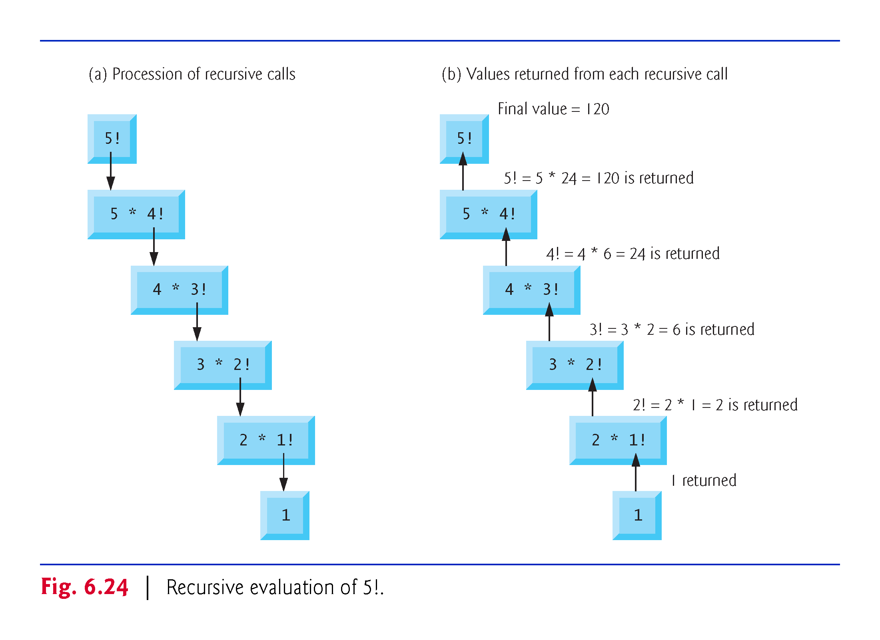
©1992-2017 by Pearson Education, Inc. All Rights Reserved.

Slide 170
6.18 Recursion (cont.)
Using a Recursive factorial Function to Calculate Factorials
Figure 6.25 uses recursion to calculate and print the factorials of the integers 0–10.
©1992-2017 by Pearson Education, Inc. All Rights Reserved.

Slide 171
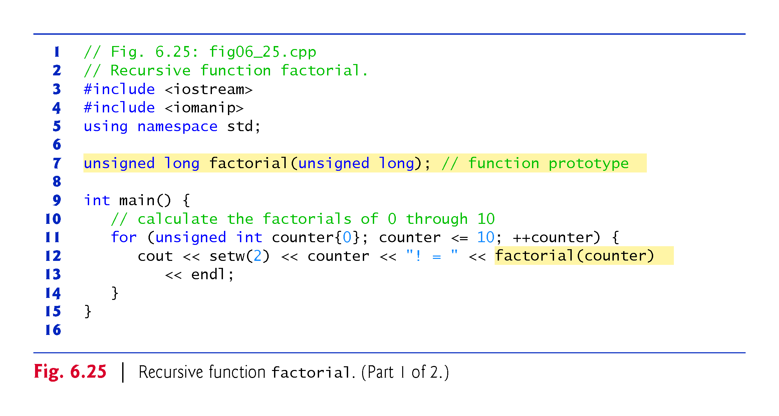
©1992-2017 by Pearson Education, Inc. All Rights Reserved.

Slide 172
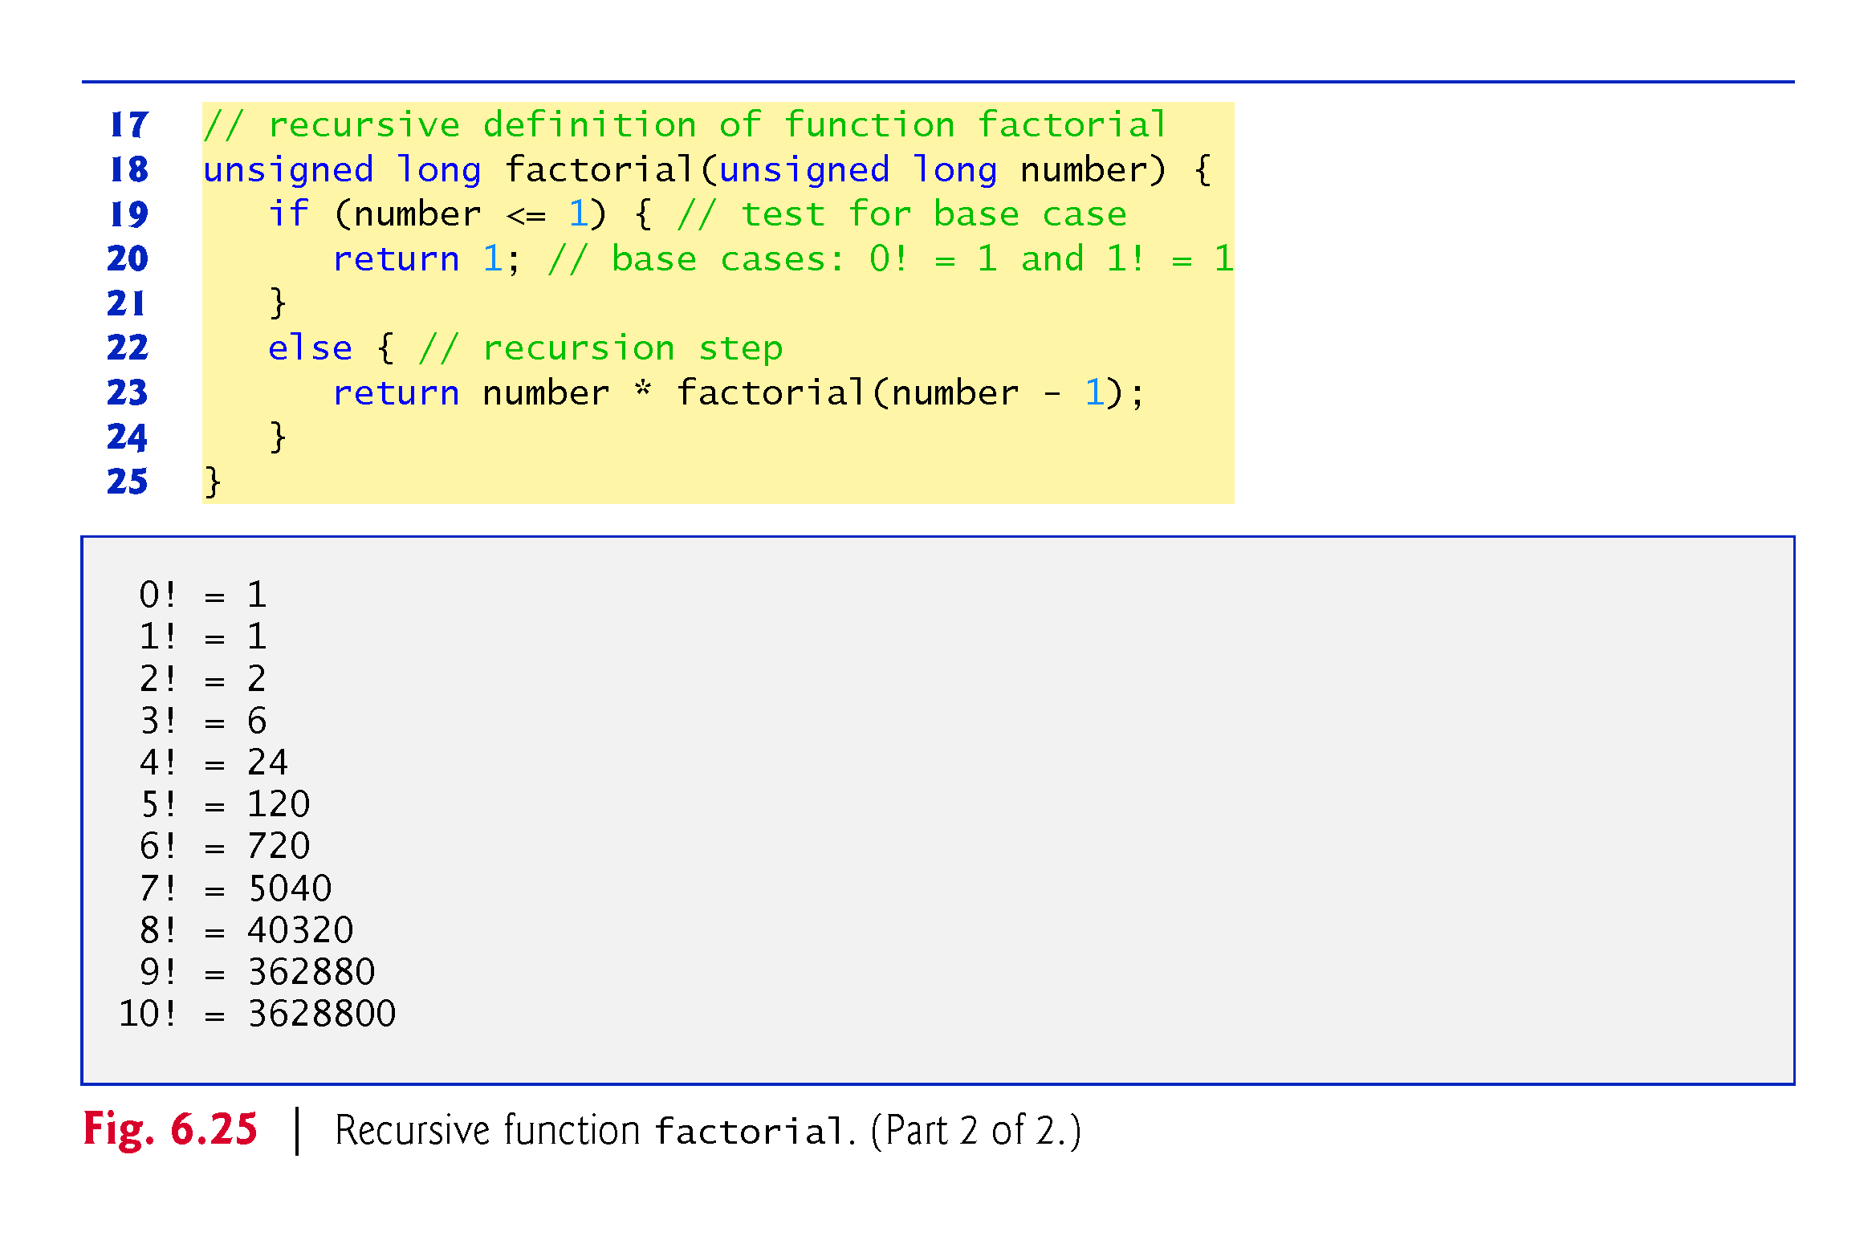
©1992-2017 by Pearson Education, Inc. All Rights Reserved.

Slide 173
6.18 Recursion (cont.)
C++11 Type unsigned long long int
C++11’s unsigned long long int type (which can be abbreviated as unsigned long long ) on some systems enables you to store values in at least 8 bytes (64 bits) which can hold numbers as large as 18,446,744,073,709,551,615.
©1992-2017 by Pearson Education, Inc. All Rights Reserved.

Slide 174
6.19 Example Using Recursion: Fibonacci Series
The Fibonacci series
0, 1, 1, 2, 3, 5, 8, 13, 21, …
begins with 0 and 1 and has the property that each subsequent Fibonacci number is the sum of the previous two Fibonacci numbers.
The series occurs in nature and, in particular, describes a form of spiral.
The ratio of successive Fibonacci numbers converges on a constant value of 1.618….
This frequently occurs in nature and has been called the golden ratio or the golden mean.
Humans tend to find the golden mean aesthetically pleasing.
©1992-2017 by Pearson Education, Inc. All Rights Reserved.

Slide 175
6.19 Example Using Recursion: Fibonacci Series (cont.)
Recursive Fibonacci Definition
The Fibonacci series can be defined recursively as follows:
fibonacci(0) = 0 fibonacci(1) = 1 fibonacci(n) = fibonacci(n – 1) + fibonacci(n – 2)
The program of Fig. 6.26 calculates the nth Fibonacci number recursively by using function fibonacci.
©1992-2017 by Pearson Education, Inc. All Rights Reserved.

Slide 176
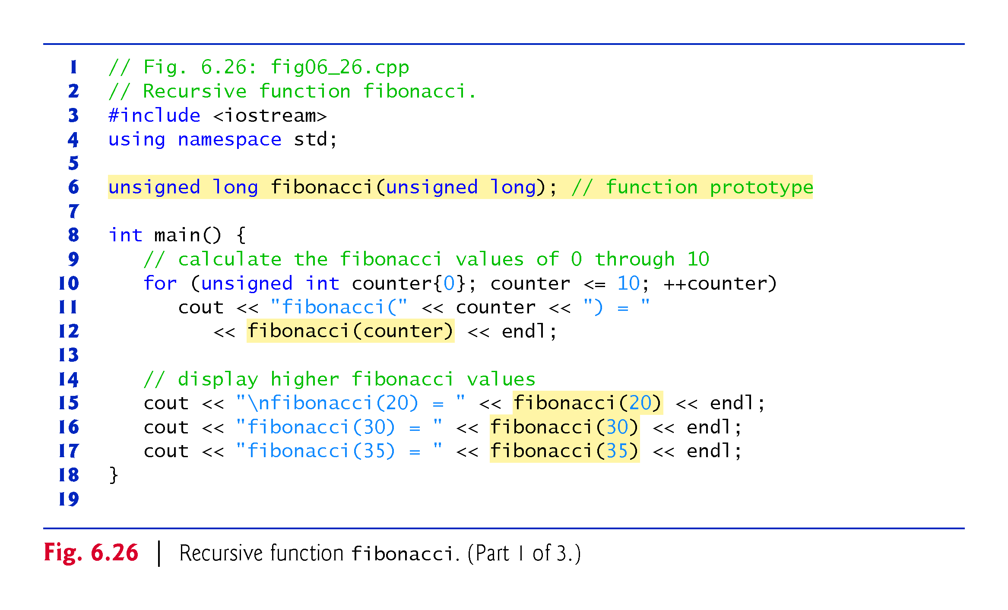
©1992-2017 by Pearson Education, Inc. All Rights Reserved.

Slide 177
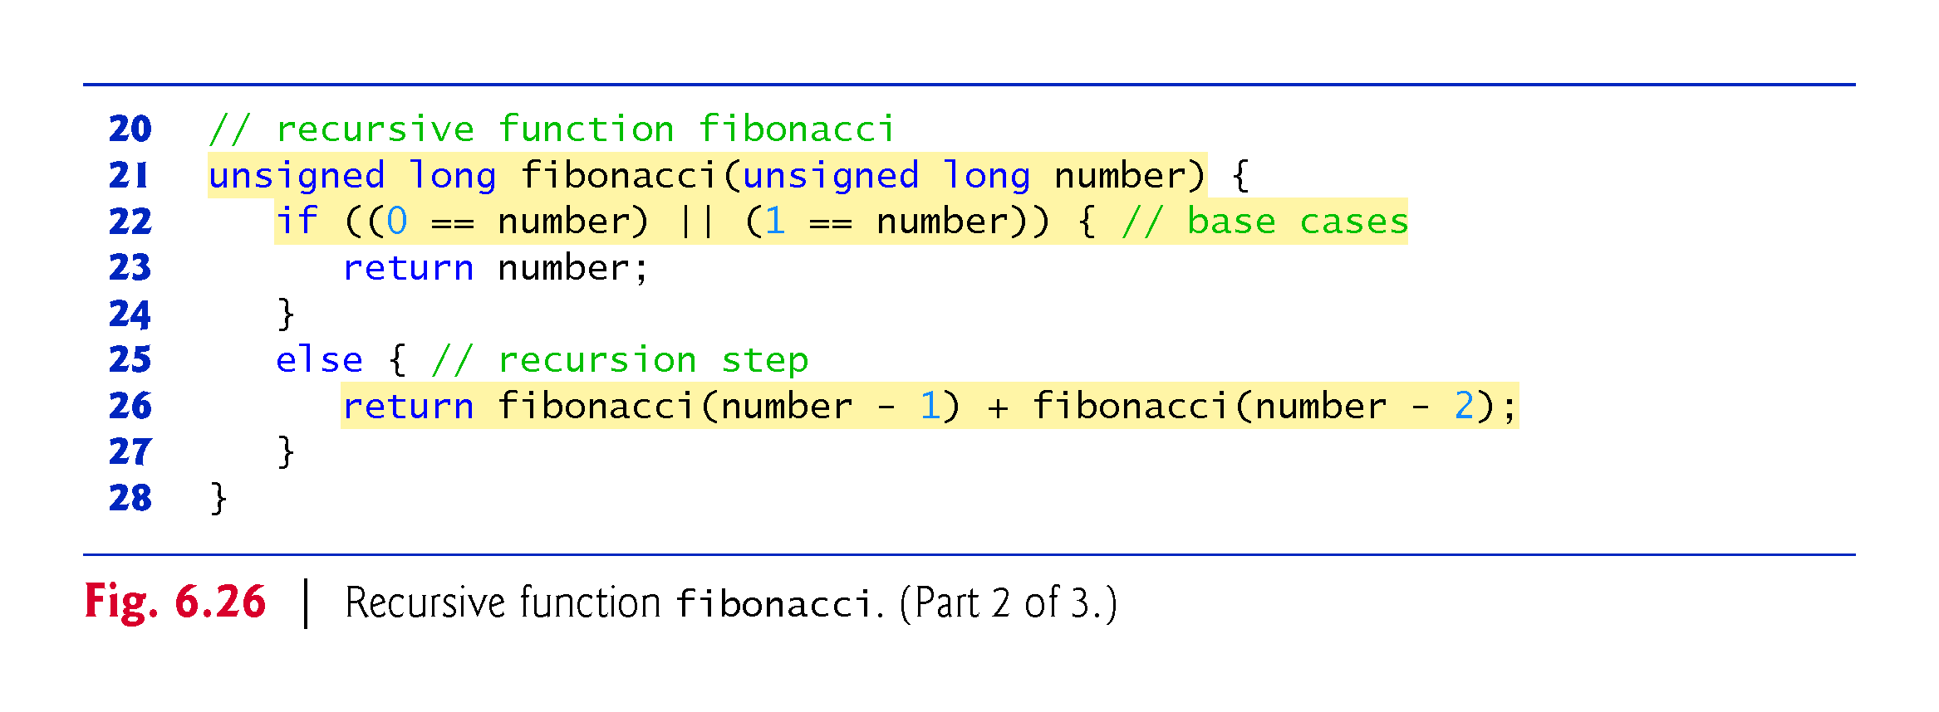
©1992-2017 by Pearson Education, Inc. All Rights Reserved.

Slide 178
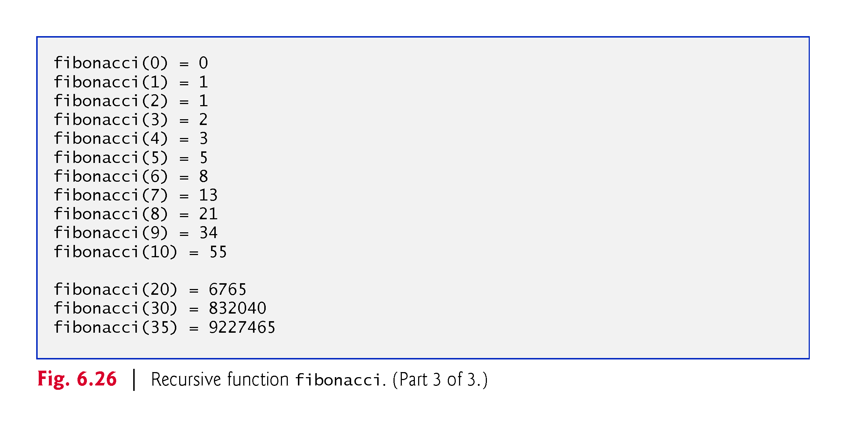
©1992-2017 by Pearson Education, Inc. All Rights Reserved.

Slide 179
6.19 Example Using Recursion: Fibonacci Series (cont.)
Figure 6.27 shows how function fibonacci would evaluate fibonacci(3).
Figure raises interesting issues about the order in which C++ compilers evaluate the operands of operators.
Separate issue from the order in which operators are applied to their operands, namely, the order dictated by the rules of operator precedence and associativity.
Most programmers assume that operands are evaluated left to right.
C++ does not specify the order in which the operands of most operators (including +) are to be evaluated.
Therefore, you must make no assumption about the order in which these calls execute.
©1992-2017 by Pearson Education, Inc. All Rights Reserved.

Slide 180
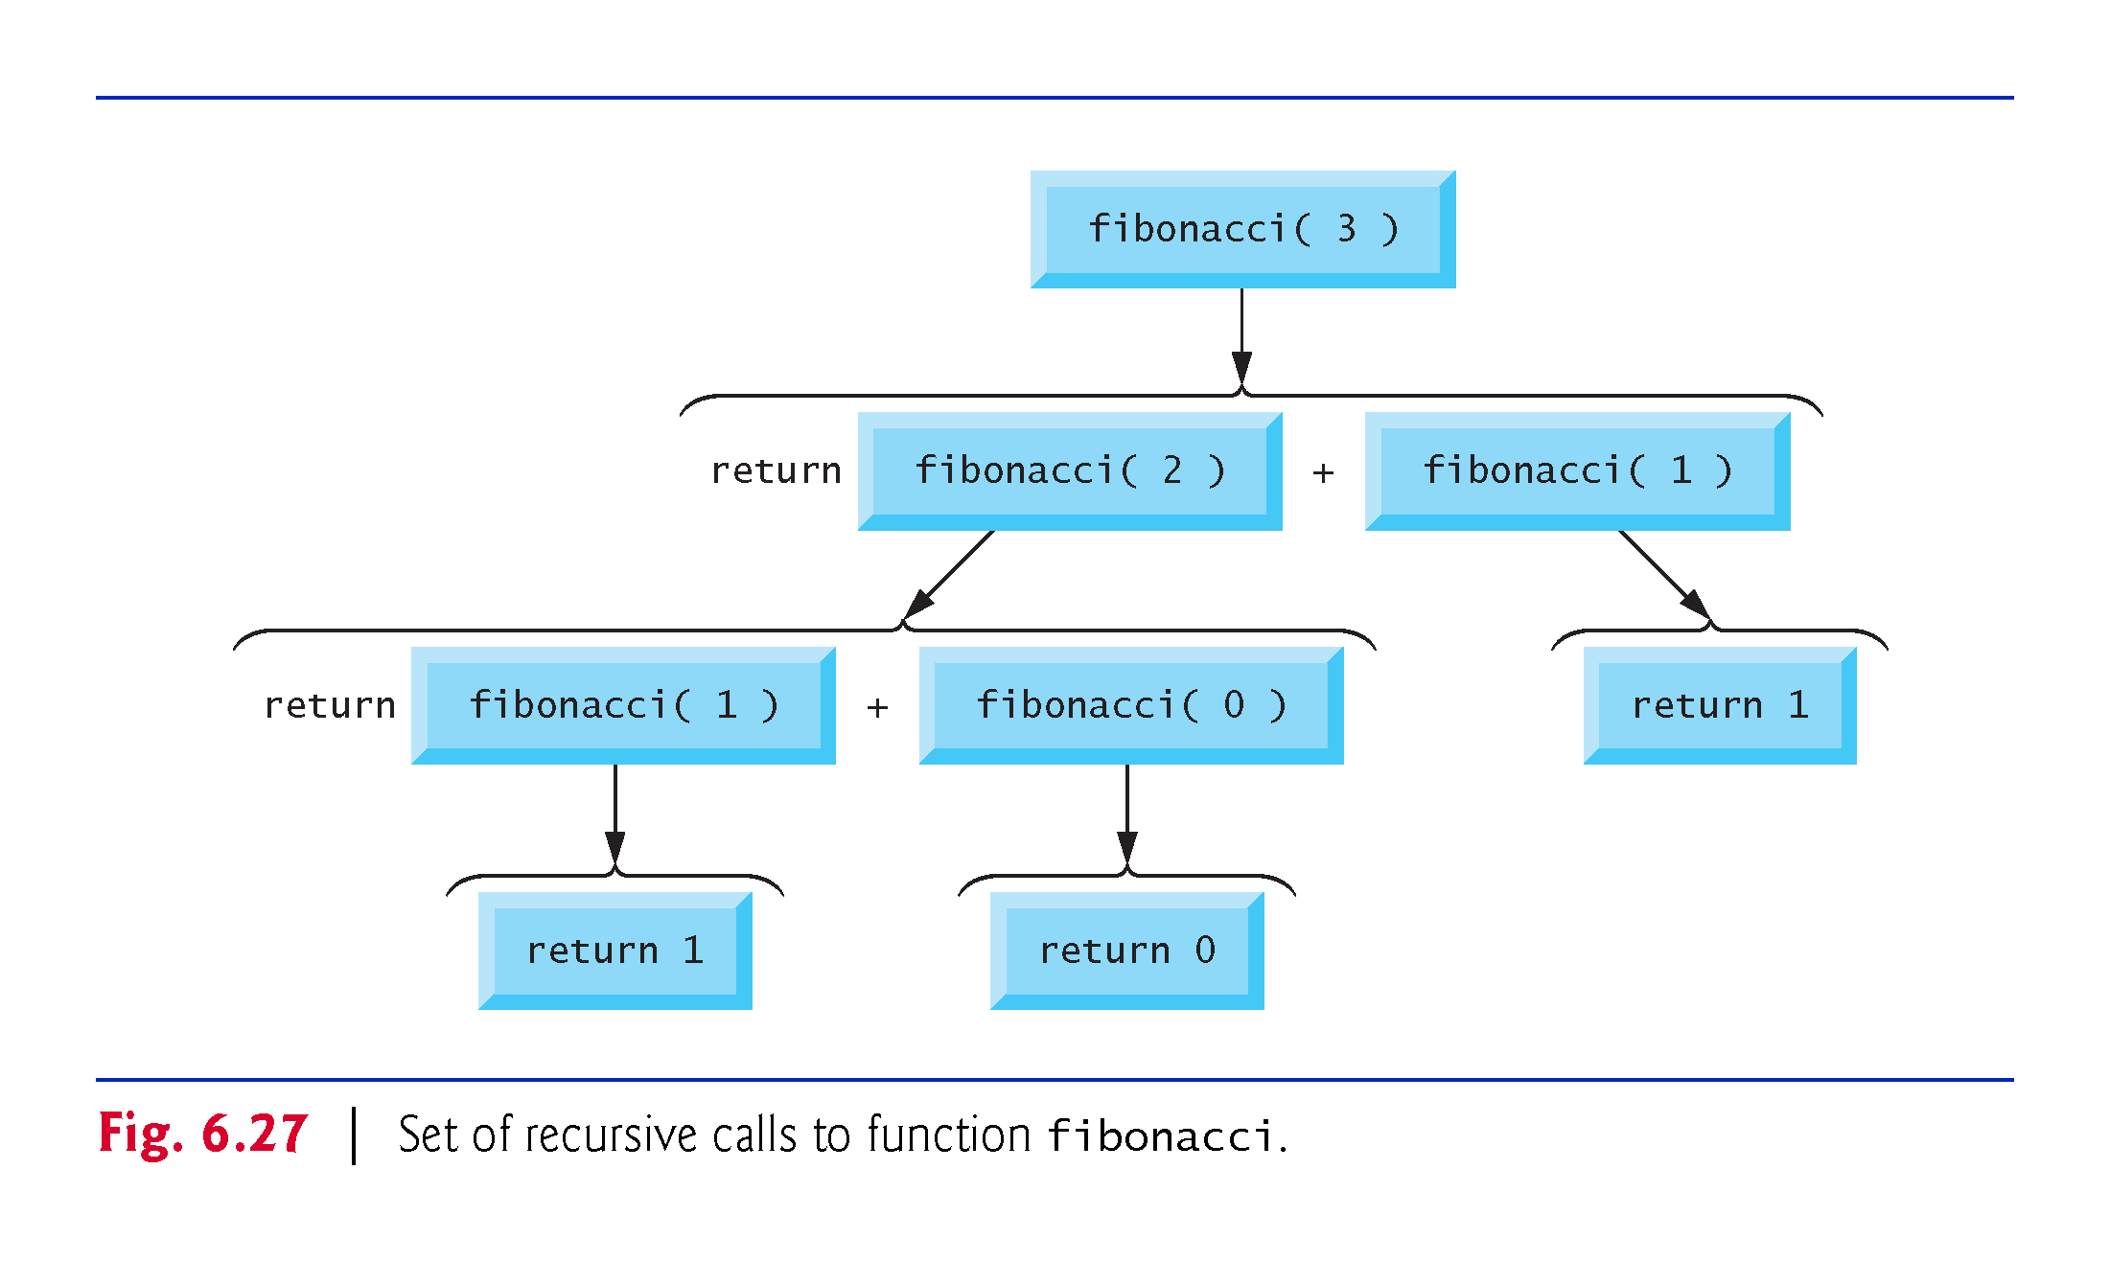
©1992-2017 by Pearson Education, Inc. All Rights Reserved.

Slide 181
©1992-2017 by Pearson Education, Inc. All Rights Reserved.

Slide 182
©1992-2017 by Pearson Education, Inc. All Rights Reserved.

Slide 183
©1992-2017 by Pearson Education, Inc. All Rights Reserved.

Slide 184
©1992-2017 by Pearson Education, Inc. All Rights Reserved.

Slide 185
©1992-2017 by Pearson Education, Inc. All Rights Reserved.

Slide 186
6.20 Recursion vs. Iteration
Both iteration and recursion are based on a control statement:
Iteration uses an iteration statement
Recursion uses a selection statement.
Both iteration and recursion involve iteration:
Iteration explicitly uses an iteration statement
Recursion achieves repetition through repeated function calls.
Iteration and recursion each involve a termination test:
Iteration terminates when the loop-continuation condition fails
Recursion terminates when a base case is recognized.
©1992-2017 by Pearson Education, Inc. All Rights Reserved.

Slide 187
6.22 Recursion vs. Iteration (cont.)
Counter-controlled iteration and recursion both gradually approach termination:
Iteration modifies a counter until the counter assumes a value that makes the loop-continuation condition fail
Recursion produces simpler versions of the original problem until the base case is reached.
Both iteration and recursion can occur infinitely:
An infinite loop occurs with iteration if the loop-continuation test never becomes false
Infinite recursion occurs if the recursion step does not reduce the problem during each recursive call in a manner that converges on the base case.
To illustrate the differences between iteration and recursion, Fig. 6.28 presents an iterative solution to the factorial problem.
©1992-2017 by Pearson Education, Inc. All Rights Reserved.

Slide 188
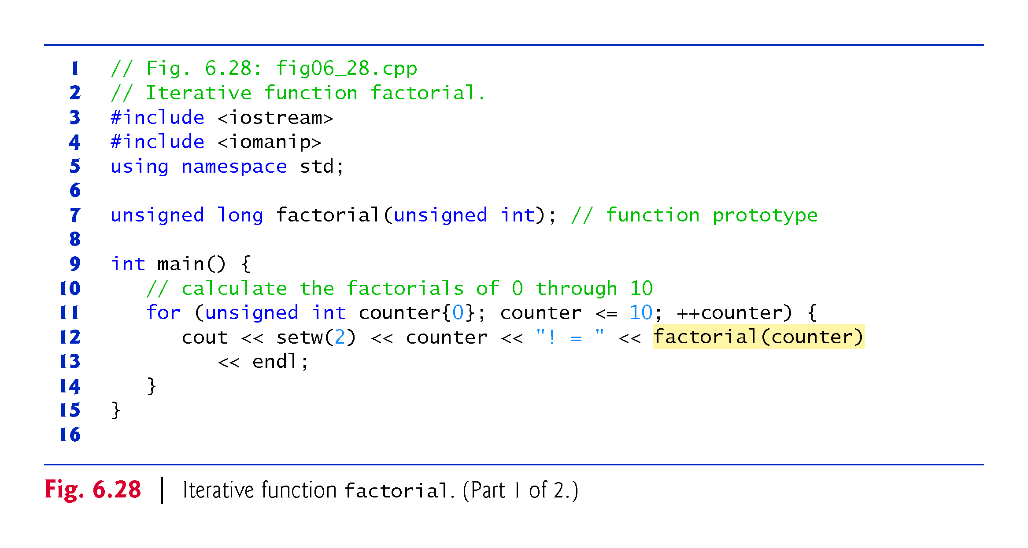
©1992-2017 by Pearson Education, Inc. All Rights Reserved.

Slide 189
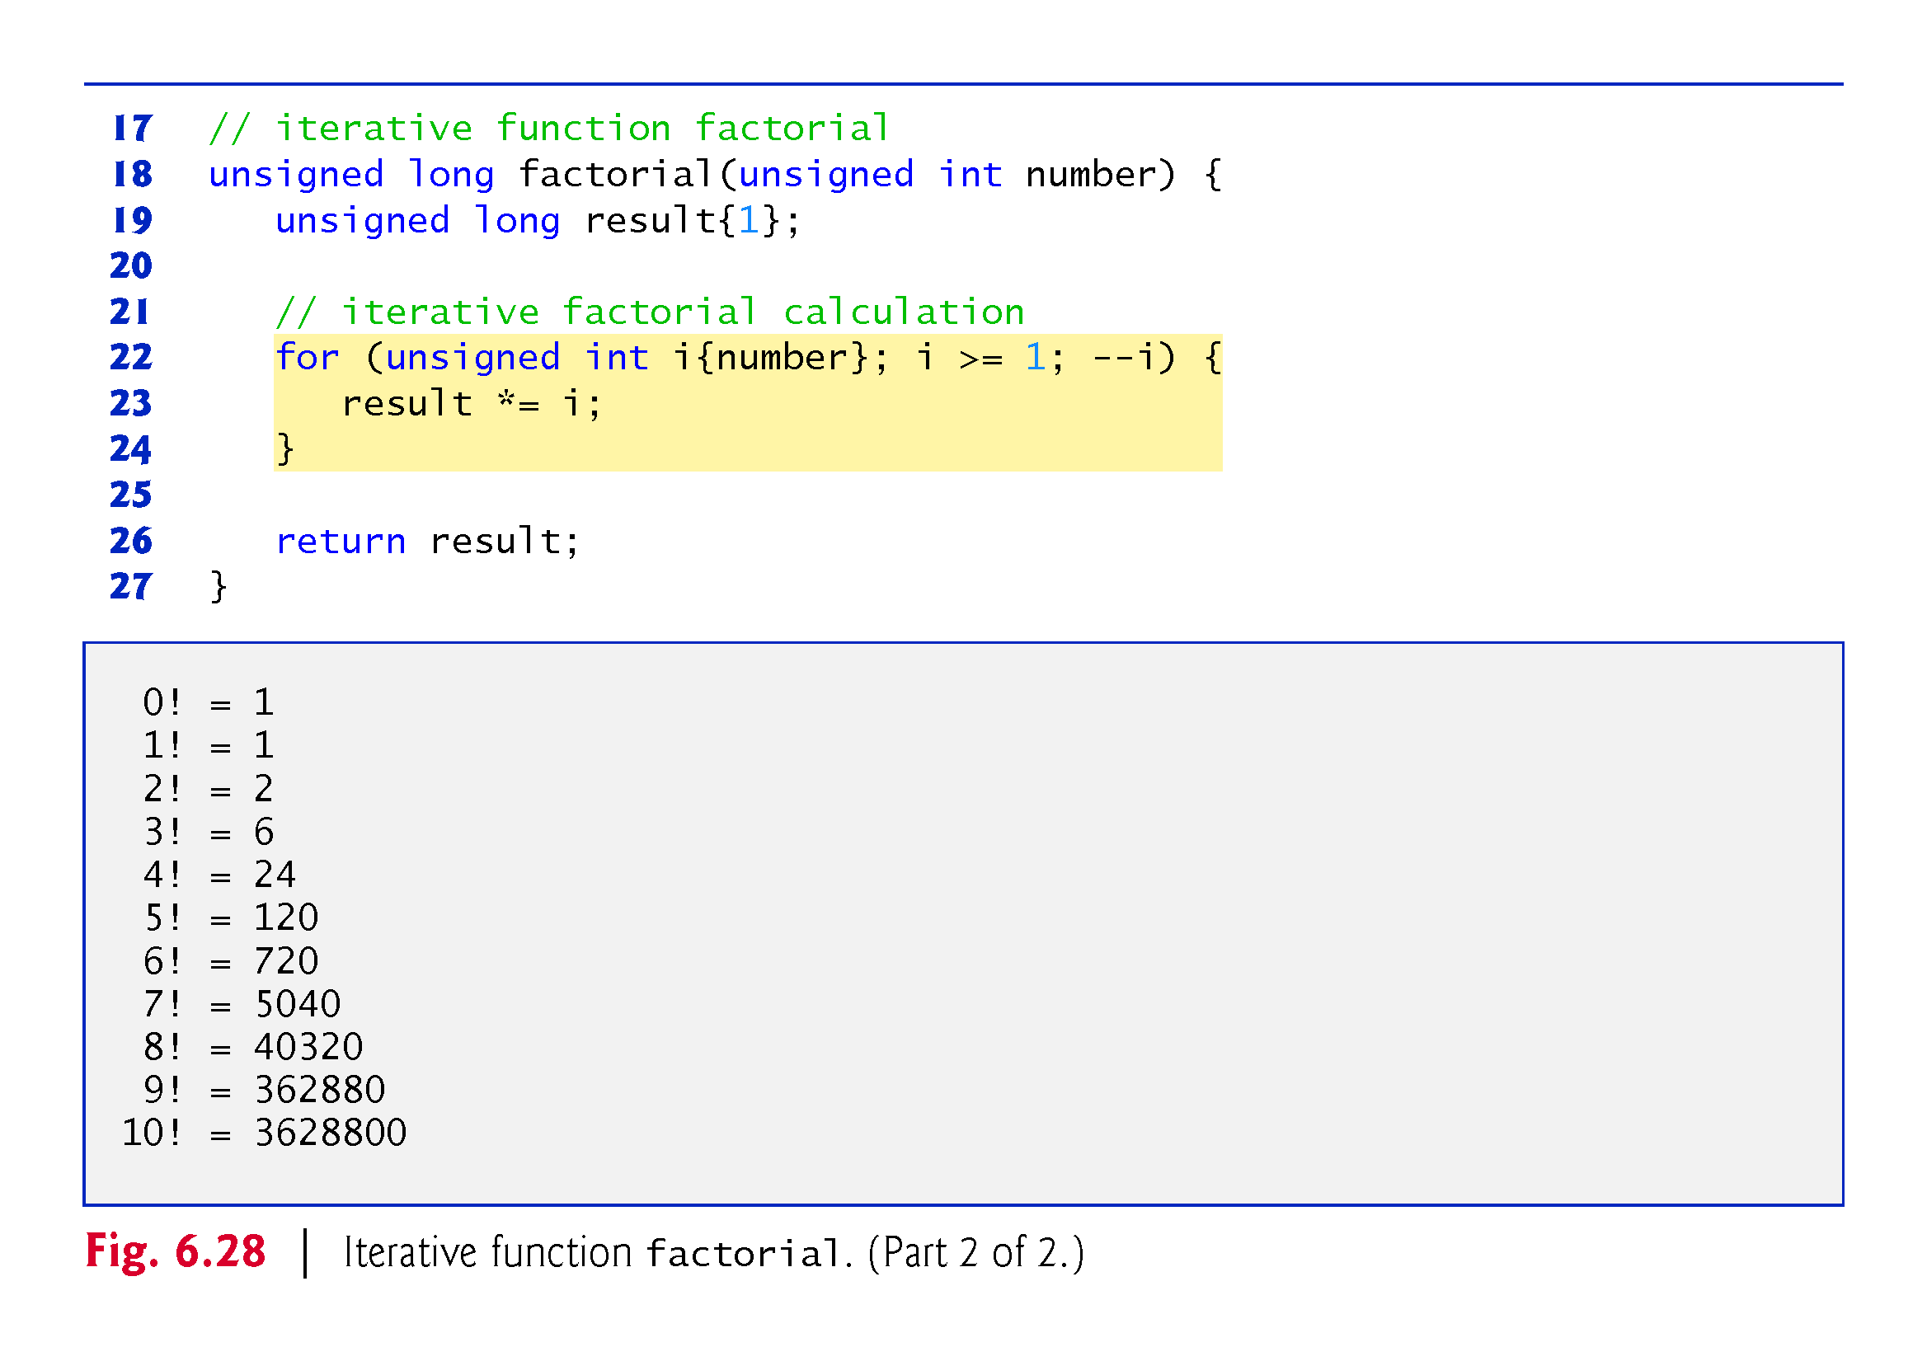
©1992-2017 by Pearson Education, Inc. All Rights Reserved.

Slide 190
©1992-2017 by Pearson Education, Inc. All Rights Reserved.

Slide 191
©1992-2017 by Pearson Education, Inc. All Rights Reserved.

Slide 192
©1992-2017 by Pearson Education, Inc. All Rights Reserved.

Slide 193
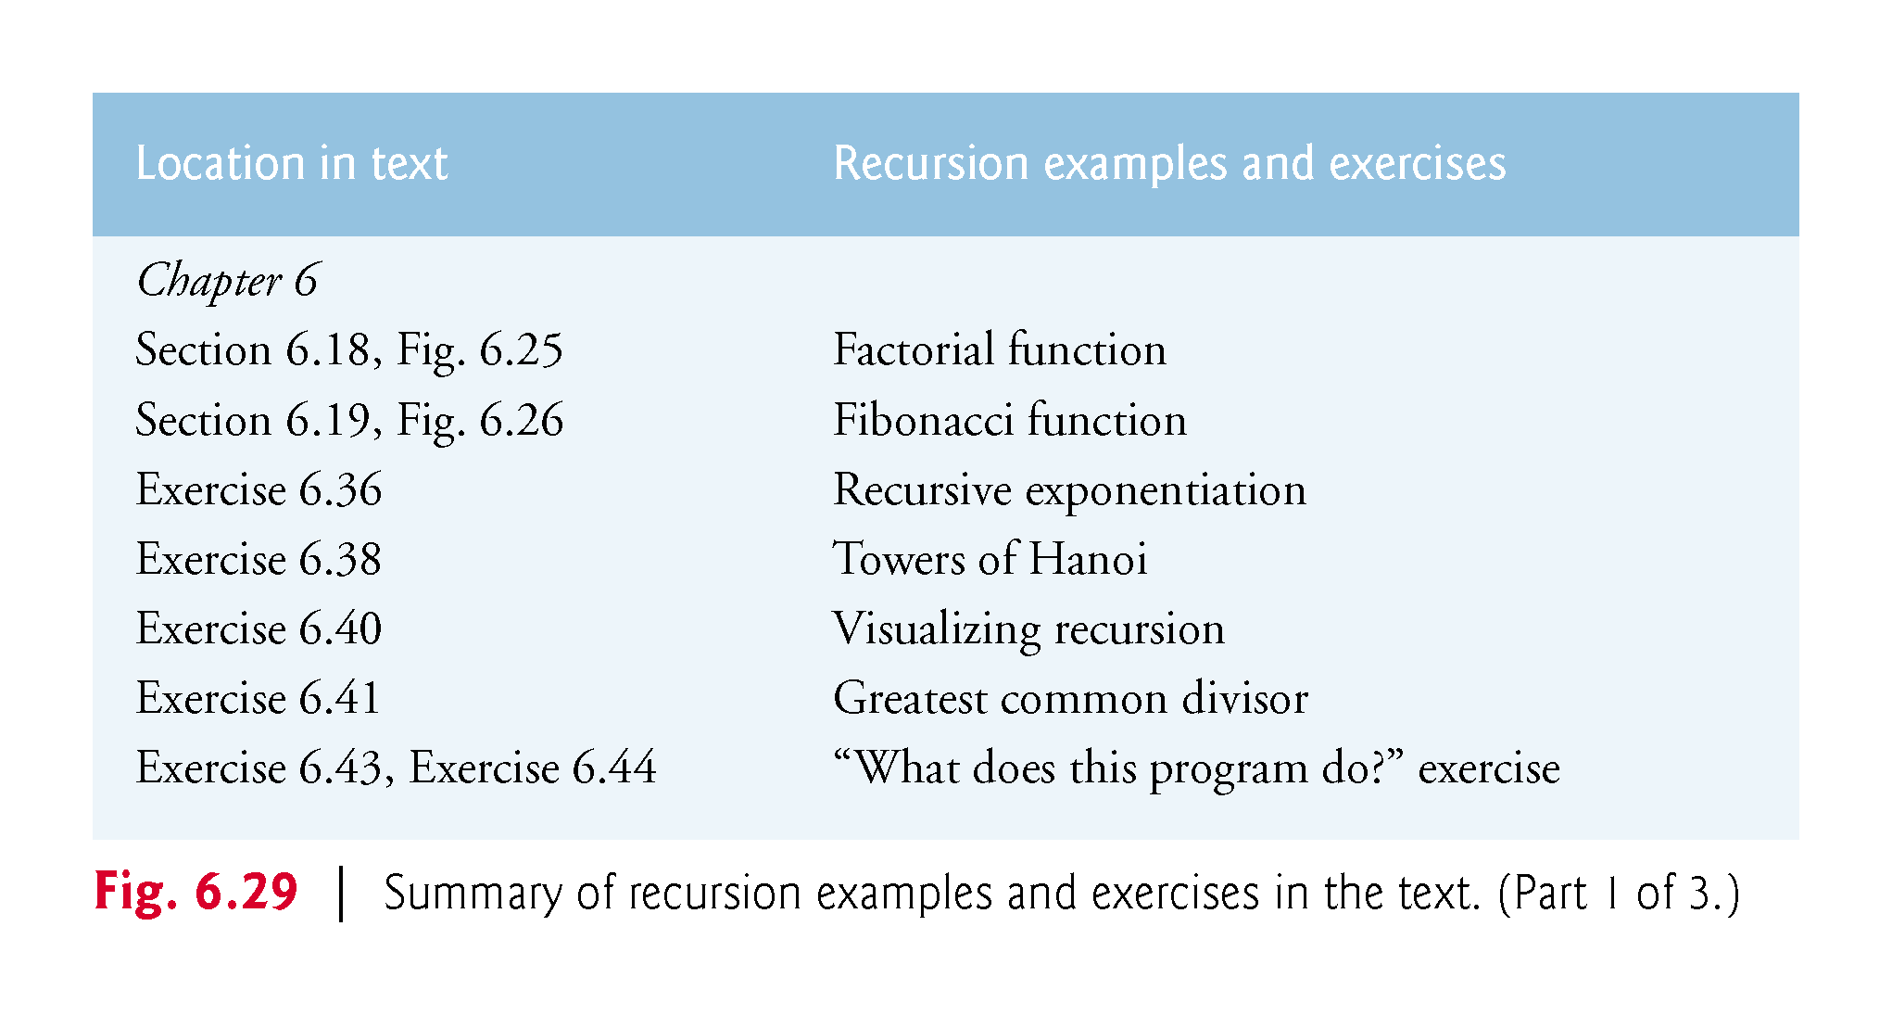
©1992-2017 by Pearson Education, Inc. All Rights Reserved.

Slide 194
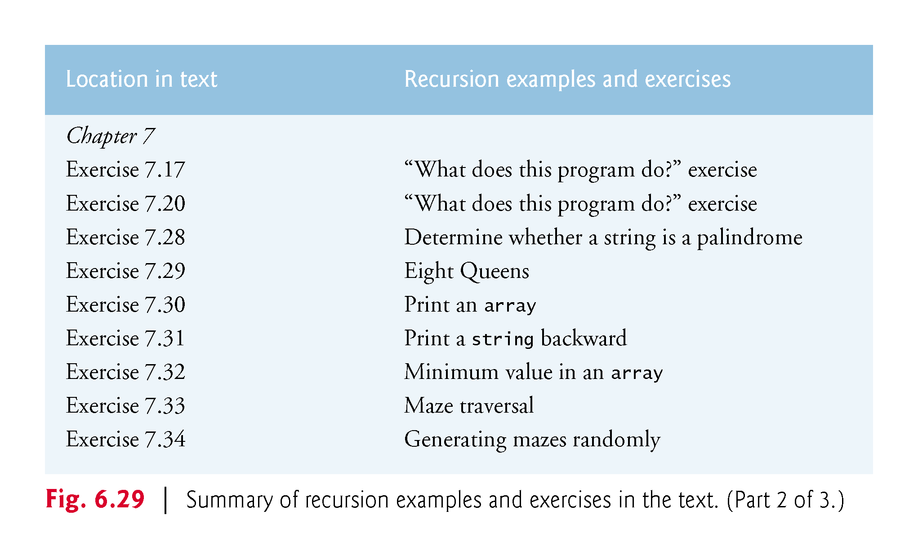
©1992-2017 by Pearson Education, Inc. All Rights Reserved.

Slide 195
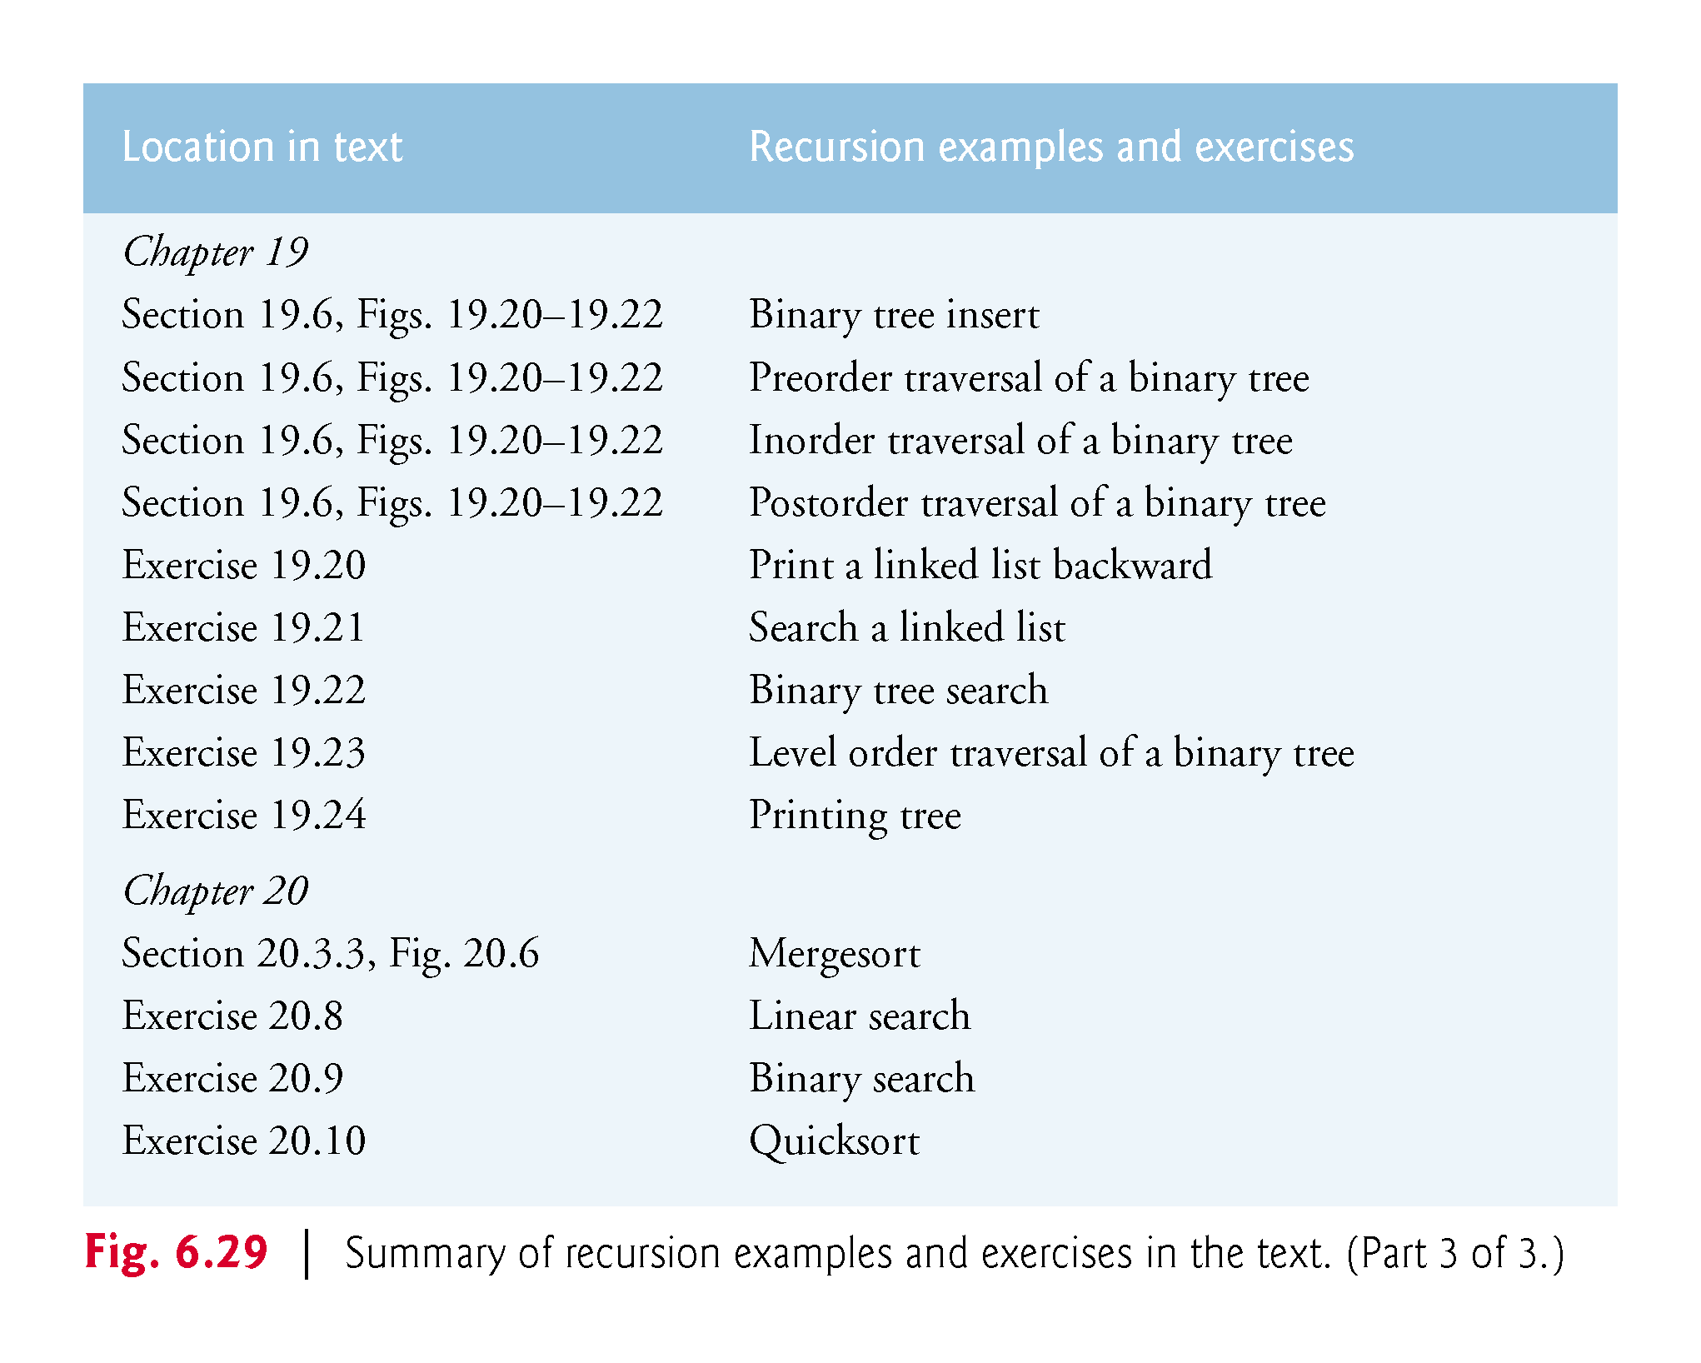
©1992-2017 by Pearson Education, Inc. All Rights Reserved.
Notes:
195

