Slide 1
Introduction to Classes, Objects, Member Functions and Strings
Chapter 3 of C++ How to Program, 10/e

Slide 2
3.1 Introduction and definitions
A class is a user-defined type or data structure (whereas for example int or double are system-defined types).
The elements of a class are called objects.
The parts used to define a class are called members.
Members can have various types. The main ones are:
Data members (also called attributes). These give the representation of an object in the class.
Function members (also called methods). These provide operations with objects of the class.

Slide 3
3.1 Definitions - Example
For example, a class “Time” that defines time of the day has 3 data members or attributes:
Hour
Minute
Second
It can have several function members or methods:
Set the Hour, Minute, Second (3 functions) of a Time object.
Get the Hour, Minute, Second (3 functions) of a Time object.
Print out the time in 24 hour format or in 12 hour format.
Add some amount of time to a given Time object.
Find time spent between two Time objects.
Etc… Many more can come to mind!

Slide 4
3.2 Interface and implementation
One normally thinks of classes as having an interface and an implementation.
The interface is the part of a class declaration that its users access directly.
The implementation is the part that the users access only indirectly via the interface.
The interface is identified with the keyword public:
This will include most or all of the member functions (such as the set and get functions, display time, etc).
The implementation with the keyword private:
This will include most or all of the member data (such as Hour, Minute, Second in the previous example).

Slide 5
3.3 C++ syntax – defining a class
class Time{
public: //public members. This is the interface, accessible to all.
void setHour(int ho)//Function member to set hour
{
}
int getHour()//Function member that returns hour stored in object
{
}
// (and similar functions to set and get minute and second)
void showTime24()//Function member to show the time
{
}
private://Here are the private members
int hour; //Data member.
int minute;//Data member.
int second;//Data member.
};

Slide 6
3.3 C++ syntax – using a class
int main()
{
Time now; //Declares now to be of class Time. Note that it is not initialized!
now.setHour(13);//Sets hour of now to 13
now.setMinute(14);//Sets minute of now to 13
now.setSecond(15);//Sets second of now to 13
now.showTime12();//shows time stored in now
}
Download and work on:
https://fsw01.bcc.cuny.edu/luis.fernandez01/web/teaching/classes/csi32/ch3/timeclass.cpp

Slide 7
3.4 Constructors
The process of declaring an object of class is called an instantiation. Sometimes the object is called an instance of its class. It only reserves memory for the object, but it does not fill the memory with values.
Giving values to the data members of an instantiated object is called initializing the object.
One could do this using the set functions, but it is not very efficient.
Instead, one can define a constructor that “constructs” the object, that is, gives the necessary values to initialize the data members of the object.

Slide 8
3.4 C++ - constructors syntax
The constructor is simply a member function that has the same name as the class.
In the timeclass program for example, we would want to define a member function Time that takes 3 arguments (ho, min, sec) and sets the member data hour, minute, second to the given values.
Syntax:
Time(int ho, int mi, int se)//constructor for Time object
:hour{ho},minute{mi},second{se}//Sets hour, minute, second
{
//Here we could write something else if we needed.
}
Go back to timeclass.cpp and give Time a constructor.

Slide 9
3.5 Checking for correct inputs
Once we have declared the set functions, it would be convenient to check that the entered values make sense. Otherwise we would get times like 34:76:123, which makes no sense.
These functions that check whether values are correct can be written as part of the set functions and the constructor, or preferably can be written as a “helper” function, only used by member functions.
Helper functions should be private (since they are only used internally by the member functions).

Slide 10
3.6 Other things to define a good class
There are many improvements and enhancements of the class Time we have defined. For example
Add some amount of time to a given time.
Find the difference between two Time instances (in hours, minutes, seconds).
Print it out in a nicer way (such as 01:05:14pm instead of 1:5:14pm).
Print an error message if the time entered is not valid.
For now the idea is to define many classes and then you can work on these other problems.

Slide 11
3.7 Example from the book
In chapter 3 the book defines the class account. Let us look at the code.

Slide 13
3.7.2 Keyword class and the Class Body (cont.)
Identifiers and Camel-Case Naming
Class names, member-function names and data-member names are all identifiers.
By convention, variable-name identifiers begin with a lowercase letter, and every word in the name after the first word begins with a capital letter—e.g., firstNumber starts its second word, Number, with a capital N.
This naming convention is known as camel case, because the uppercase letters stand out like a camel’s humps.
Also by convention, class names begin with an initial uppercase letter, and member-function and data-member names begin with an initial lowercase letter.

Slide 14
3.7.3 Data Member name of Type string
An object has attributes, implemented as data members—the object carries these with it throughout its lifetime.
Each object has its own copy of the class’s data members.
Normally, a class also contains one or more member functions that manipulate the data members belonging to particular objects of the class.

Slide 15
3.7.7 Account UML Class Diagram
UML class diagrams summarize a class’s attributes and operations.
In industry, UML diagrams help systems designers specify systems in a concise, graphical, programming-language-independent manner, before programmers implement the systems in specific programming languages.
Figure 3.3 presents a UML class diagram for class Account.

Slide 17
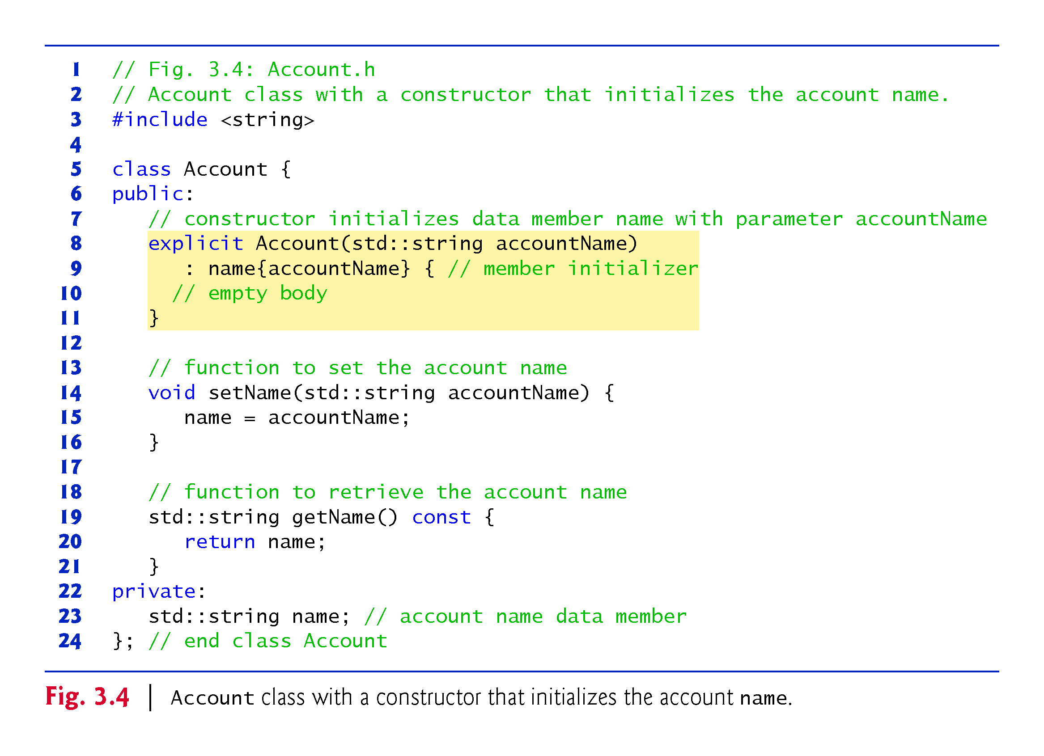

Slide 18
3.7.8 Account UML Class Diagram with a Constructor
The UML class diagram of Fig. 3.6 models class Account of Fig. 3.4, which has a constructor with a string accountName parameter.
Like operations, the UML models constructors in the third compartment of a class diagram.
To distinguish a constructor from the class’s operations, the UML requires that the word “constructor” be enclosed in guillemets (« and ») and placed before the constructor’s name.
It’s customary to list constructors before other operations in the third compartment.

Slide 19
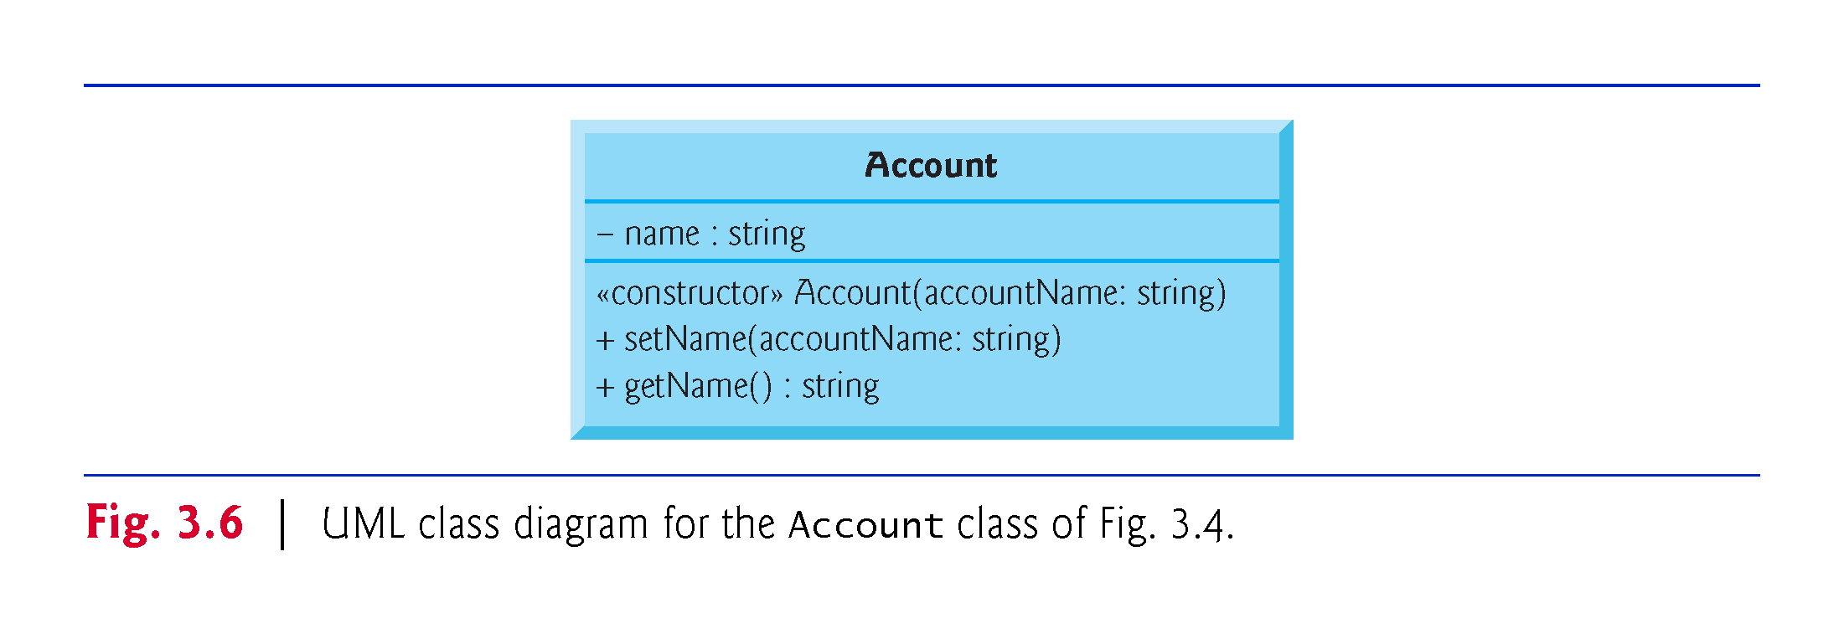

Slide 20
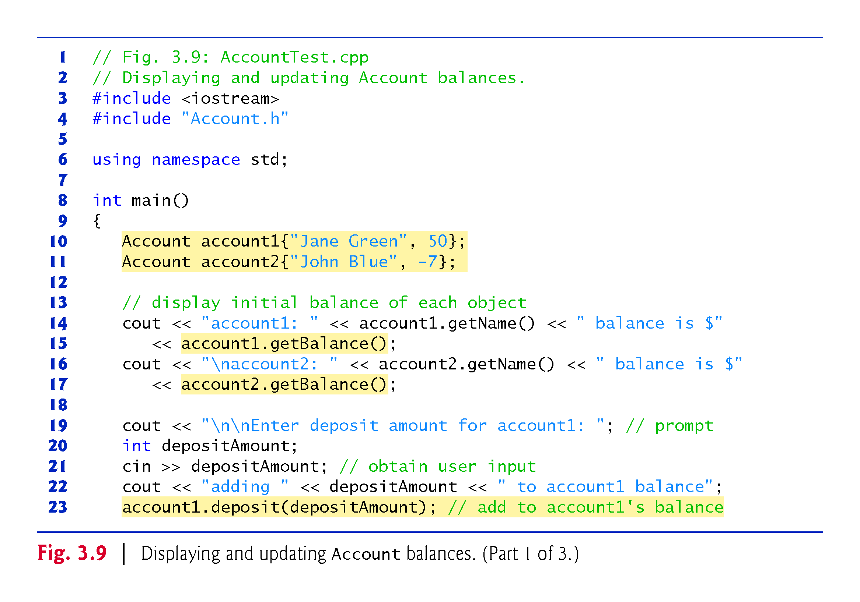

Slide 21
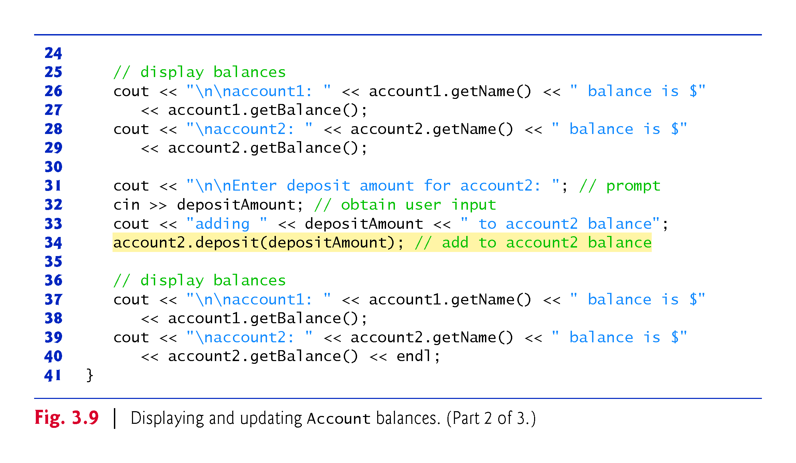

Slide 22
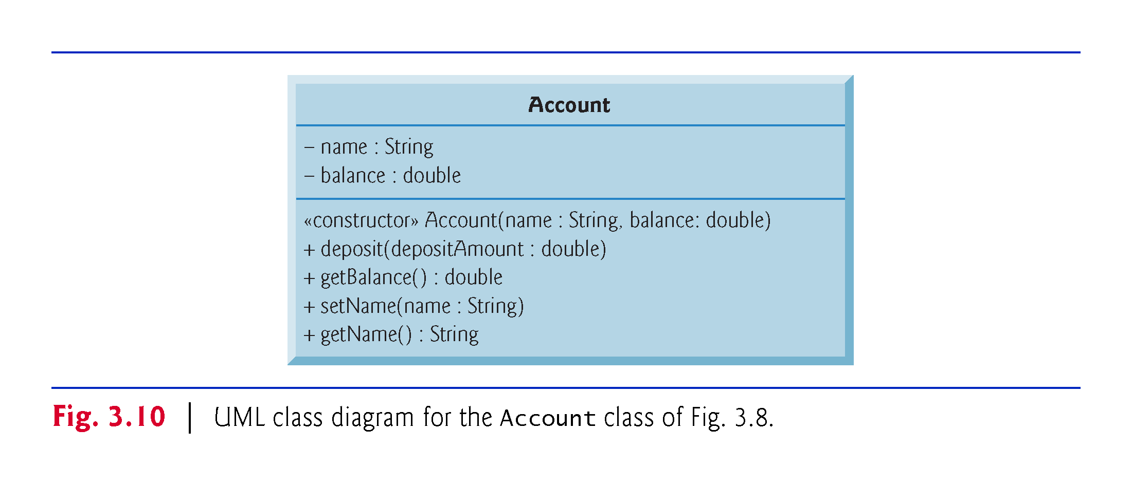

Slide 23
3.8 Separating class definitions from implementation
A class is really an object that can be used in many programs (same as we have used int in tons of programs, for example!).
This is why it is a good idea to write all the class definitions in one file (named with the extension .h) and then #include that file in the program that is using the class.
Further, it is even better to have two different files to define a class (note that classes can be huge!):
A file with the class header that has the data members and the prototypes of the class functions. Should have extension .h
A file that has the definitions of the class functions.
To be able to use this class in a program, you only need to have it in the same directory and use an #include “file.h” at the top.
Check files timeclass.h , timeclass.aux.h , timeclass.main.cpp

Slide 24
3.9 Exercises.
Do the following in a single file where the class is defined and tested with a main, as we did for the Time class. For each example, provide a constructor, a default constructor, and set and get functions. Also provide a function to display relevant information.
Define and test a class Date that has day, month, year (all in numbers for now). The display function should write the date as say 3/4/2019.
Define and test a class Student with member data: name, ID, grade. The display function should write: ID (space) Name (space) grade.
Define and test a class Fraction with member data: numerator, denominator. Your display function should write say 5/6.
Define and test a class Complex with member data: realPart, imPart. The display function should write say 5 + 6 i.
Do and upload Exercises 3.11 and 3.12 from the book.

Slide 25
Tortoise and Hare
Simulation: (The Tortoise and the Hare) In this exercise, you will re-create the classic race of the tortoise and the hare. You will use random number generation to develop a simulation of this memorable event.
Our contenders begin the race at "square 1" of 70 squares. Each square represents a possible position along the race course. The finish line is at square 70. The first contender to reach or pass square 70 wins. The course weaves its way up the side of a slippery mountain, so occasionally the contenders lose ground.
There is a clock that ticks once per second. With each tick of the clock, your program should adjust the position of the animals according to the rules in the following figure.
Use variables to keep track of the positions of the animals (i.e., position numbers are 1 - 70). Start each animal at position 1 (i.e., the "starting gate"). If an animal slips left before square 1, move the animal back to square 1.
Generate the percentages in the preceding table by producing a random integer i in the range 0 <= i < 10. For the tortoise, perform a "fast plod" when 0 <= i < 5, a "slip" when 5 <= i < 6 or a "slow plod" when 7 <= i < 9. Use a similar technique to move the hare.
Begin the race by printing BANG !!!!! AND THEY'RE OFF !!!!!
For each tick of the clock (i.e., each repetition of a loop), print a 70-position line showing the letter T in the tortoise's position and the letter H in the hare's position. Occasionally, the contenders land on the same square. In this case, the tortoise bites the hare and your program should print OUCH!!! beginning at that position. All print positions other than the T, the H or the OUCH!!! (in case of a tie) should be blank.
Animal | Move type | Percentage of the time | Actual move
Tortoise | Fast plod Slip Slow plod | 50% 20% 30% | 3 squares to the right 6 squares to the left 1 square to the right
Hare | Sleep Big hop Big slip Small hop Small slip | 20% 20% 10% 30% 20% | No move at all 9 squares to the right 12 squares to the left 1 square to the right 2 squares to the left

Slide 26
Begin the race by printing
BANG !!!!!
AND THEY'RE OFF !!!!!
For each tick of the clock (i.e., each repetition of a loop), print a 70-position line showing the letter T in the tortoise's position and the letter H in the hare's position. Occasionally, the contenders land on the same square. In this case, the tortoise bites the hare and your program should print OUCH!!! beginning at that position. All print positions other than the T, the H or the OUCH!!! (in case of a tie) should be blank.
After printing each line, test if either animal has reached or passed square 70. If so, print the winner and terminate the simulation. If the tortoise wins, print TORTOISE WINS!!! YAY!!! If the hare wins, print Hare wins. Yuch. If both animals win on the same clock tick, you may want to favor the tortoise (the "underdog"), or you may want to print It's a tie. If neither animal wins, perform the loop again to simulate the next tick of the clock.

