Slide 1
Object-Oriented Programming: Inheritance
Based on Chapter 11 of C++ How to Program, 10/e

Slide 2
11.1 Introduction
Inheritance
A form of software reuse in which you create a class that absorbs an existing class’s data and behaviors and enhances them with new capabilities.
You can designate that a new class should inherit the members of an existing class.
This existing class is called the base class, and the new class is referred to as the derived class.
A derived class represents a more specialized group of objects.
C++ offers public, protected and private inheritance.
With public inheritance, every object of a derived class is also an object of that derived class’s base class.
However, base-class objects are not objects of their derived classes.

Slide 3
11.1 Introduction (cont.)
With object-oriented programming, you focus on the commonalities among objects in the system rather than on the special cases.
We distinguish between the is-a relationship and the has-a relationship.
The is-a relationship represents inheritance.
In an is-a relationship, an object of a derived class also can be treated as an object of its base class.
By contrast, the has-a relationship represents composition.

Slide 4
11.2 Base Classes and Derived Classes
Figure 11.1 lists several simple examples of base classes and derived classes.
Base classes tend to be more general and derived classes tend to be more specific.
Because every derived-class object is an object of its base class, and one base class can have many derived classes, the set of objects represented by a base class typically is larger than the set of objects represented by any of its derived classes.
Inheritance relationships form class hierarchies.

Slide 5
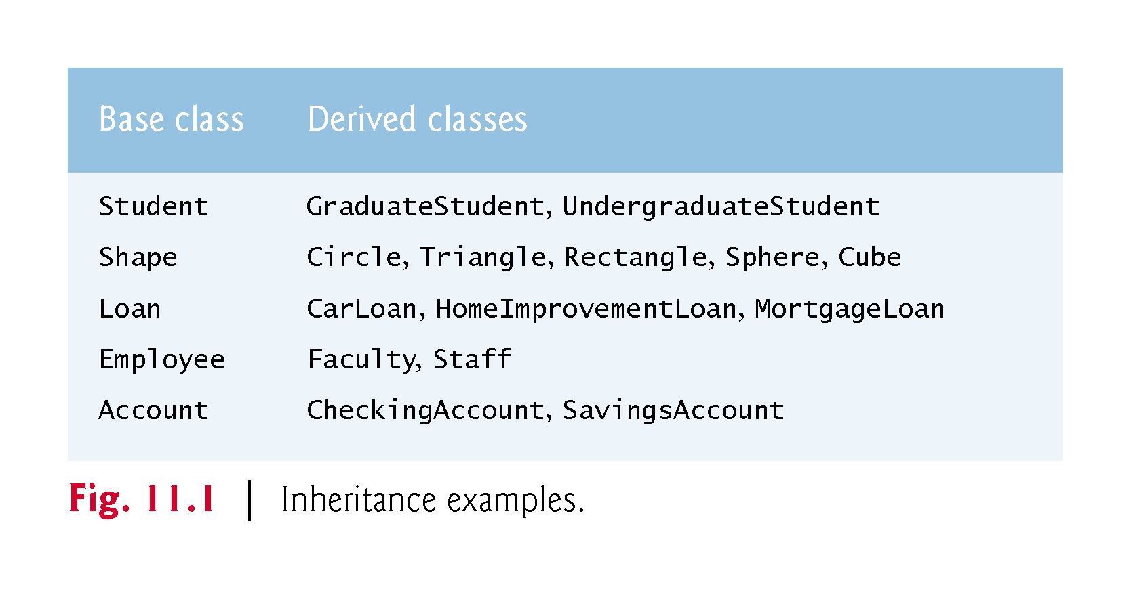

Slide 6
11.2.1 CommunityMember Class Hierarchy
Let’s develop a simple inheritance hierarchy with five levels (represented by the UML class diagram in Fig. 11.2).
A university community has thousands of CommunityMembers.
Employees are either Faculty or Staff.
Faculty are either Administrators or Teachers.
Some Administrators, however, are also Teachers.
We’ve used multiple inheritance to form class AdministratorTeacher.

Slide 7
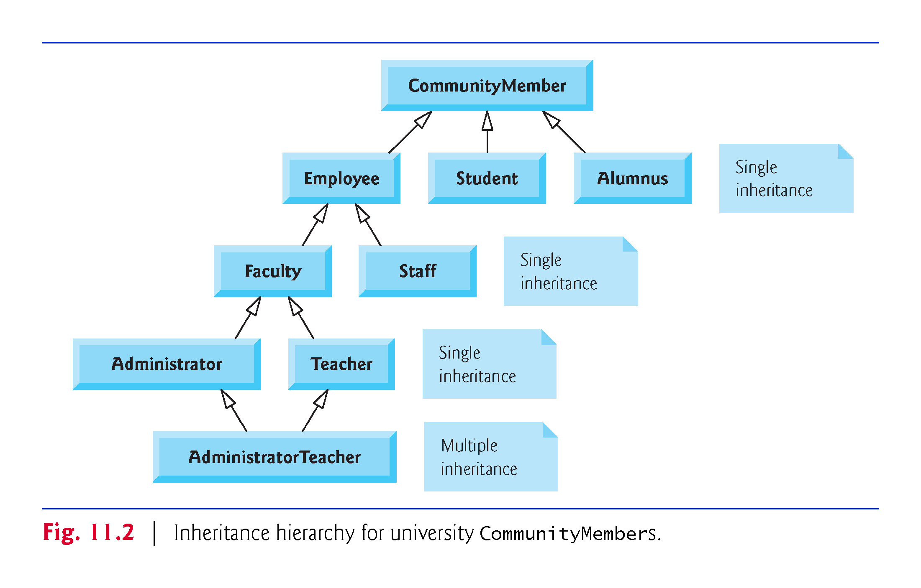

Slide 8
11.2.1 CommunityMember Class Hierarchy
With single inheritance, a class is derived from one base class.
With multiple inheritance, a derived class inherits simultaneously from two or more (possibly unrelated) base classes.

Slide 9
11.2.1 CommunityMember Class Hierarchy
Each arrow in the hierarchy (Fig. 11.2) represents an is-a relationship.
As we follow the arrows in this class hierarchy, we can state “an Employee is a CommunityMember” and “a Teacher is a Faculty member.”
CommunityMember is the direct base class of Employee, Student and Alumnus.
CommunityMember is an indirect base class of all the other classes in the diagram.
Starting from the bottom of the diagram, you can follow the arrows and apply the is-a relationship to the topmost base class.
An AdministratorTeacher is an Administrator, is a Faculty member, is an Employee and is a CommunityMember.

Slide 10
11.2.2 Shape Class Hierarchy
Consider the Shape inheritance hierarchy in Fig. 11.3.
Begins with base class Shape.
Classes TwoDimensionalShape and ThreeDimensionalShape derive from base class Shape—Shapes are either TwoDimensionalShapes or Three-DimensionalShapes.
The third level of this hierarchy contains some more specific types of TwoDimensionalShapes and ThreeDimensionalShapes.
As in Fig. 11.2, we can follow the arrows from the bottom of the diagram to the topmost base class in this class hierarchy to identify several is-a relationships.

Slide 11
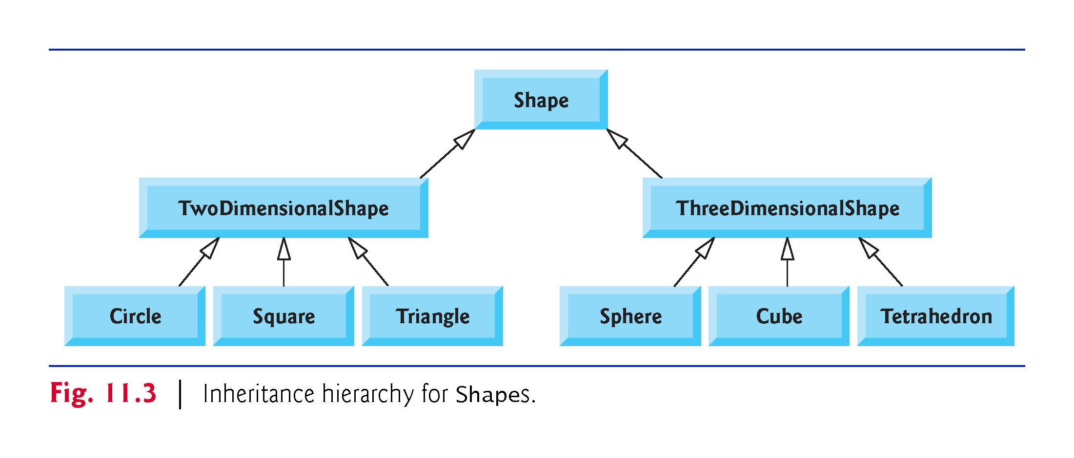

Slide 12
11.3 Example: BCCCommunity Class
We are going to program the following:
Download BCCstaff.cpp where the BCC Community and Teacher are defined. Check the code and define class Student as subclass of BCCComm and Tutor as subclass of Teacher and Student.
BCC Community Member
Teacher
Student
Tutor

Slide 13
11.3.1 Example: BCCCommunity class
The Student class should have data members name, emplid (inherited from BCCCommunity), and string classtaking (the class the student is currently taking). It should have the usual set and get functions and overload of operators << and >> for input and output.
The Student class should have data members name, emplid (inherited from both Teacher and Student), classtaking (inherited from Student) and classteaching (inherited from Teacher). It should have the usual set and get functions and overload of operators << and >> for input and output.

Slide 14
11.3.1 Example: Package inheritance hierarchy
This is a simplified version of exercise 12.9 from the book. Let us do it together.
Package Inheritance Hierarchy) Package-delivery services, such as FedEx®, DHL® and UPS®, offer a number of different shipping options, each with specific costs associated. Create an inheritance hierarchy to represent various types of packages. Use Package as the base class of the hierarchy, then include classes TwoDayPackage and OvernightPackage that derive from Package. Base class Package should include data members representing the name, address, city, state and ZIP code for both the sender and the recipient of the package the barcode of the package, in addition to data members that store the weight (in ounces) and cost per ounce to ship the package. Package's constructor should initialize these data members. Ensure that the weight and cost per ounce contain positive values. Package should provide a public member function calculateCost that returns a double indicating the cost associated with shipping the package. Package's calculateCost function should determine the cost by multiplying the weight by the cost per ounce. Derived class TwoDayPackage should inherit the functionality of base class Package, but also include a data member that represents a flat fee that the shipping company charges for two-day-delivery service. TwoDayPackage's constructor should receive a value to initialize this data member. TwoDayPackage should redefine member function calculateCost so that it computes the shipping cost by adding the flat fee to the weight-based cost calculated by base class Package's calculateCost function. Class OvernightPackage should inherit directly from class Package and contain an additional data member representing an additional fee per ounce charged for overnight-delivery service. OvernightPackage should redefine member function calculateCost so that it adds the additional fee per ounce to the standard cost per ounce before calculating the shipping cost. Write a test program that creates objects of each type of Package and tests member function calculateCost.

Slide 15
11.4 Constructors and Destructors in Derived Classes
Instantiating a derived-class object begins a chain of constructor calls in which the derived-class constructor, before performing its own tasks, invokes its direct base class’s constructor either explicitly (via a base-class member initializer) or implicitly (calling the base class’s default constructor).
If the base class is derived from another class, the base-class constructor is required to invoke the constructor of the next class up in the hierarchy, and so on.
The last constructor called in this chain is the constructor of the class at the base of the hierarchy, whose body actually finishes executing first.
The most derived-class constructor’s body finishes executing last.
Each base-class constructor initializes the base-class data members that the derived-class object inherits.

Slide 17
11.4 Constructors and Destructors in Derived Classes (cont.)
When a derived-class object is destroyed, the program calls that object’s destructor.
This begins a chain (or cascade) of destructor calls in which the derived-class destructor and the destructors of the direct and indirect base classes and the classes’ members execute in reverse of the order in which the constructors executed.
When a derived-class object’s destructor is called, the destructor performs its task, then invokes the destructor of the next base class up the hierarchy.
This process repeats until the destructor of the final base class at the top of the hierarchy is called.
Then the object is removed from memory.

Slide 19
11.4 Constructors and Destructors in Derived Classes (cont.)
Base-class constructors, destructors and overloaded assignment operators (Chapter 10) are not inherited by derived classes.
Derived-class constructors, destructors and overloaded assignment operators, however, can call base-class versions.

Slide 20
11.5 public, protected and private Inheritance
When deriving a class from a base class, the base class may be inherited through public, protected or private inheritance.
Use of protected and private inheritance is rare.
Figure 11.16 summarizes for each type of inheritance the accessibility of base-class members in a derived class.
The first column contains the base-class access specifiers.
A base class’s private members are never accessible directly from a derived class, but can be accessed through calls to the public and protected members of the base class.

Slide 21
